Slide 1
Product and Branding Strategy

Slide 2
The different levels of a product

Slide 3
The different levels of a product
Core benefit level: is the core customer value and the core customer need that is being provided/fulfilled by a product or service.
Basic product level: are the basic different attributes of a product which delivers the core benefit to the customers.
Expected product level: are the different attributes and performance marks a consumer expects from a product or service.
Augmented product level: are the additional customer services and benefits that a company provides to its customers.
Potential product level: are all the possible augmentations and transformations the product or offering might undergo in the future.
Discussion: do you think expected product level increases as competition increases?
Notes:
Lets discuss the different levels of a product with the example of hotel service.
Core benefit: accomodation.
Basic level: bed, bathroom, towels, desk, closet.
Expected level: clean bed sheets, clean washroom, AC.
Augmented level: breakfast.
Potential level: pool, gym, better customer service, laundry services.

Slide 4
Different ways to break down a market
A potential market is the set of consumers with a sufficient level of interest in a market offer. However, their interest is not enough to define a market unless they have sufficient income or access to the product.
The available market is the set of consumers who have an interest, income, and access to the product.
The target market is the set of consumers amongst the available market that a company wants to serve.
The penetrated market (from a company’s perspective) is the set of consumers who are buying the company’s products or services.
The penetrated market (from the category perspective) is the set of consumers who are using the company’s and its competitor’s products. In other words, it is also the available market.
The non-penetrated market from the category perspective is the potential market.
The non-penetrated market from the company’s perspective are the set of consumers from the available market who are not buying the company’s products.
Notes:
Interest signifies the fact that the product addresses their needs.
If there are a total of 100 consumers in a market. 30 consumers are buying your product, 40 are buying the competitors product and the other 30 are not buying the product. Then they fall under which market?

Slide 5
Significance of Brands
Brands are the most valuable intangible assets of the company and a good strategist knows how to build and manage powerful brands.

Slide 6
Significance of Brands
Significance of brand equity to understand the fundamental reason why brands are the most valuable assets of a company by embracing the master brand strategy
Notes:
Hence, a strong brand with a strong brand equity can make a company have a cometitive advantage and generate greater revenues and profits.

Slide 7
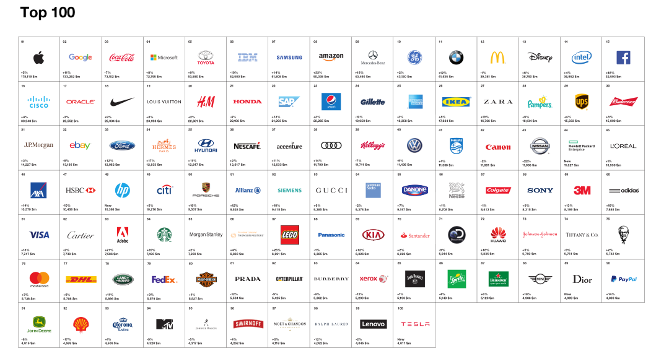
Interbrand Releases 2016 Best Global Brands Report

Slide 8
Significance of Brands
To qualify as cool, a brand must meet the following six criteria:
It must be thought as stylish
It must be perceived as innovative
It must be seen as original
It must be felt as authentic
It must be desirable
It must be considered as unique

Slide 9
Creating Brand Identity by utilizing brand elements
Packaging
Brand
names
URLs
Logos
Brand
Elements
Slogans
Characters
Symbols
Jingles

Slide 12
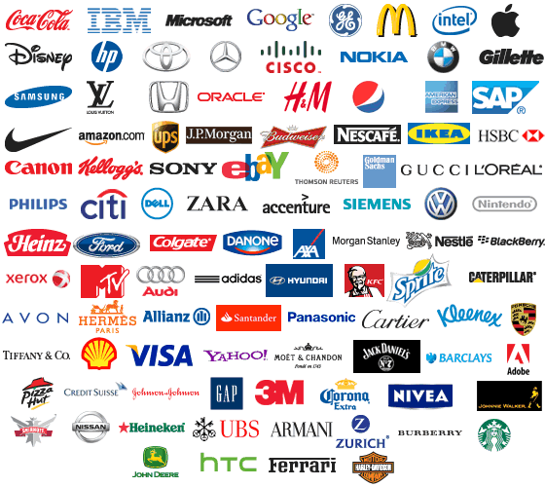
Notes:
Logos

Slide 13
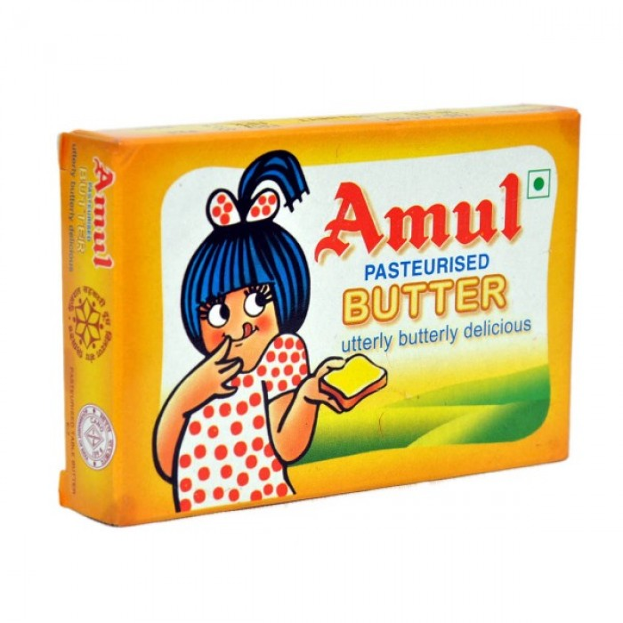

Slide 14
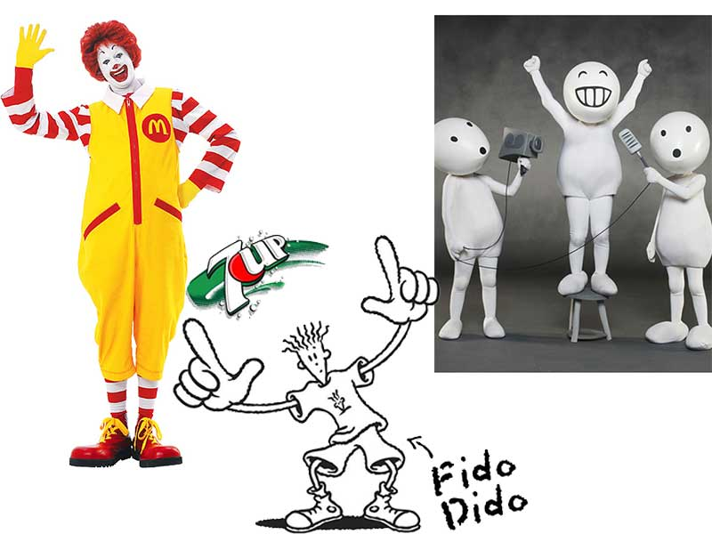

Slide 15
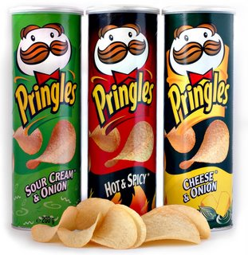

Slide 16
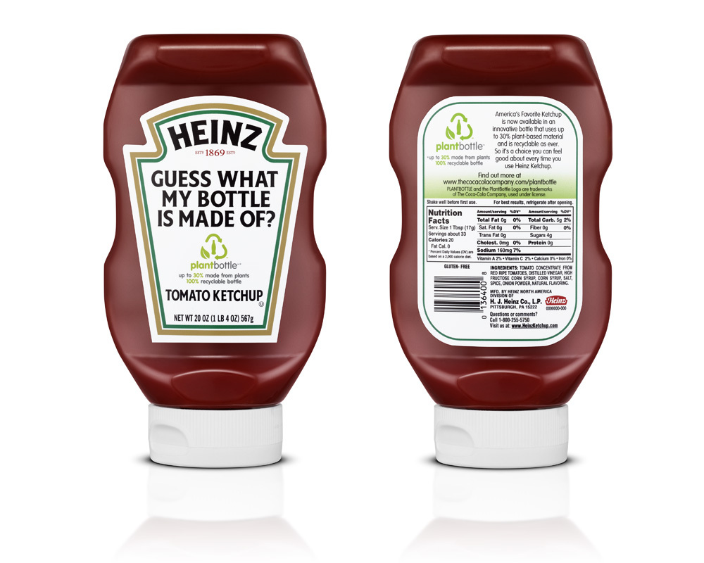

Slide 17
Slogans
All in or nothing
Be 100% sure
Think different
Broadcast yourself
Life’s Good
Eat Fresh
The best a man can get
Das Auto

Slide 18
Brand equity assets
Aaker (1991) described brand equity as the set of assets connected to the name and symbols of the brand that adds to the value of a product or service to a company and its customers.
Brand equity is a set of assets. Management of brand equity involves investment to create and enhance these assets.

Slide 19
Brand Awareness
Brand Associations
Perceived Quality
Brand
Equity
Assets
Brand Loyalty
Intellectual rights

Slide 20
Brand equity assets
Brand Awareness: comprises of brand recognition and brand recall.
Awareness refers to the strength of a brand’s presence in the consumer’s mind
Consumers instinctively prefer a brand that they have previously seen to one that is new to them. Familiar brand has an edge!

Slide 21
Brand equity assets
Brand Associations: are the various information, knowledge and qualities that consumers have in their mindset about a brand.
Brand association is anything linked in memory to a brand.
Association not only exists but has level of strengths.
A link to a brand will be stronger when it is based on many experiences or exposures to communications.
Notes:
Through repeatitive communication „pure“ is a strong association for fruitika.
Through experience, comfortable is a strong association for hush puppies.

Slide 22
Types of Brand Associations
Product attributes
Intangible benefits
Customer benefits
Relative price
Use / application
User / Customer
Celebrity / person
Lifestyle / personality
Product category
Country of origin
Perceived quality

Slide 23
Brand Associations
User Friendly
Innovative
Cool
High perform-ance
Reliable/-durable

Slide 24
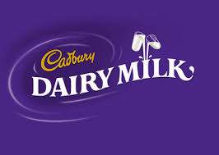
Building brand associations
Cadbury
quality
tasty
family
Gift
Chocolate

Slide 25
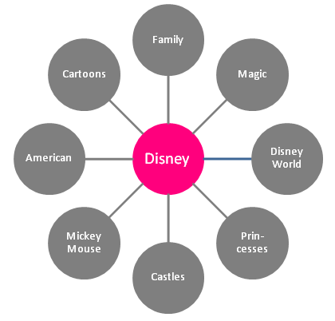
Building brand associations

Slide 26
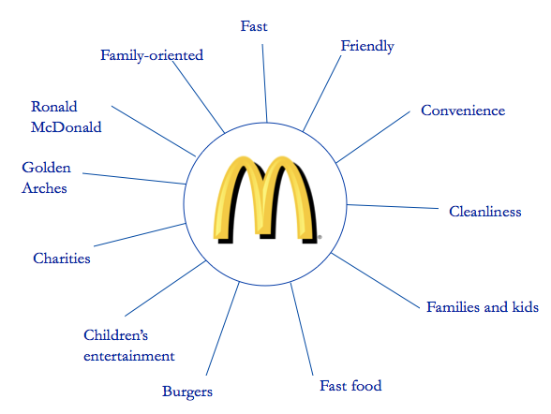
Building brand associations

Slide 27
Brand equity assets
An association can provide an important basis for differentiation because it can be a unique association. For example: Dove Soap has cream inside.
Many brand associations involve product attributes or customer benefits that provide a specific reason to buy the brand.

Slide 28
Brand equity assets
Perceived Quality: Perceived quality can be defined as the customer’s perception of the overall quality or superiority of a product or service with respect to its intended purpose, relative to alternatives.
Perceived quality is an intangible and overall feeling about a brand

Slide 29
Brand equity assets
Perceived quality is a brand association which elevates the value of a brand:
Among all brand associations, only perceived quality has been shown to drive financial performance
Perceived quality is often a major strategic thrust of a business
Perceived quality is linked to and often drives other aspects of how a brand is perceived

Slide 30
Brand equity assets
In many contexts, perceived quality provides the pivotal reason to buy
Could differentiate and be a principal positioning characteristic of a brand
Provides the option of charging a premium price

Slide 31
Brand equity assets
Brand loyalty: comprises of attitudinal and behavioral loyalty. Loyal consumers will spread positive WOM and attract new customers. It is a measure of attachment that a customer has towards a brand
Intellectual rights: include trademarks and patents which support the brand to keep it authentic.

Slide 32
How brands help consumers
Brands help in product identification which reduces search cost
Signal of quality which reduces perceived risk.
Provides social status which reduces social and psychological risk.
Notes:
Consumers trust brands which they have had a positive experience before. Hence, the next time they want to address their need, they will want to purchase the same brand. Hence, search cost is reduced (internal and external).
Brands help consumers project an image in the society.

Slide 34
Brand Wheel Model
The Brand Wheel model helps a brand strategist to have a clear understanding about “what is the brand”?
In other words, what are the attributes? The benefits? the brand values and the personality of the brand? The core promise of the Brand?

Slide 35
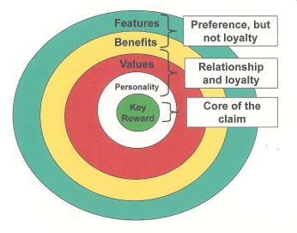
Brand Wheel Model

Slide 36
Brand Wheel Model
The features are the various attributes or ingredients of the main product/service.
The benefits are the advantages provided by the features.
Important note: features and benefits generate consumer preference but is not enough to build loyalty.

Slide 37
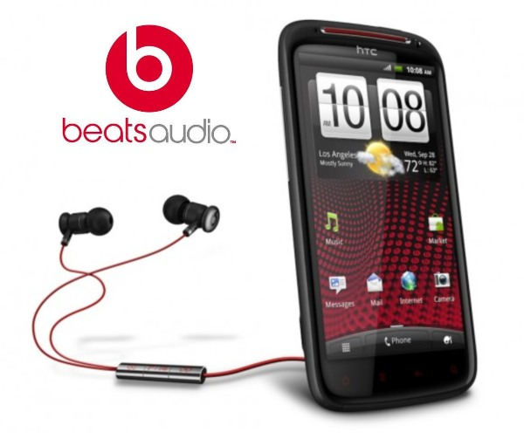

Slide 38
Brand Wheel Model
Values: signify the principles and standards of the company which owns the brand.
British council has the following values:
Valuing people
Integrity
Professionalism
Creativity
Mutuality

Slide 39
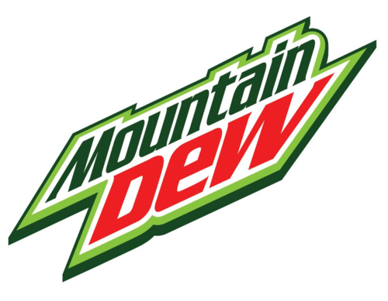
Brand Wheel Model
Personality: are the psychological characteristics of a brand. It’s how a brand can possess human characteristics.

Slide 40
Brand Wheel Model
Important note: values and personality reflect the character of the brand and hence offer the potential of loyalty.
Hence, consumers will love the brand not only because of its performance, but because of its character.

Slide 41
Brand Wheel Model
Key reward: is the central reason that people buy the brand based upon the four earlier levels of the brand wheel.
Key reward can be found in any one or a combination of levels. For instance, it can be found in the benefit level, in the personality level, or the attribute level or any combination of them.
Key reward can be generated from the cumulative effect of the previous 4 levels of the brand wheel.

Slide 42
Brand Wheel Model
For example Channel provides its key reward from the personality level.
Magic provides its key reward from the benefit level.
Dove provides its key reward from the feature level.
NSU SBE provides its key reward through the cumulative effect of all the levels.

Slide 43
Brand Architecture
Brand Architecture teaches us how to organize our brand portfolio and specifies the role of each brand and the nature of relationship between the brands.
The name a powerful brand architecture tool is called the brand relationship spectrum.
Notes:
Brand architecture teaches us how we can organize all the brands of a company.
Brand architecture teaches us the role of each brand in order to increase the overall business performance of the company.
Brand architecture teaches us about the relationship of each brand with another.

Slide 44
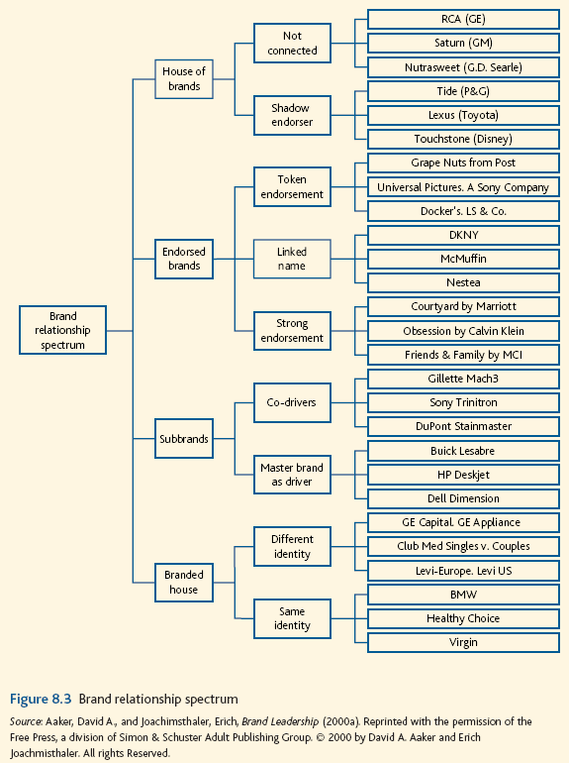

Slide 45
Brand Architecture
House of brands strategy involved building a set of individual stand alone brands each operating in a defined market/industry.
House of brands can have:
A shadow endorser of the organization. This provides an advantage of having a known organization backing the brand.
No connection with the organization.
Notes:
It is when a company is utilizing a range of individual brands to operate in different markets/industries.

Slide 46
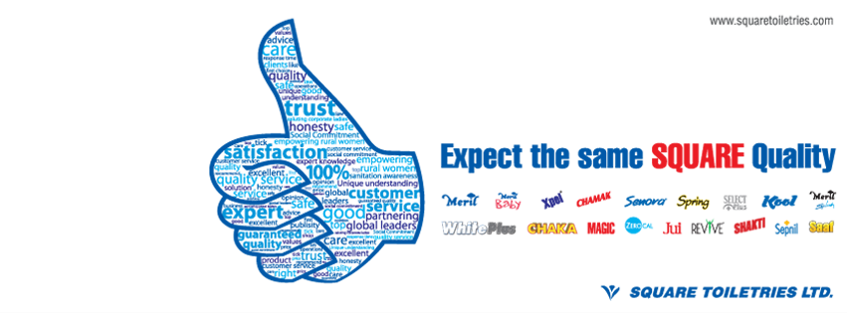

Slide 47
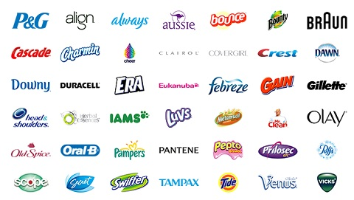

Slide 49
Brand Architecture
Endorsed Brands are still independent brands but they are endorsed by another brand usually an organizational brand. This link, this endorsement can be strong or weak.
It can be of three types:
Strong endorsement: when the endorsement is very strong and the endorser brand plays a strong role in branding.
Linked Name: it provides the benefits of a separate name without having to establish a second name from scratch and link it to the master brand.
Token endorsement: the role of token endorser is to provide some reassurance and credibility while still allowing the brand maximum freedom to create its own associations.
Notes:
Endoresed means supported.
Endorser brand (brand that is providing the support)

Slide 50
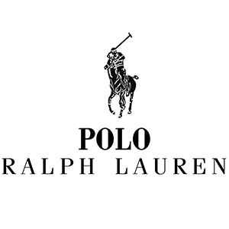
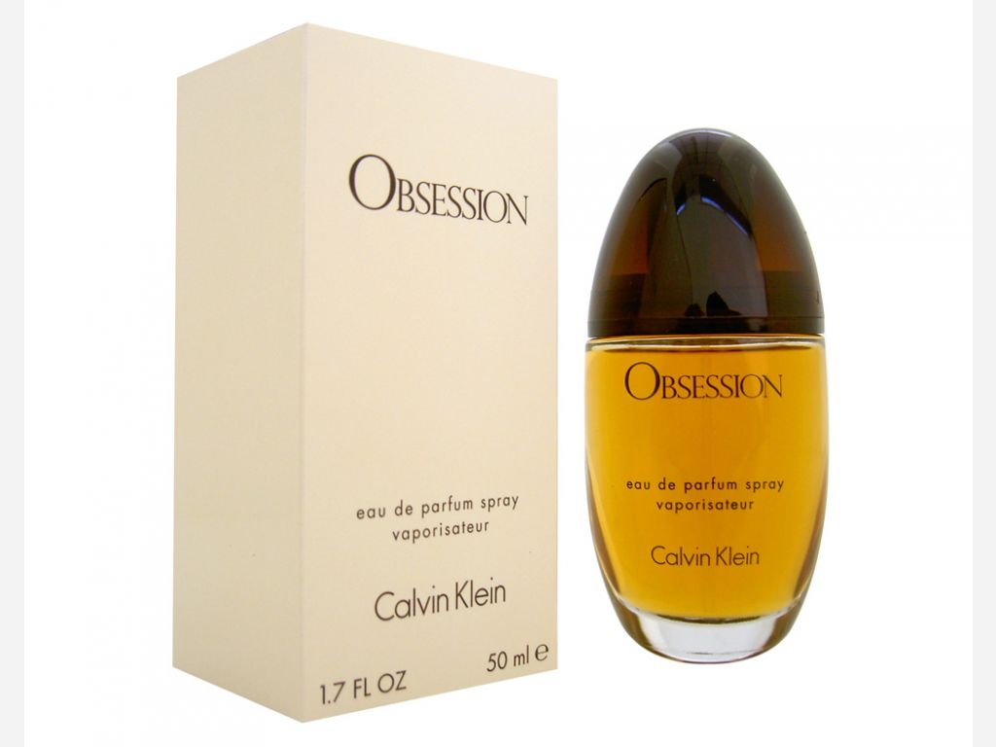
Notes:
Strong endorsement

Slide 51
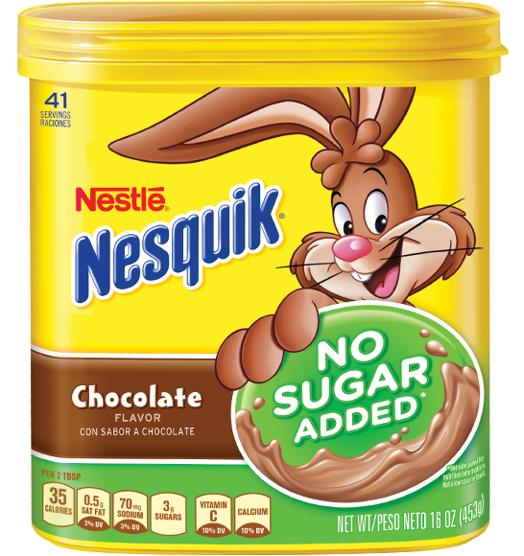
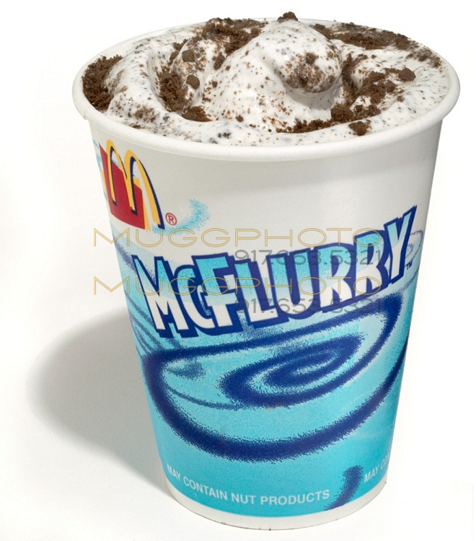
Notes:
The linked name uses a few letters from the parents brand and immediately consumers know that it is a product of nestle.
Hence, by using a linked brand name, we are creating a new brand name by taking the support of the parent brand.

Slide 52
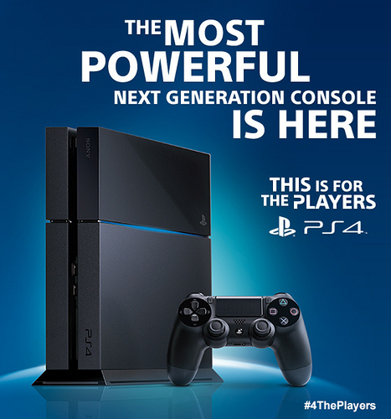
Notes:
Token Endoresment

Slide 53
Brand Architecture
Sub-brands: are brands connected to the master / parents brand and helps the master brand to reach new markets.
For example: Nestle KitKat, Meril Splash, Meril Baby, Holiday Inn Crowne Plaza.
Sub-brands can be of two types:
Co-drivers : splits the driver role equally between the master brand and the sub brand that means both play large roles in the purchasing decision from customers’ perspective.
Master brand as drivers: the ability of the master brand to affect the purchasing decision since it can be considered as an established brand with significant popularity and loyalty among customers.
Notes:
When another brand is connected with the master brand.

Slide 54
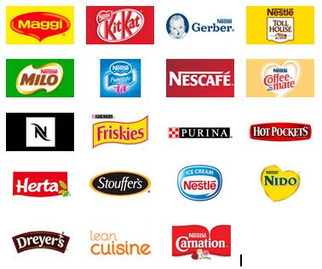
Notes:
Nestle Sub-brands all of which are co-drivers

Slide 55
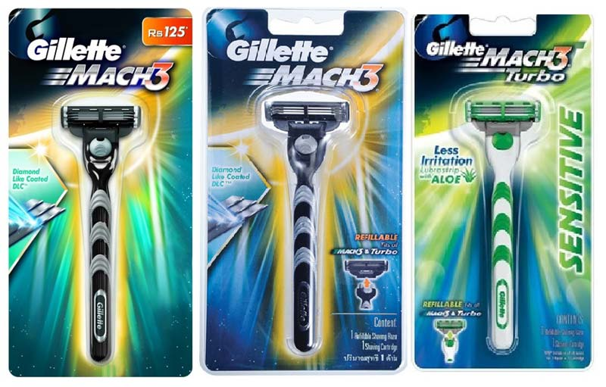

Slide 56
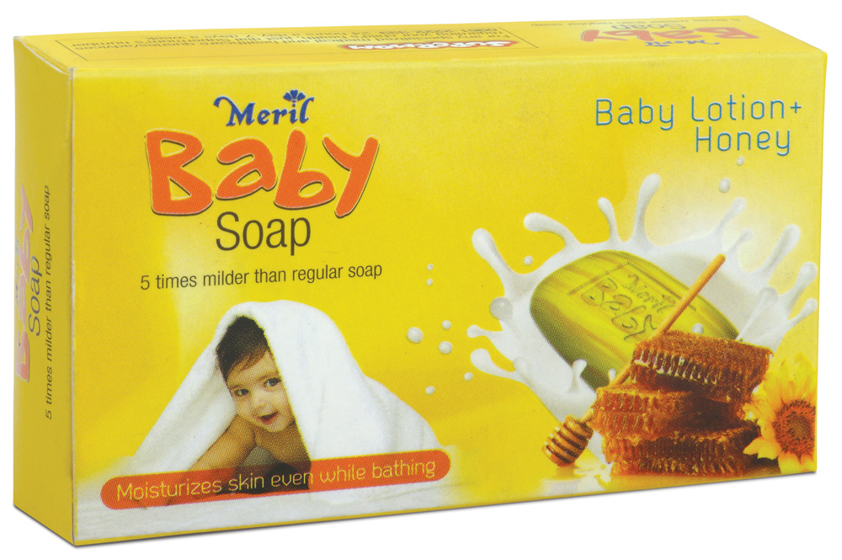
Notes:
Master brand driver

Slide 57
Brand Architecture
A Branded house uses a single master brand to sell their products in the marketplace. Hence, the master brand plays the entire driver role.
“Same identity” describes a phenomenon where the brand has a unique identity and “position” in every context it operates.
“Different identity” is a phenomenon that can be observed when a specific brand is used in several market sections, nations or commodities.
Notes:
In different markets, while selling different products/services identity of the brand is same.

Slide 58
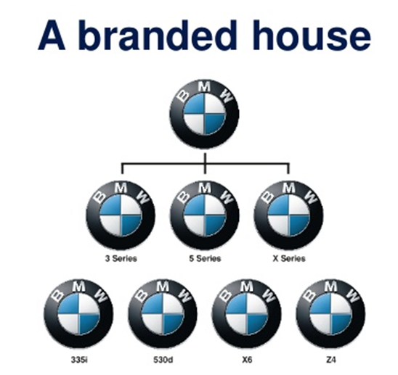
Notes:
Branded house: same identity

Slide 59
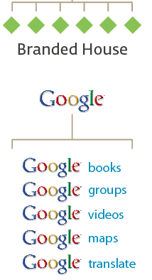
Notes:
Branded house:different identity

Slide 60
Notes:
Branded house:different identity

