Slide 1
Strategic Marketing, 3rd edition
Chapter 1 & 2:
Overview and Strategic perspective

Slide 2
So what is marketing all about?

Slide 3
So what is marketing all about?
A corporate state of mind that exists on the integration and co-ordination of all the marketing functions which, in turn, are melded with all other corporate functions, for the basic objective of producing long-range profits (Felton, 1959)
Marketing is the process of planning and executing the conception, pricing, planning and distribution of ideas, goods and services to create exchanges that satisfy individual and organizational objectives (AMA, 1985)
The marketing concept holds that achieving organizational goals depends on determining the needs and wants of target markets and delivering the desired satisfactions more effectively and efficiently than competitors do (Kotler et al., 1996)
Marketing is the activity, set of institutions, and processes for creating, communicating, delivering, and exchanging offerings that have value for customers, clients, partners, and society at large (AMA, 2008)
Notes:
As you can see from the definitions, the idea of consumer’s value integration into the definition came only in 1996, and the definition of 2008 is probably closest to being correct, for the time!

Slide 4
So what is marketing all about?
Marketing has successfully ‘migrated’ from being a functional discipline to being a concept of how businesses should be run (Greyser, 1997)
Of all the management functions, marketing has the most difficulty in defining its position in the organization, because it is simultaneously culture, strategy and tactics (Webster, 1997)

Slide 5
So what is marketing all about?
Organizational culture: marketing may be expressed as the ‘marketing concept’, i.e. a set of values and beliefs that drives the organization through a fundamental commitment to serving customers’ needs as the path to sustained profitability
Strategy: as strategy, marketing seeks to develop effective responses to changing market environment by defining market segments, and developing and positioning product offerings for those target markets
Tactics: marketing as tactics is concerned with the day to day activities of product management, pricing, distribution and marketing communications such as advertising, personal selling and publicity and sales promotion.
Notes:
Organizational culture: e.g. from Puma’s reading pertaining to how the whole organization including supply chain, and marketing was involved. Not mentioned in the case but obviously called for involvement of Finance, and HR as well.
Strategy: e.g. from Puma’s reading of how they figured out about the rising class of consumers concerned about the environment. Puma went ahead and made this change in their packaging.
Tactics: while Puma carried out this packaging initiative, they did not shun other responsibilities, rather continued with all other 4P related tasks.

Slide 6
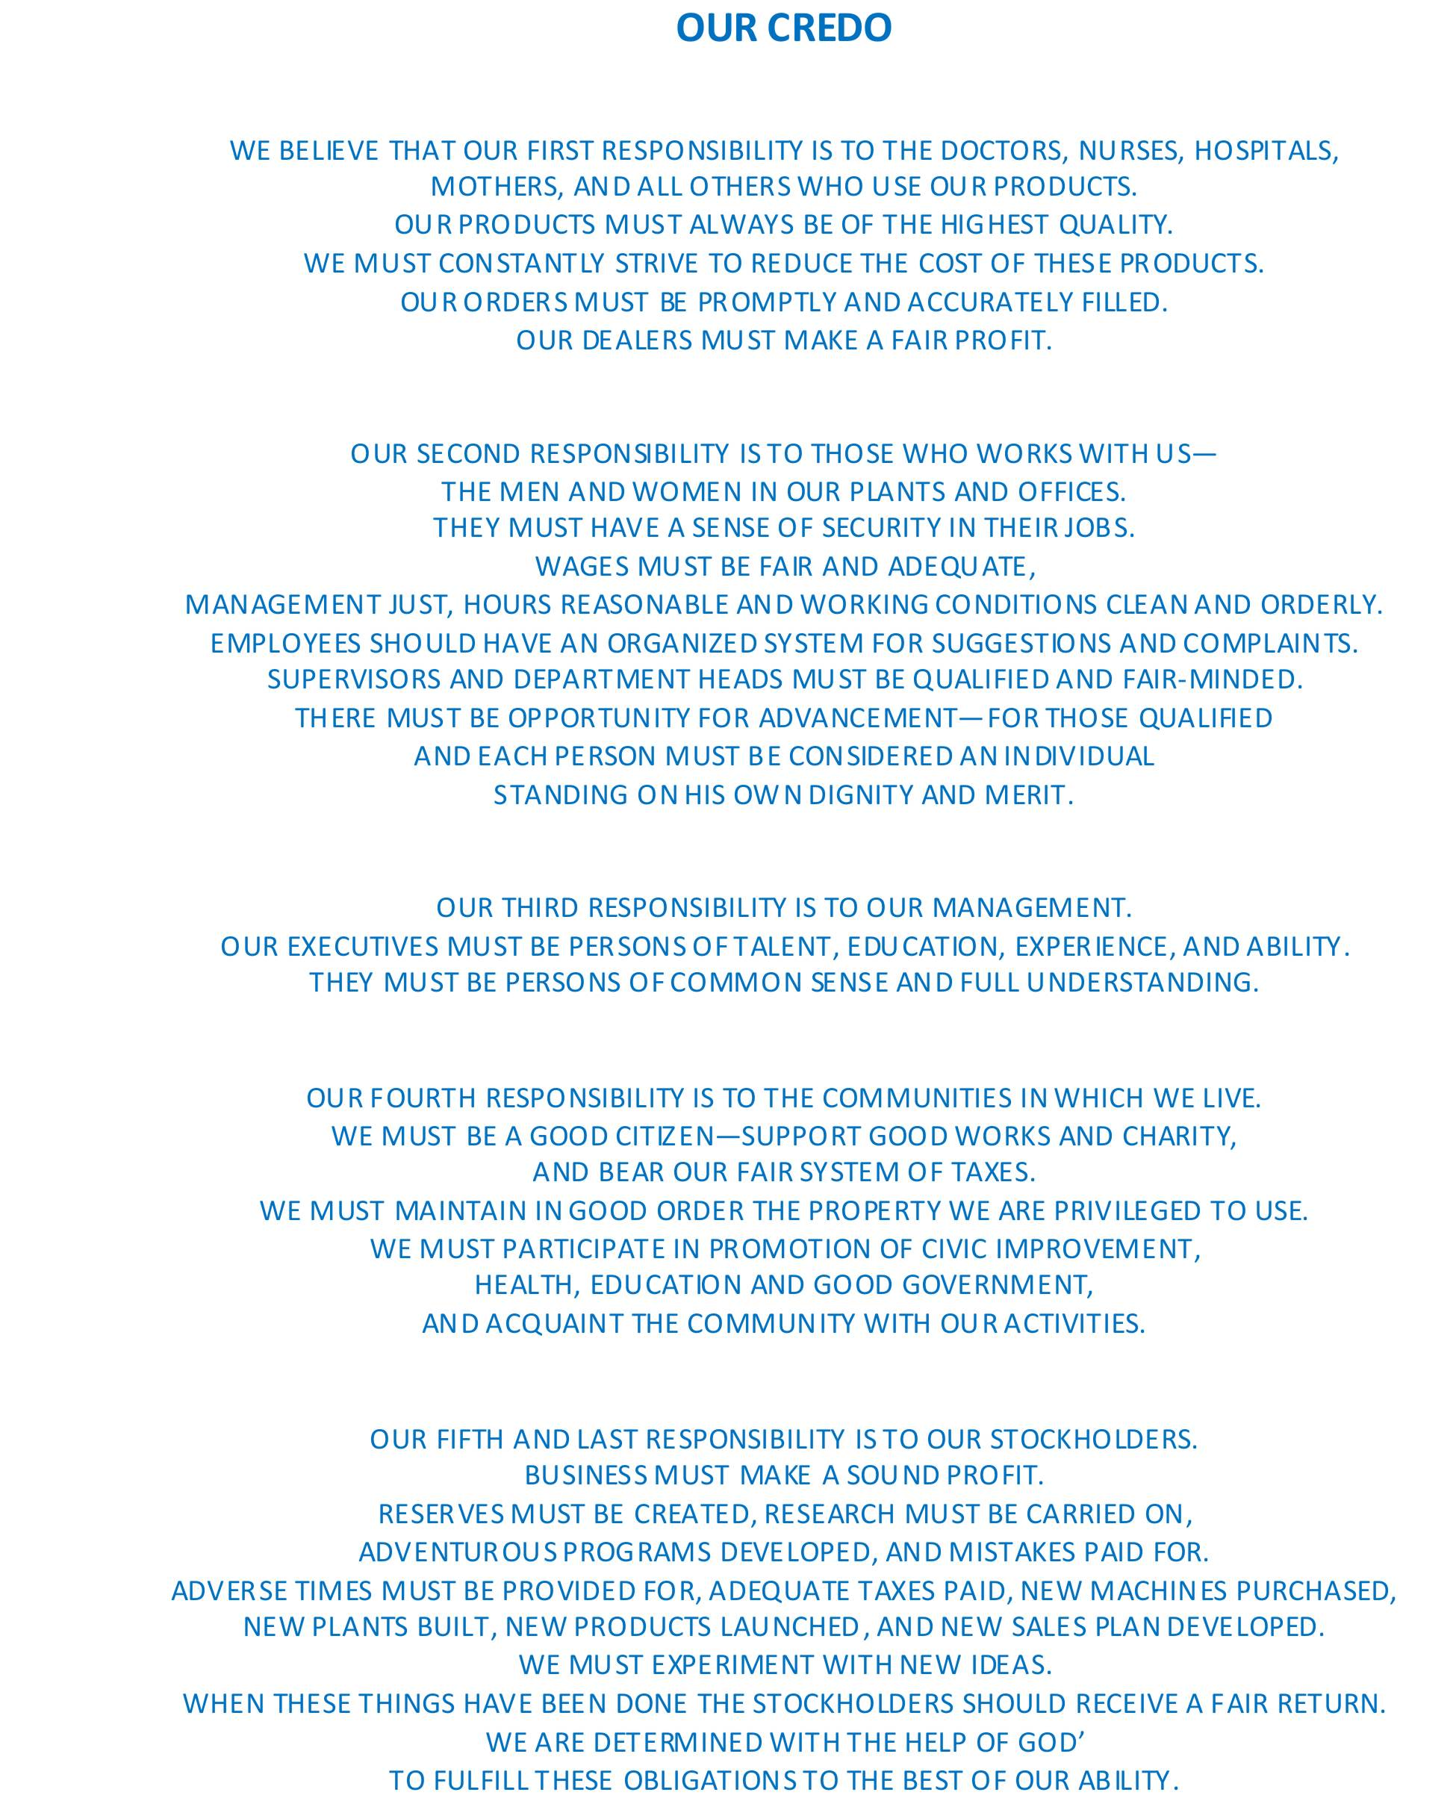

Slide 7
Conceptualizing Marketing
One of the shortest definition of marketing is “creating profitable customer relationships”
Marketing is a process by which companies create value for customers and capture value from customers in return.
Note 1: understanding the needs is vital to create value.
Note2: Delivering satisfaction is a key to make sure the “profitable relationship” is sustainable.

Slide 8
Marketing
Marketing is a process by which companies create value for customers and build strong customer relationships to capture value from customers in
return
Needs
Physical—food, clothing, warmth, safety
Social—belonging and affection
Individual—knowledge and self-expression
Wants
Demands
Form that human needs take as they are shaped by culture and individual personality
Human wants backed by buying power
States of deprivation

Slide 9
Company Orientations Towards the Marketplace
Production Concept
Consumers prefer products that are
widely available and inexpensive
Product Concept
Consumers favor products that
offer the most quality, performance,
or innovative features
Selling Concept
Consumers will buy products only if
the company aggressively
promotes/sells these products
Marketing Concept
Focuses on needs/ wants of target
markets & delivering value
better than competitors
company should make marketing decisions by considering consumers' wants, the company's requirements, and society's long-term interests.
Societal Marketing Concept

Slide 10
Conceptualizing Holistic Marketing
Holistic Marketing
Integrated Marketing
Relationship Marketing
Performance Marketing
Internal Marketing

Slide 11
The parameters of Holistic Marketing
Relationship Marketing signifies building mutually satisfying long term relationships with key constituents that directly or indirectly affect the success of a firm’s marketing activities.
The Key constituents include: customers, employees, marketing partners (suppliers & marketing intermediaries), and members of the financial community ( banks and shareholders).
Research has indicated a correlation between relationship marketing and profitability.

Slide 12
The parameters of Holistic Marketing
Integrated Marketing signifies the formulation of a product strategy, pricing strategy, channel strategy and communications strategy in order to create, deliver, exchange and communicate value for the consumers.
In other words:
the right product/service should be designed that provides a value which satisfies a need.
The right price should be set so that consumers will be ready to buy the product while also making sure that the company makes profits.
The right channels should be pursued so that consumers can access the value.
And an effective IMC campaign should be designed to communicate value to the consumers.

Slide 13
The parameters of Holistic Marketing
Internal Marketing signifies the alignment of every department in the organization to be marketing oriented in order to achieve marketing goals.
A marketing manager will not be able to execute her strategy effectively without the help of all the other departments. Hence, there should be an inter-departmental harmony in order to provide customer value.

Slide 14
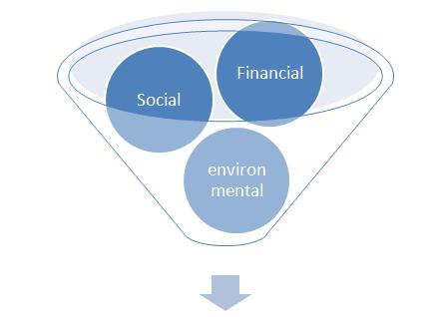
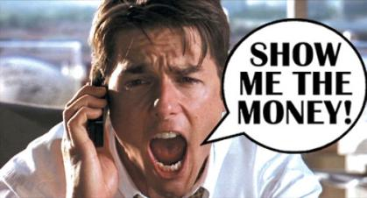
The parameters of Holistic Marketing: Performance Marketing
Performance Marketing signifies how well the business has performed in terms of financial and non financial parameters.
Discussion on the triple bottom line approach:

Slide 15
Notes:
What is this? From this is it possible to tell whether the elephant is running, sitting, sick?

Slide 16
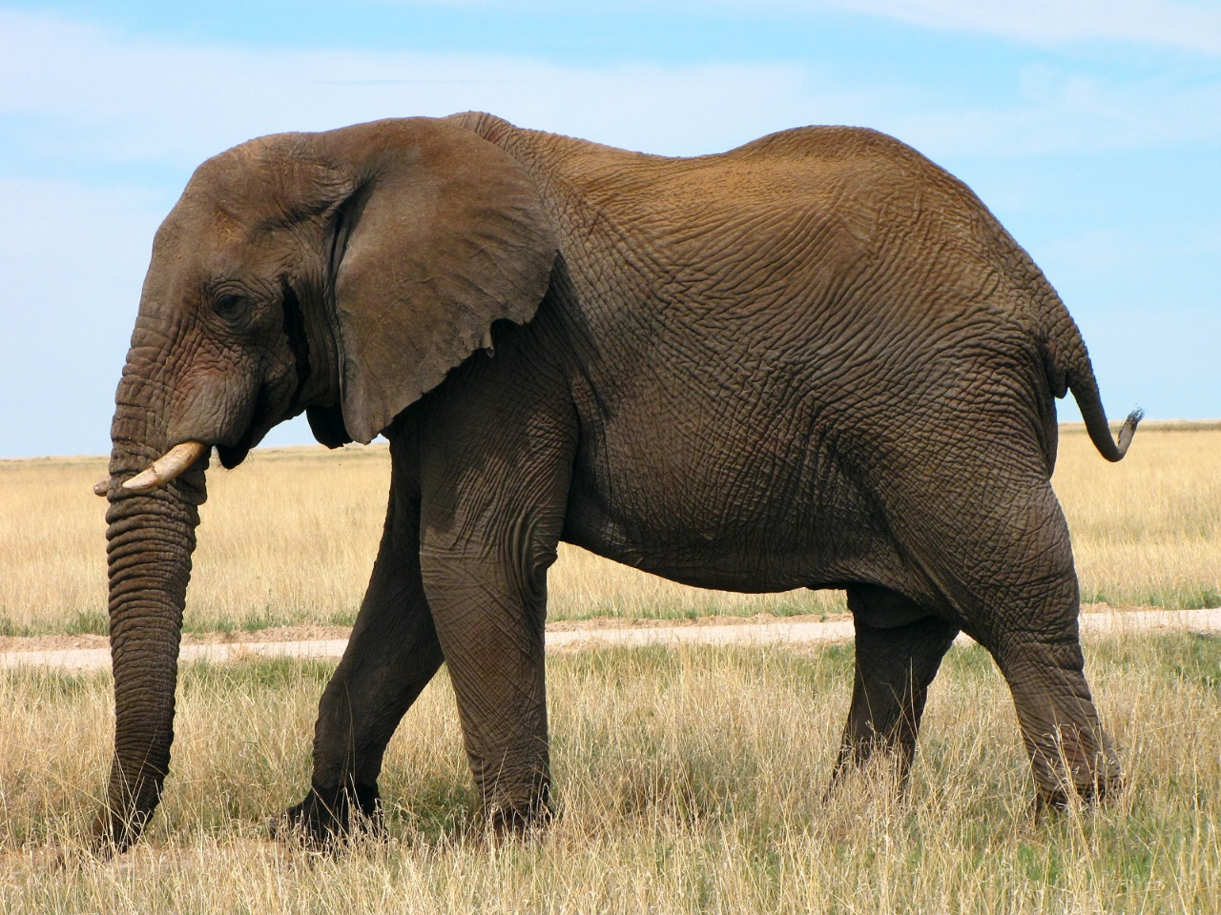
Notes:
You need the whole picture of the elephant or the business

Slide 17
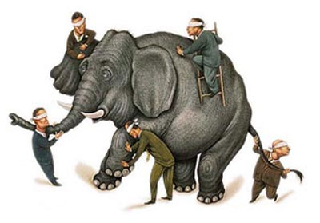
Notes:
Business strategy is driven by marketing

Slide 18
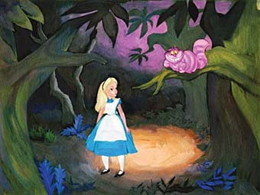
“Would you tell me, please, which way I ought to go from here?”
“That depends a good deal on where you want to get to”, said the cat.
“I don’t much care where” said Alice.
“Then it doesn’t matter which way you go,” said the cat.
Alice’s Adventures in Wonderland,
Lewis Carroll

Slide 19
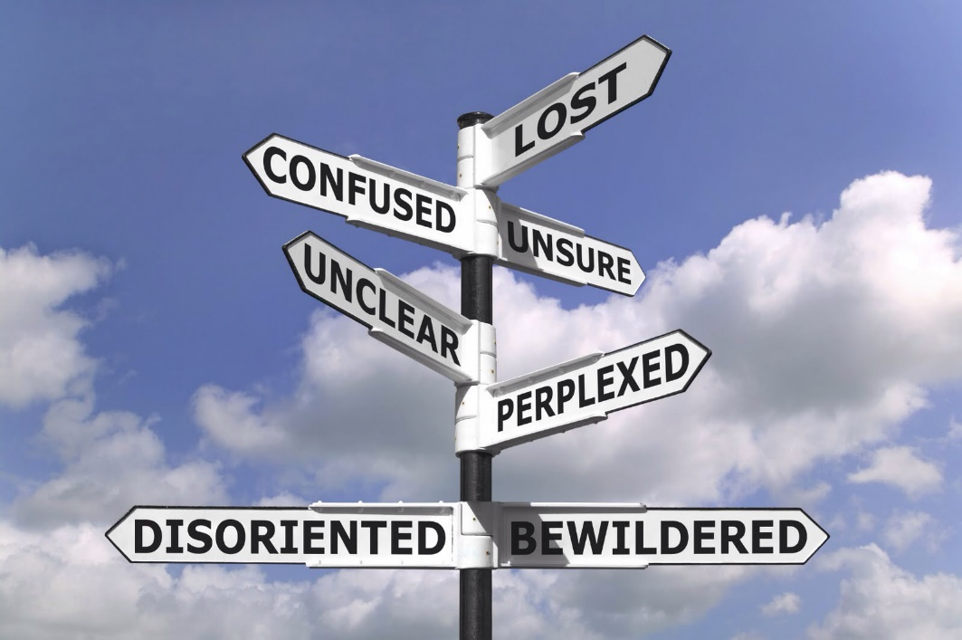
Where do you want to go?
Notes:
Alice in Wonderland
38.28 – 40.04

Slide 20
Conceptualizing Strategy in a simplistic manner
Goals indicate what a business unit wants to achieve; strategy is the game plan for getting there.
A manager comes up with a strategy or a plan of action to achieve superior performance in the marketplace than its competitors.

Slide 21
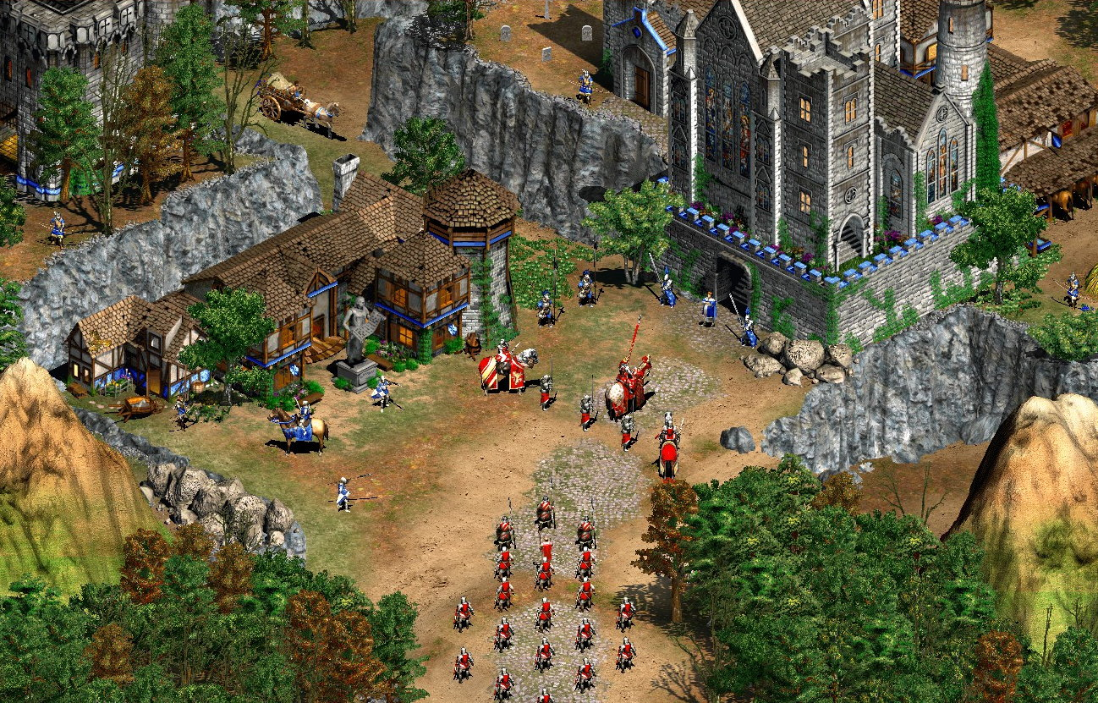

Slide 22
How do I strategize: Battle v/s marketing strategy
You need to know your current and desired situation – set your goals.
You need a map – to understand the environment.
You need a compass to give you directions – which consumers are you going after?
And finally you need to ACT (execution of your strategy) – through the 4ps of marketing.

Slide 23
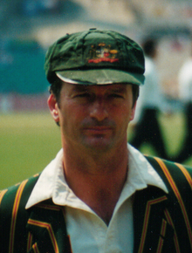
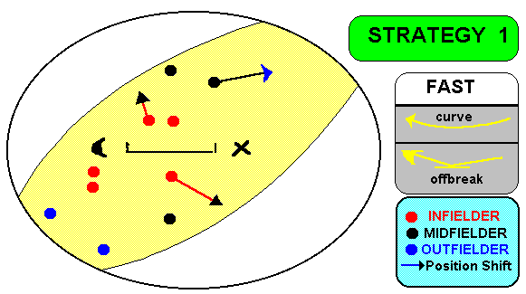
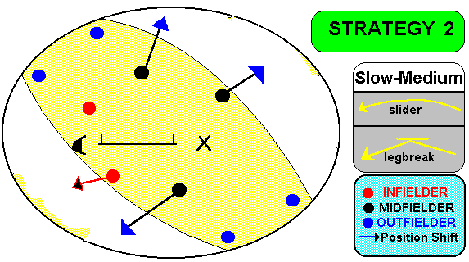
“Your strategy revolves around the bowlers you have got” - Steve Waugh.

Slide 24
The Concept of ‘Strategy’
The word ‘Strategy’ was initially introduced and defined in the ancient military dictionaries
It comes from the Greek word ‘strategos’, strictly meaning a general in command of an army; it is formed from ‘stratos’, meaning army and ‘ag’, meaning to lead
Used first time in business literature by William Newman (1951)

Slide 25
Marketing Strategy is a Gap Analysis
Formulate
Marketing
Strategies
Internal
Environment:
Resources &
Capabilities
External
Environment:
Market Scan &
Scenarios
Strategic
Fit
Gap
analysis
Notes:
Internal:
Pest repellent (Mortein), Surface care (Trix, Harpic), Personal care (Veet) – SCA in all these fields
External:
Mosquito season → health concerns
Disposable income increasing, people want better/easier solution to problems
Gap analysis:
Drill down and see what’s going on
People want good night’s sleep
They don’t want to worry about fumigating too often
They want health security from mosquitoes
They want safety from unhygienic creepy crawlies (cockroach)
Strategic fit:
Can we offer them a solution? Yes we can.
Formulate marketing strategies:
Go ahead and develop your 4Ps

Slide 26
Dress Down Version!
“Marketing strategy is an approach to enable an organisation to best use its resources to meet the needs of its customers.”

Slide 27
The Concept of ‘Strategy’
Generic
a plan of attack for winning
a plan for beating the opposition
Organisational
a plan for achieving organisational goals
a plan for securing a competitive advantage in a given market

Slide 28
Purpose of Strategy
To set the future direction for the organisation
To state how it is to create value to customers
To identify what product/s and in which markets the firm will invest its resources
To describe how it is to perform better than competition

Slide 29
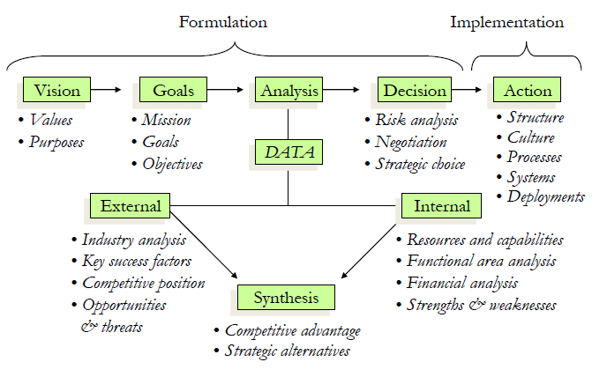
Strategic Process

Slide 30
To do:
There will be a class discussion session in the next class. So prepare yourself accordingly. I'll randomly ask people to participate. You are required to do a bit of research and: 1. Find a company that did something 'customer centric'. Explain what they did and whether or not it was successful. Summarize within 4-5 sentences. 2. Explore the organizational culture of a company of your choice. Summarize and explain it in 4-5 sentences. *I encourage you to cite local example. But global examples will be accepted as well. You do not need to prepare any presentation but write down the answers in a paper. Just be prepared to answer any one of the above questions.

Slide 31
Strategic Marketing, 3rd edition
Chapter 1 & 2:
Overview and Strategic perspective

Slide 32
Hierarchy of strategy
Corporate Strategy
Corporate Headquarters
Business (Division Level) Strategy
SBU SBU SBU
Functional Strategy
Manufacturing Finance Marketing R&D HRM
Strategic management may be initiated at any or all of these hierarchical levels of an organisation

Slide 33
Three levels of strategy
Corporate
The overall goals of the business; often expressed in financial terms
Competitive/Business (SBU)
How to compete in individual product-markets and support the corporate strategy
Functional
Functional strategies for the organisation’s functional areas in support of SBUs and corporate strategies

Slide 34
Marketing Strategy – Two Perspectives
Marketing strategy at the functional level
Planning and controlling the marketing activities
Planning and implementing the 4Ps/7Ps
Management customer relationship
Marketing as a philosophy/orientation
Guiding the organisation’s overall activities
Playing a key role in the strategic management process (SMM)

Slide 35
The interrelationship between marketing and corporate strategy
Corporate Strategy
Specifying the organisation’ mission
Allocation of resources across the whole organisation
Portfolio of activities for the organisation
Defining organisational objectives
Guides
Directs
Controls
Co-ordinates
Informs
Achieves
operationalises
Marketing Strategy
Competing in a product market
Selecting market segments
Designing the mix
Brassington Frances and Stephen Pettitt (2006)

Slide 36
Introduction: Definition of Competitive Marketing Strategy
“Marketing strategy is a market oriented game plan which establishes a profitable & sustainable market position for the firm against all forces that determine industry competition by continuously creating & developing a sustainable competitive advantage (SCA) from the potential sources that exist in a firm’s value chain.”

Slide 37
4 Main Ways of Approaching Marketing Strategy
THINKING FIRST
SEEING FIRST
COMPETITIVE
MARKETING
STRATEGY
DOING FIRST
SIMPLE RULES

Slide 38
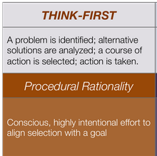
Thinking first
-Logical, sequential and linear approach
-It’s about analyzing a strategic marketing problem and developing the solution and the strategy through a carefully thought through and largely sequential process
-Instant views and decisions are not made

Slide 39
Thinking First
It can help to see the big picture occasionally throughout the process. It can involve some inspiration & insight, but largely the process is one of painstakingly doing your homework
Cognitively analysing a strategic marketing problem & developing the solution (the strategy) through a carefully thought-out process

Slide 40
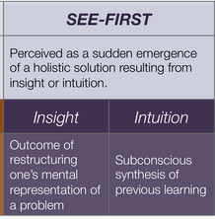
Seeing first
-Importance of seeing the overall decision is sometimes greater than thinking about it
-Insight often only comes after a period of preparation, incubation, illumination & verification in the cold light of day

Slide 41
Doing First
do something,
(2) make sense of it
(3) repeat the successful parts & discard the rest.
Instead of marketing strategy –
the reality is often that ‘doing’ drives
Many companies have successfully diversified
their businesses
by a process of figuring out what worked
& what did not

Slide 42
DO SOMETHING
MAKE SENSE OF IT
REPEAT THE SUCCESSFUL PARTS
DISCARD THE REST

Slide 43
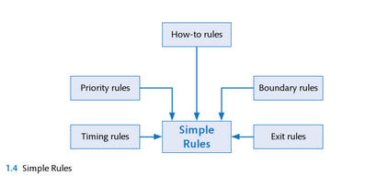
Simple rules
-It’s about selecting a few key marketing strategic processes, crafting a handful of simple rules and “jumping in” rather than avoiding uncertainty
-In many respects the approach is related to Doing First aside from the main difference is that the rules are predefined

Slide 44
Simple Rules
How-to rules keeping managers organised to be able to seize opportunities
Boundary rules help managers to pick the best opportunities
based geography, customers or technology
Priority rules are about allocating resources amongst competing opportunities
Timing rules relate to the rhythm of key strategic processes
Exit rules are about pulling out from past opportunities

Slide 45
Process and Temporality and the Four Main Approaches to Competitive Marketing Strategy
PROCESS
Experiential
Cognitive
Short-Term
SIMPLE RULES
SEEING FIRST
TEMPORALITY
DOING FIRST
THINKING FIRST
Long-Term

Slide 46
Postmodern view
Buyers are increasingly sophisticated and cynical about regular marketing
Customers prefer context specific persuasion knowledge
According to Brown (2001)
customers do not want the truth, the whole truth and nothing but the truth
They want marketing to be about glitz and glamour and to be mischievous and mysterious.
Marketing should be fun, but any nastiness is forbidden
To undertake retro strategy (but in a manipulative way), marketers need to practice TEASE

Slide 47
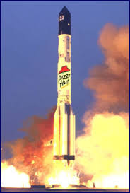
Postmodern view
Tricksterism
Entertainment
Amplification
Exclusivity
Secrecy
(Brown, 2003)

Slide 48
What to Choose?
Thinking First Market Orientation works best when the issues are clear, the data are reliable, the context is structured, thoughts can be pinned down & discipline can be applied
Seeing First works best when many elements have to be creatively applied, commitment to solutions is key & communications across boundaries are needed
Doing First or simple rules work best when the situation is novel & confusing, complicated specifications would get in the way & a few simple relationship rules can help move the process forward
The Postmodern orientation needs to be continually borne in mind to provide a check on how, in reality, buyers will interpret the final offering

