Slide 1
CHAPTER 2
NATIONAL DIFFERENCES IN POLITICAL ECONOMY

Slide 2
Political Economy
The political economy of a nation refers to how the political, economic, and legal systems of a country are interdependent
they interact and influence each other
they affect the level of economic well-being in the nation

Slide 3
Political System
Political system refers to the system of government in a nation
Assessed according to
the degree to which the country emphasizes collectivism as opposed to individualism
the degree to which the country is democratic or totalitarian

Slide 4
Collectivism
Collectivism stresses the primacy of collective goals over individual goals
can be traced to the Greek philosopher, Plato (427-347 BC)
Today, collectivism is equated with socialists (Karl Marx 1818-1883)
advocate state ownership of the basic means of production, distribution, and exchange
manage to benefit society as a whole, rather than individual capitalists

Slide 5
How Does Modern-Day Socialism Look?
In the early 20th century, socialism split into
Communism – socialism can only be achieved through violent revolution and totalitarian dictatorship
in retreat worldwide by mid-1990s
Social democrats – socialism is achieved through democratic means
retreating as many countries move toward free market economies
state-owned enterprises have been privatized

Slide 6
Individualism
Individualism refers to philosophy that an individual should have freedom in his own economic and political pursuits
can be traced to Greek philosopher, Aristotle (384-322 BC), who argued that individual diversity and private ownership are desirable
individual economic and political freedoms are the ground rules on which a society should be based
implies democratic political systems and free market economies

Slide 7
Democracy
Democracy refers to a political system in which government is by the people, exercised either directly or through elected representatives
usually associated with individualism
pure democracy is based on the belief that citizens should be directly involved in decision making
most modern democratic states practice representative democracy where citizens periodically elect individuals to represent them

Slide 8
Totalitarianism
Totalitarianism is a form of government in which one person or political party exercises absolute control over all spheres of human life and prohibits opposing political parties
Communist totalitarianism – found in states where the communist party monopolizes power. E.g. : China (The Communist Party of China).
Theocratic totalitarianism - found in states where political power is monopolized by a party, group, or individual that governs according to religious principles. E.g. : Iran since 1979.
Tribal totalitarianism - found in states where a political party that represents the interests of a particular tribe monopolizes power. E.g. : Rwanda (Hutus).
Right-wing totalitarianism - permits some individual economic freedom, but restricts individual political freedom. E.g. : Nazi Germany.

Slide 9
Economic System
There are three types of economic systems
Market economies - all productive activities are privately owned and production is determined by the interaction of supply and demand
government encourages free and fair competition between private producers
Command economies - government plans the goods and services that a country produces, the quantity that is produced, and the prices as which they are sold
all businesses are state-owned, and governments allocate resources for “the good of society”
because there is little incentive to control costs and be efficient, command economies tend to stagnate
Mixed economies - certain sectors of the economy are left to private ownership and free market mechanisms while other sectors have significant state ownership and government planning
governments tend to own firms that are considered important to national security

Slide 10
Legal System
The legal system of a country refers to the rules that regulate behavior along with the processes by which the laws are enforced and through which redress for grievances is obtained
There are three types of legal systems
Common law - based on tradition, precedent, and custom
Civil law - based on detailed set of laws organized into codes
Theocratic law - law is based on religious teachings

Slide 11
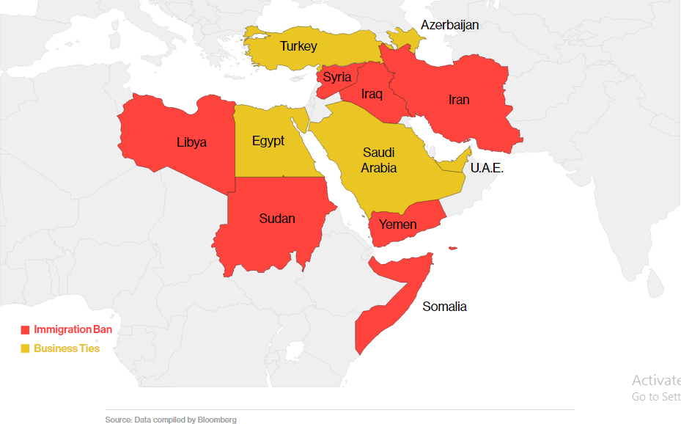
A federal judge in Detroit has ordered the administration to stop enforcement of President Trump's executive order barring citizens from certain Muslim-majority countries from traveling to the U.S, CBS Detroit reported Friday.

Slide 12
Contracts
A contract is a document that specifies the conditions under which an exchange is to occur and details the rights and obligations of the parties involved.
Contract law is the body of law that governs contract enforcement.
Under a common law system, contracts tend to be very detailed with all contingencies spelled out
Under a civil law system, contracts tend to be much shorter and less specific because many issues are already covered in the civil code
Many countries have ratified the United Nations Convention on Contracts for the International Sale of Goods (CIGS) which establishes a uniform set of rules governing certain aspects of the making and performance of everyday commercial contracts between buyers and sellers who have their places of business in different nations.

Slide 13
How Are Property Rights And Corruption Related?
Property rights refer to the legal rights over the usage of a resource and over the usage of any income that may be derived from that resource.
Can be violated through
Private action – theft, piracy, blackmail
Public action - legally - ex. excessive taxation; bribes or blackmailing
high levels of corruption reduce foreign direct investment, the level of international trade, and the economic growth rate in a country
The Foreign Corrupt Practices Act makes it illegal for U.S. companies to bribe foreign government officials to obtain or maintain business over which that foreign official has authority

Slide 14
Which Countries Are Most Corrupt?

Slide 15
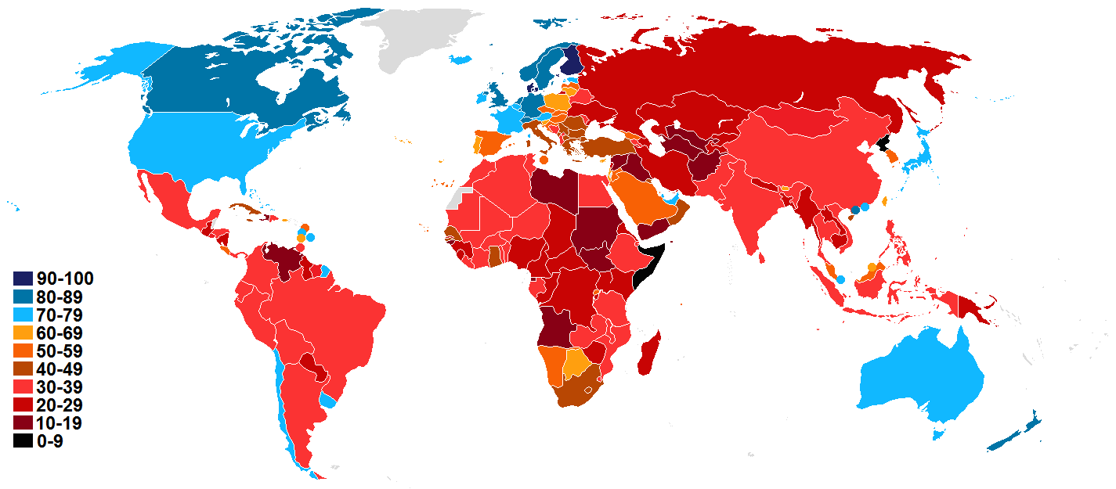
Rankings of Corruption by Country 2015

Slide 16
Rankings of Corruption by Country 2015

Slide 17
Intellectual Property
Intellectual property - property that is the product of intellectual activity
Can be protected using
Patents – exclusive rights for a defined period to the manufacture, use, or sale of that invention
Copyrights – the exclusive legal rights of authors, composers, playwrights, artists, and publishers to publish and disperse their work as they see fit
Trademarks – design and names by which merchants or manufacturers designate and differentiate their products

Slide 18
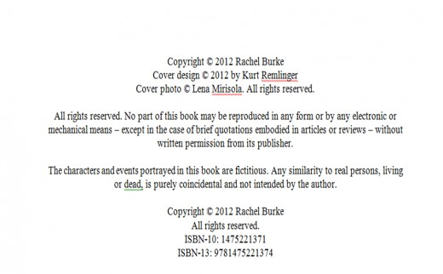
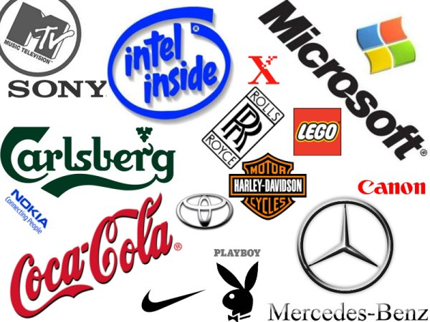
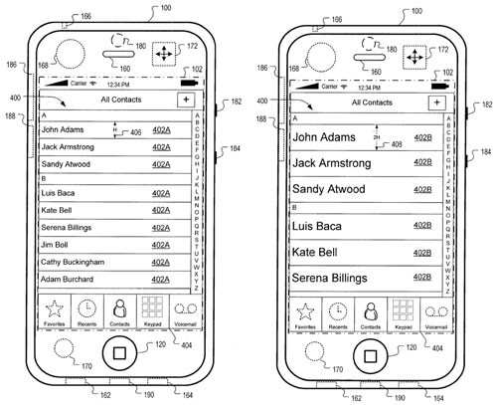

Slide 19
How Can Intellectual Property Be Protected?
Protection of intellectual property rights differs from country to country
World Intellectual Property Organization
Paris Convention for the Protection of Industrial Property
To avoid piracy, firms can
stay away from countries where intellectual property laws are lax
file lawsuits
lobby governments for international property rights agreements and enforcement

Slide 20
Product Safety & Product Liability
Product safety laws set certain standards to which a product must adhere
Product liability involves holding a firm and its officers responsible when a product causes injury, death, or damage
When product safety laws are stricter in a firm’s home country than in a foreign country, or when liability laws are more lax, the firm has to decide whether to adhere to home country or host country standards

