Slide 1
CHAPTER 3
POLITICAL ECONOMY & ECONOMIC DEVELOPMENT

Slide 2
What Determines A Country’s Level Of Economic Development?
Gross National Income (GNI): measures the total income received by resident of a nation.
The GNI can be misleading because it does not take the cost of living into consideration.
Purchasing power parity (PPP) allows for a more direct comparison of living standards in different countries.
The GNI and PPP data give a static picture development but does not give a measurement of whether the difference between the countries is being shortened or not.
Notes:
Now, let’s move on to the determinants of economic development.
The political, economic, and legal environments of a country can have a significant impact on its economic development, and on its attractiveness as a potential investment location or target market.
Economic development levels an be measured using gross national income per person, or GNI.
But, GNI measures can be misleading because they don’t take into account cost of living differences. So, we adjust these numbers by purchasing power. Using purchasing power parity or PPP, we can adjust the numbers to reflect how far your money actually goes in a particular country.
What does this mean for companies? Well, looking at a PPI adjusted GNI for India in 2007, we would conclude that the average India could only consume about 6 percent of the goods and services consumed by the average American. Think about that the next time you go to the mall! Should we discount India as a potential market then? No, because if we look a little deeper we would find that the country has an emerging middle class of about 100 million people that represents a tremendous opportunity for foreign companies.
Are there other ways to measure economic development? Nobel-prize winning economist Amartya Sen thinks so!
Amartya Sen argues that rather than simply focusing on material output measures like GNI per capital, we should consider the capabilities and opportunities people enjoy when measuring economic development. Sen believes that economic progress includes things like removing impediments to freedom like tyranny, poverty, and the neglect of public facilities, and a democratization of political communities so that citizens have a voice in decisions. So, for example, Sen argues that providing basic health care and education is essential for economic growth.

Slide 3
Differences In Economic Development

Slide 4
Table: Economic Data for Select Countries [GNI per capita (current US$)]

Slide 5
Table: Economic Data for Select Countries [GNI per capita, PPP (current international $)]

Slide 6
Broader conceptions of Development: Amartya Sen
Development should be assessed less by material output measures such as GNI per capita and more by what people enjoy.
Sen emphasizes basic health care and basic education
The United Nations used Sen’s ideas to develop the Human Development Index (HDI):
Life expectancy at birth
Educational achievement
Average incomes sufficient to meet the basic needs of life

Slide 7
Political Economy And Economic Development
What is the relationship between political economy and economic progress? Experts agree that:
Innovation and entrepreneurship are the engines of long-run economic growth
Innovation and entrepreneurship require a market economy
Innovation and entrepreneurship require strong property rights
Democratic regimes are more conducive to long-term economic growth than a dictatorship, even one of the benevolent kind
Subsequent economic growth leads to establishment of democratic regimes
Notes:
A country’s economic development is a function of its economic and political systems. Economic freedom associated with a market economy creates greater incentives for innovation and entrepreneurship than either a planned or a mixed economy.
Innovation and entrepreneurship require strong property rights.. Without strong property rights protection, businesses and individuals run the risk that the profits from their innovative efforts will be expropriated, either by criminal elements or by the state.
There is debate on the kind of political system that best achieves a functioning market economy with strong protection for property rights. People in the West tend to associate a representative democracy with a market economic system, strong property rights protection, and economic progress. Building on this, we tend to argue that democracy is good for growth.
However, some totalitarian regimes have fostered a market economy and strong property rights protection and have experienced rapid economic growth. Four of the fastest-growing economies of the past 30 years—South Korea, Taiwan, Singapore, and Hong Kong—had one thing in common at the start of their economic growth: undemocratic governments!
While it is possible to argue that democracy is not a necessary precondition for a free market economy in which property rights are protected, subsequent economic growth often leads to establishment of a democratic regime

Slide 8
Geography, Education, And Economic Development
Geography and education are also important determinants of economic development
Countries with favorable geography are more likely to engage in trade, and so, be more open to market-based economic systems, and the economic growth they promote
Countries that invest in education have higher growth rates because the workforce is more productive

Slide 9
States In Transition
Since the late 1980s, two trends have emerged in the political economy:
A wave of democratic revolutions swept the world in the late 1980s and early 1990s
There has been a move away from centrally planned and mixed economies and toward a more free market economic model
Notes:
Two trends are evident: first, during the late 1980s and early 1990s, a wave of democratic revolutions swept the world; second, totalitarian governments collapsed and were replaced by democratically elected governments that were typically more committed to free market capitalism than their predecessors had been.
These changes were most dramatic in Eastern Europe, where the collapse of communism bought an end to the Cold War and led to the breakup of the Soviet Union, but similar changes were occurring throughout the world during the same period. Across much of Asia, Latin America, and Africa there was a marked shift toward greater democracy.

Slide 10
The Spread Of Democracy
There are three main reasons for the spread of democracy:
Many totalitarian regimes failed to deliver economic progress
New information and communication technologies, have broken down the ability of the state to control access to uncensored information
Emergence of increasingly prosperous middle and working classes who have pushed for democratic reforms
Notes:
There are three reasons for the spread of democracy:
First, many totalitarian regimes failed to deliver economic progress to the vast bulk of their populations.
Second, new information and communication technologies, including shortwave radio, satellite television, fax machines, desktop publishing, and the Internet have broken down the ability of the state to control access to uncensored information.
Third, the economic advances of the past quarter century have led to the emergence of increasingly prosperous middle and working classes who have pushed for democratic reforms.

Slide 11
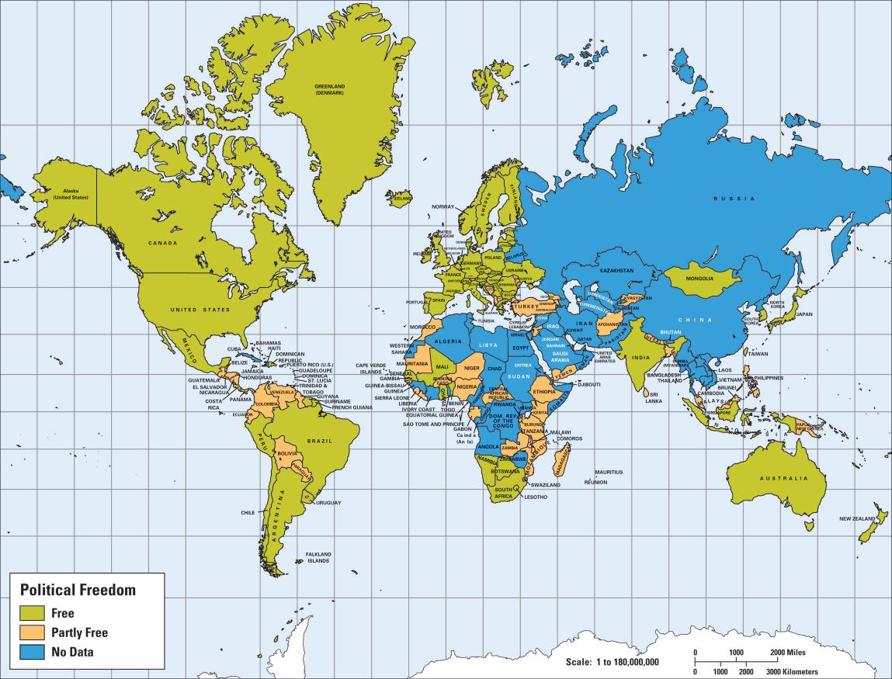
Map 2.5: Political Freedom in 2006

Slide 12
The Nature Of Economic Transformation
The shift toward a market-based system involves:
Deregulation – removing legal restrictions to the free play of markets, the establishment of private enterprises, and the manner in which private enterprises operate
Privatization - transfers the ownership of state property into the hands of private investors
The creation of a legal system to safeguard property rights
Notes:
The shift toward a market-based system involves:
Deregulation- involves removing legal restrictions to the free play of markets, and allowing the establishment and operations of private enterprises.
Privatization- transfers the ownership of state property into the hands of private individuals, frequently by the sale of state assets through an auction.
Privatization -is seen as a way to unlock gains in economic efficiency by giving new private owners a powerful ­incentive—the reward of greater profits—to search for increases in productivity, to enter new markets, and to exit losing ones.
Without a legal system that protects property rights, and without the machinery to enforce that system, the incentive to engage in economic activity can be reduced substantially.

Slide 13
Implications For Managers
There are two broad implications for managers:
the political, economic, and legal systems of a country raise important ethical issues that have implications for the practice of international business
the political, economic, and legal environment of a country clearly influences the attractiveness of that country as a market and/or investment site

