Slide 1
CHAPTER 4
DIFFERENCES IN CULTURE

Slide 3
What is Culture?
A system of values and norms that are shared by a group of people.
Culture, when together, design a way of living .

Slide 4
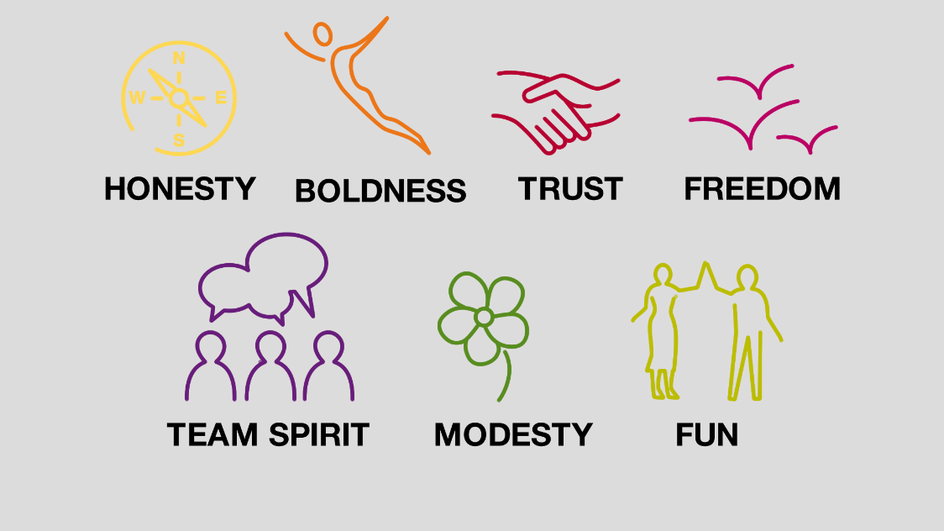
Values
They provide the context within which a society’s norms are established.
They include society’s attitude towards concepts such as democracy, role of women, love, sex, etc.
They are often reflected in the political and economic system of a society

Slide 5
Norms
They are social rules that govern people’s actions toward one another.
2 categories:
Folkways – routine conventions of everyday life such as: good social manners, eating with the right utensils, and so on. Not necessarily punishable if not followed.
Mores – norms that are seen as central to the functioning of a society. E.g. accusations against theft, adultery, incest and so on. Punishable if not followed.

Slide 6
Society
A group of people who share a common set of values and norms

Slide 7
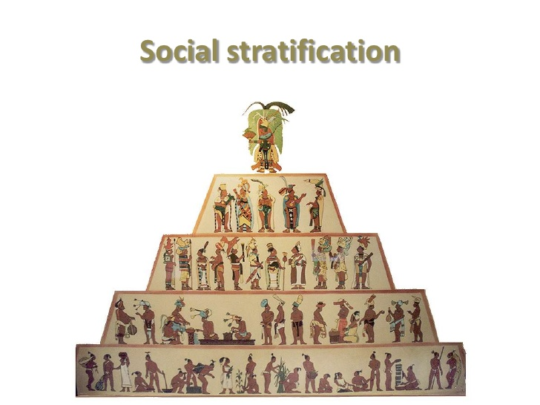
Determinants of Culture: SOCIAL STRATIFICATION
All societies are stratified on a hierarchical basis into social categories, or social strata
Characteristics such as family background, occupation and income
Individuals are born into a particular stratum.
They become member of the social category to which their parents belong to.

Slide 8
Determinants of Culture: SOCIAL MOBILITY
The extent to which people can move out of the strata or social category they were born into.
caste system - social position is determined by the family into which a person is born
change is usually not possible during an individual's lifetime
class system - form of open social stratification
position a person has by birth can be changed through achievement or luck
Class consciousness: where people tend to perceive themselves in terms of their class background, and this shapes their relationships with others

Slide 9
CLASS Consciousness VS FALSE Consciousness

Slide 10
Determinants of Culture: SOCIAL STRUCTURE
Social Structure refers to the basic social organization.
2 aspects are important in explaining differences between cultures:
The degree to which social organization is focused on the individual, as opposed to the group. E.g. Western societies tend to emphasize the primacy of the individual.
The degree to which a society is stratified into classes or castes. E.g. Indian (high degree of social stratification and low mobility between strata); American (low degree of social stratification and high mobility between strata).

Slide 11
Determinants of Culture: INDIVIDUALS & GROUPS
THE INDIVIDUAL
In Western societies, there is a focus on the individual
individual achievement is common
dynamism of the U.S. economy
high level of entrepreneurship
But, creates a lack of company loyalty and failure to gain company specific knowledge
competition between individuals in a company instead of team building
less ability to develop a strong network of contacts within a firm

Slide 12
Determinants of Culture: INDIVIDUALS & GROUPS
THE GROUP: Association of two or more individuals who have a shared sense of identity and who interact with each other on a common set of expectations.
In many Asian societies, the group is the primary unit of social organization
discourages job switching between firms
encourages lifetime employment systems
leads to cooperation in solving business problems
But, might also suppress individual creativity and initiative .

Slide 13
Religious & Ethical Systems
RELIGION
A system of shared beliefs and rituals that are concerned with the realm of the sacred.

Slide 14
Religions in the World Map

Slide 15
Christianity
It is the world’s largest religion. Found throughout Europe, the Americas, and other countries settled by Europeans
2 major Christian Organizations:
The Roman Catholic Church – accounts for more than half of all Christians.
The Orthodox Church – while less influential still of major importance in several countries such as Greece and Russia.

Slide 16
Islam
It is the world’s second largest religion
Islamic fundamentalism is associated in the Western media with militants, terrorists, and violent upheavals, but in fact Islam teaches peace, justice, and tolerance.
Fundamentalists, who demand rigid commitment to religious beliefs and rituals, have gained political power in many Muslim countries, and blame the West for many social problems.
People do not own property, but only act as stewards for God
people must take care of that which they have been entrusted with
Supportive of business, but the way business is practiced is prescribed

Slide 17
Hinduism
practiced primarily on the Indian sub-continent
focuses on the importance of achieving spiritual growth and development
Hindus are valued by their spiritual rather than material achievements
promotion and adding new responsibilities may not be important, or may be infeasible due to the employee's caste

Slide 18
Confucianism
ideology practiced mainly in China
teaches the importance of attaining personal salvation through right action
high morals, ethical conduct, and loyalty to others are stressed
three key teachings of Confucianism - loyalty, reciprocal obligations, and honesty - may all lead to a lowering of the cost of doing business in Confucian societies

Slide 19
Language: SPOKEN LANGUAGE
countries with more than one language often have more than one culture
English is the most widely spoken language in the world
Chinese is the mother tongue of the largest number of people
English is also becoming the language of international business
knowledge of the local language is still beneficial

Slide 20
Language: UNSPOKEN LANGUAGE
Refers to non-verbal communication
Failing to understand the nonverbal cues of another culture can lead to communication failure
E.g. making a circle with the thumb and the forefinger is a friendly gesture in the United States, but it is a vulgar sexual invitation in Greece and Turkey.

Slide 21
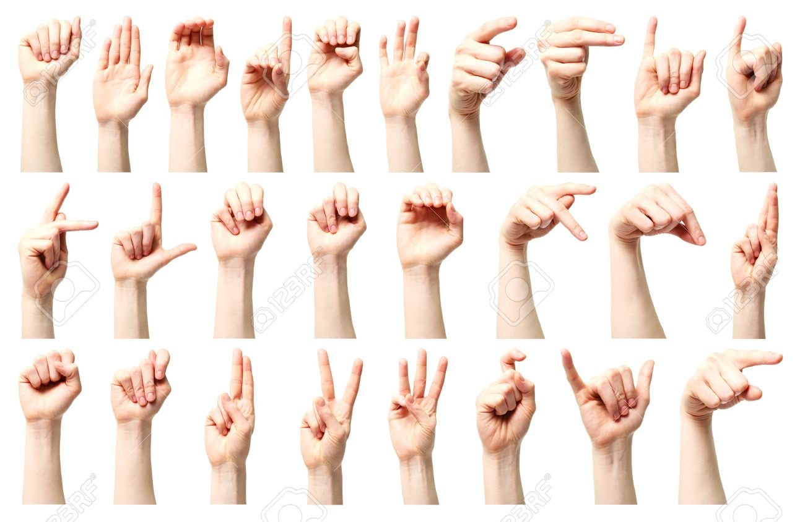

Slide 22
Role of Education in Culture
Individuals learn many of the language, conceptual, and mathematical skills that are indispensable in a modern society
important in determining a nation’s competitive advantage
general education levels can be a good index for the kinds of products that might sell in a country

Slide 23
Culture and its impact on the Workplace
Management processes and practices must be adapted to culturally determined work-related values
Hofstede’s Cultural Dimensions

Slide 24
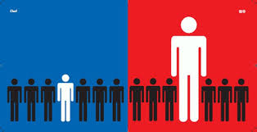
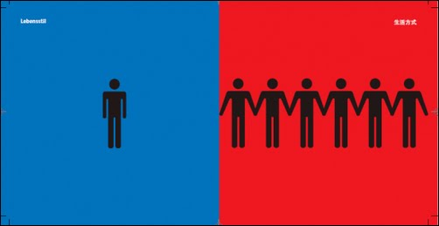
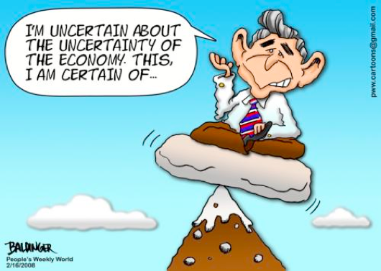
Hofstede’s Cultural Dimensions
Power Distance
Individualism Vs. Collectivism
Uncertainty Avoidance
Masculinity Vs. Femininity

Slide 25
Hofstede’s Cultural Dimensions

Slide 26
Was Hofstede Right?
Hofstede later expanded added a fifth dimension called Confucian dynamism
captures attitudes toward time, persistence, ordering by status, protection of face, respect for tradition, and reciprocation of gifts and favors
Hofstede’s work has been criticized because
made the assumption there is a one-to-one relationship between culture and the nation-state (many countries can have more than one culture)
study may have been culturally bound (research team composing of Europeans & Americans)
used IBM as sole source of information
culture is not static – it evolves
But, it is a starting point for understanding how cultures differ, and the implications of those differences for managers

Slide 27
Implications For Managers?
It is important to develop cross-cultural literacy
companies that are ill informed about the practices of another culture are unlikely to succeed in that culture
managers must be aware of ethnocentric behavior, or a belief in the superiority of one's own culture
There is a connection between culture and national competitive advantage
suggests which countries are likely to produce the most viable competitors
has implications for the choice of countries in which to locate production facilities and do business

