Slide 1
CHAPTER 6
INTERNATIONAL TRADE THEORY

Slide 2
TRADE THEORY: Overview
Free Trade – situation where a government does not attempt to restrict trading of goods and services within countries.
In the world of International Trade, there are always winners and losers.
Economists argue that in the long-run free trade stimulates economic growth, and in turn living standards.

Slide 3
BENEFITS OF TRADE
A country’s economy may gain if its citizens buys certain products from other nations, even if they themselves are capable of producing them.
This is because International Trade allows a country to specialise in the production & export of certain products according to their efficiency level.
EXAMPLE: United States specialising in the production & export of jet aircraft as they have skilled labour force in that field.

Slide 4
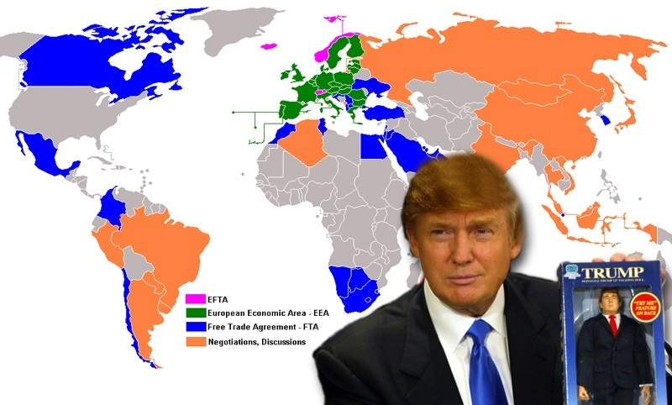

Slide 6
THE PATTERN OF INTERNATIONAL TRADE
Some aspects of the pattern are easy to understand.
Ex: Ghana exports cocoa because their climate and natural resources are favourable for cocoa plantation.
On the other hand, some aspects are not.
Ex: Why does Switzerland export watches?
Theory of comparative advantage offers an explanation.
The Heckscher-Ohlin theory emphasises the interplay between the proportions in which the factors of production are available in a country.

Slide 8
THE PATTERN OF INTERNATIONAL TRADE: New Trade Theory
Developed by Paul Krugman during the 1980’s.
This theory states that in some cases countries specialise in the production and export of particular products not because of underlying differences in factor of production, but because in certain industries the world market can support only a limited number of firms.
First-mover advantage
Ex: the US is a major exporter of commercial jet airplanes because American firms such as Boeing were first movers in the world market.

Slide 9
MERCANTILISM
The principle assertion was that gold and silver were the mainstays of national wealth.
It is in the country’s best interest to have a trade-surplus.
The flaw of Mercantilism is that it viewed trade as a zero-sum game. [Discuss example from pg 179]
Neo-mercantilists: equate political power with economic power, and economic power with trade-surplus.
China deliberately keeping its currency low against the United States in order to sell more goods to the US.

Slide 10
ABSOLUTE ADVANTAGE
Adam Smith, 1776
Absolute advantage: a country has an absolute advantage in the production of goods and services when it is more efficient than any other country in producing it.
Production Possibility Frontier [refer to fig 6.1]

Slide 11
COMPARATIVE ADVANTAGE
David Ricardo, 1817
A country should specialise in the production of those goods that it produces most efficiently.

Slide 12
FREE TRADE: Qualifications & Assumptions
The free trade model makes a few unrealistic assumptions:
A world consisting of only 2 countries and 2 goods
We did not take transportation cost into account
We have not taken exchange rate into account
Free movement of resources have been assumed.
We have assumed constant returns to scale. The amount of goods required to produce a good might decrease or increase as a nation specialises.
A country may make use of its limited resources in a more efficient manner.
Effects of trade on income distribution.

Slide 13
HECKSCHER-OHLIN THEORY
This theory argues that comparative advantage arises from the differences in national factor endowments of a country.
Factor Endowments: the extent to which a country is endowed with resources such as land, labour, and capital.
Countries will export those goods that make use of factors that are locally abundant.
Countries will import those goods that make use of factors that are locally scarce.
EXAMPLE: Bangladesh excels in the export of goods produced in labour-intensive textile industry reflecting the country’s abundance of low-cost labour.

Slide 14
THE PRODUCT LIFE-CYCLE THEORY
Early in the product life-cycle, demand for a product will rise rapidly in the home country, but its demand will be limited to the high income group in other developed countries.
Overtime the overseas demand increases making it worthwhile for the domestic producer to start producing in the foreign developed countries. A certain level export still exists from the home country.
In the long run demand in the overseas market may exceed that of the local market which may cause the producer to shift their production facilities overseas.

Slide 15
THE PRODUCT LIFE-CYCLE THEORY: EVALUATION
Historically the product life-cycle theory seems to be an accurate one.
The Xerox example (pg. 192)

Slide 16
PORTER’S DIAMOND MODEL: An Explanation for the National Competitive Advantage
Porter theorizes that six broad attributes of a nation shape the environment in which the local firms compete, and these attributes promote or impede the creation of competitive advantage.
The attributes are:
Factor endowments: are human resources, physical resources, knowledge resources, capital resources and infrastructure. Specialized resources are often specific for an industry and important for its competitiveness.
Demand conditions: in the home market can help companies create a competitive advantage, when sophisticated home market buyers pressure firms to innovate faster and to create more advanced products than those of competitors.
Related and supporting industries: can produce inputs that are important for innovation and internationalization. These industries provide cost-effective inputs, but they also participate in the upgrading process, thus stimulating other companies in the chain to innovate.

Slide 17
PORTER’S DIAMOND MODEL: An Explanation for the National Competitive Advantage
The attributes are:
Firm strategy, structure and rivalry: is the way in which companies are created, set goals and are managed is important for success. But the presence of intense rivalry in the home base is also important; it creates pressure to innovate in order to upgrade competitiveness.
Government: can influence each of the above four determinants of competitiveness. Clearly government can influence the supply conditions of key production factors, demand conditions in the home market, and competition between firms.
Chance events: are occurrences that are outside of control of a firm. They are important because they create discontinuities in which some gain competitive positions and some lose.

