Slide 1
CHAPTER 7
THE POLOTICAL ECONOMY OF INTERNATIONAL TRADE

Slide 2
INSTRUMENTS OF TRADE POLICY: Tariffs
Taxes levied on imports that effectively raise the cost of imported products relative to domestic product.
Specific tariffs - levied as a fixed charge for each unit of a good imported
Ad valorem tariffs - levied as a proportion of the value of the imported good
Tariffs -
increase government revenues
force consumers to pay more for certain imports
are pro-producer and anti-consumer
reduce the overall efficiency of the world economy

Slide 3
INSTRUMENTS OF TRADE POLICY: Subsidies
Government payments to domestic producers.
Subsidies help domestic producers to:
compete against low-cost foreign imports
gain export markets
Consumers typically absorb the costs of subsidies.

Slide 4
INSTRUMENTS OF TRADE POLICY: Import Quotas
Restrict the quantity of some good that may be imported into a country.
Tariff rate quotas - a hybrid of a quota and a tariff where a lower tariff is applied to imports within the quota than to those over the quota. (fig: 7.1)
Voluntary Export Restraints - quotas on trade imposed by the exporting country, typically at the request of the importing country’s government. (USA – Japan example on pg 218)
A quota rent - the extra profit that producers make when supply is artificially limited by an import quota.

Slide 5
ARGUMENTS FOR GOVT. INTERVENTION
There are two main arguments for government intervention in the market:
Political arguments - concerned with protecting the interests of certain groups within a nation (normally producers), often at the expense of other groups (normally consumers)
Economic arguments - concerned with boosting the overall wealth of a nation – benefits both producers and consumers

Slide 6
GOVERNMENT INTERVENTION: Political Arguments
Protecting jobs
Protecting industries deemed important for national security
Retaliating to unfair foreign competition - when governments take or threaten to take specific actions, other countries may remove trade barriers. EXAMPLE: The U.S. govt. has used the threat of trade sanctions to try and get the Chinese govt. to enforce the intellectual property law.
Protecting consumers from “dangerous” products – limit “unsafe” products
Furthering the goals of foreign policy - preferential trade terms can be granted to countries that a government wants to build strong relations with.
Protecting the Environment – increasing environmental groups such as Friends of the earth & Sierra Club have been pressurising govt. to regulate international trade in a way that protects the environment.

Slide 7
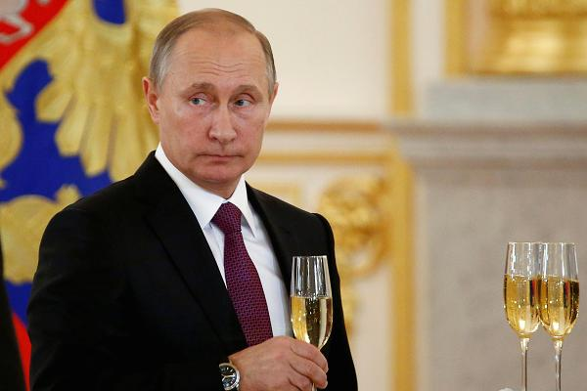

Slide 8
GOVERNMENT INTERVENTION: Economic Arguments
The infant industry argument - an industry should be protected until it can develop and be viable and competitive internationally
accepted as a justification for temporary trade restrictions under the WTO
Strategic trade policy - in cases where there may be important first mover advantages, governments can help firms from their countries attain these advantages
governments can help firms overcome barriers to entry into industries where foreign firms have an initial advantage

Slide 9
WORLD TRADE ORGANIZATION
It acts as an umbrella organization that encompasses the GATT along with two sister bodies, one on services and the other on intellectual property.
The WTO’s General Agreement on Trade in Services (GATS) has taken the lead to extending the free trade agreement to services.
The WTOs Agreement on Trade-Related Aspects of Intellectual Property Rights (TRIPS) is an attempt in the way IP rights are protected around the world and to bring them under common international rules.
WTO has taken responsibility for arbitrating trade disputes and monitoring the trade policies of member countries

Slide 10
WTO AS A GLOBAL POLICE
Between 1995 to early 2009, more than 370 trade disputes between member countries have been brought to the WTO
Of these, three fourths had been resolved by informal consultations between the disputing countries. Resolving the remainder has involved more formal procedures.
In general, countries have adopted the WTO’s recommendations
The fact that countries are using the WTO’s recommendations represents an important vote of confidence in the organization’s dispute resolution procedures.

Slide 11
CURRENT AGENDA OF THE WTO
the rise of anti-dumping policies
reductions in high-tariffs on agricultural goods
the lack of strong protection for intellectual property rights in many nations
continued high tariffs on non-agricultural goods and services in many nations

Slide 12
THE FUTURE OF WTO
The WTO launched a new round of talks at Doha, Qatar in 2001
The agenda includes:
cutting tariffs on industrial goods and services
phasing out subsidies to agricultural producers
reducing barriers to cross-border investment
limiting the use of anti-dumping laws

Slide 13
WHAT DO TRADE BARRIERS MEAN FOR MANAGERS
Managers need to consider how trade barriers affect the strategy of the firm and the implications of government policy on the firm
Trade barriers raise the cost of exporting products to a country
Voluntary export restraints (VERs) may limit a firm’s ability to serve a country from locations outside that country
To conform to local content requirements, a firm may have to locate more production activities in a given market than it would otherwise
Managers have an incentive to lobby for free trade, and keep protectionist pressures from causing them to have to change strategies

