Slide 1
WELCOME
SERVICES MARKETING
(MKT412)

Slide 2
MAHTAB MUNTAZERI (Mbt)
Lecturer,
Department of Marketing & INB
School of Business & Economics,
North South University.
CONTACTS
Office: NAC727
Consultation Hour :
TBA
Email: mahtab.muntazeri@northsouth.edu
Website: http://mahtab-nsu.weebly.com

Slide 3
Communication
Please utilize the class time in a best possible way.
Office hours are there for your academic help. But remember, it requires your preparation as well.
You MUST be professional in writing e-mails.
There’s a Facebook group called “Mbt class update” for providing urgent notices and sharing of academic contents. However, social media communication will be limited to this group only.

Slide 4
Course Readings
Text book
Author | Title | Edition & Year | Publisher | ISBN
Christopher Lovelock, Jochen Wirtz and Jayanta Chatterrjee | Services Marketing- People, Technology, Strategy | 7th, 2007 | Prentice Hall | 0131875523

Slide 5
Course Evaluation
Assessment Strategy and Grading Scheme
Grading tool | Points
Attendance & Participation | 5%
Quizzes | 10%
Case/Role-play | 5%
Workshop | 5%
Individual assignment | 5%
Mid-Term 1 | 15%
Mid-Term 2 | 15%
Final | 20%
Group project | 20%

Slide 6
Grading Policy
Numerical Scores | Letter Grade | Grade Points
93 and above | A | 4.0
90 - 92 | A- | 3.7
87 - 89 | B+ | 3.3
83 - 86 | B | 3.0
80 - 82 | B- | 2.7
77 - 79 | C+ | 2.3
73 - 76 | C | 2.0
70 - 72 | C- | 1.7
67 - 69 | D+ | 1.3
60 - 66 | D | 1.0
Below 60 | F | 0.0
 | I** Incomplete | 0.0
 | W** Withdrawal | 0.0

Slide 7
YOUR GRADE IS YOUR ACHIVEMENT. ABSOLUTELY BASED ON YOUR PERFORMANCE, NOTHING ELSE.
Grading Policy

Slide 8
Policies to follow…
Attendance & Participation- Maximum of two missed classes will be excused and after that 1 marks will be deducted for each missed class. There will NOT be any late attendance.
Etiquette- Please be quiet during lectures unless, of course, class participation is required. And be punctual.

Slide 9
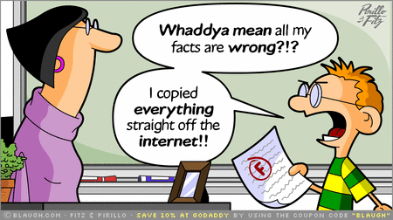
Policies to follow…
Plagiarism: If any information is taken from any sources, it must be referenced properly. Plagiarism may result in a “Fail” grade.

Slide 10
Exam Policies
All exam related information will be provided in the class in due course. However, please don’t ask for “suggestion”. You need to understand all the topics and prepare yourselves accordingly.
Make-up Exam- Only extreme situations might be “considered”. Any make-up taken will be comprehensive. There is NO make-up for quizzes, debate, case works & final project.
Students must remain in their own class & section for all the exams & course work.

Slide 11
Policies to follow…

Slide 12
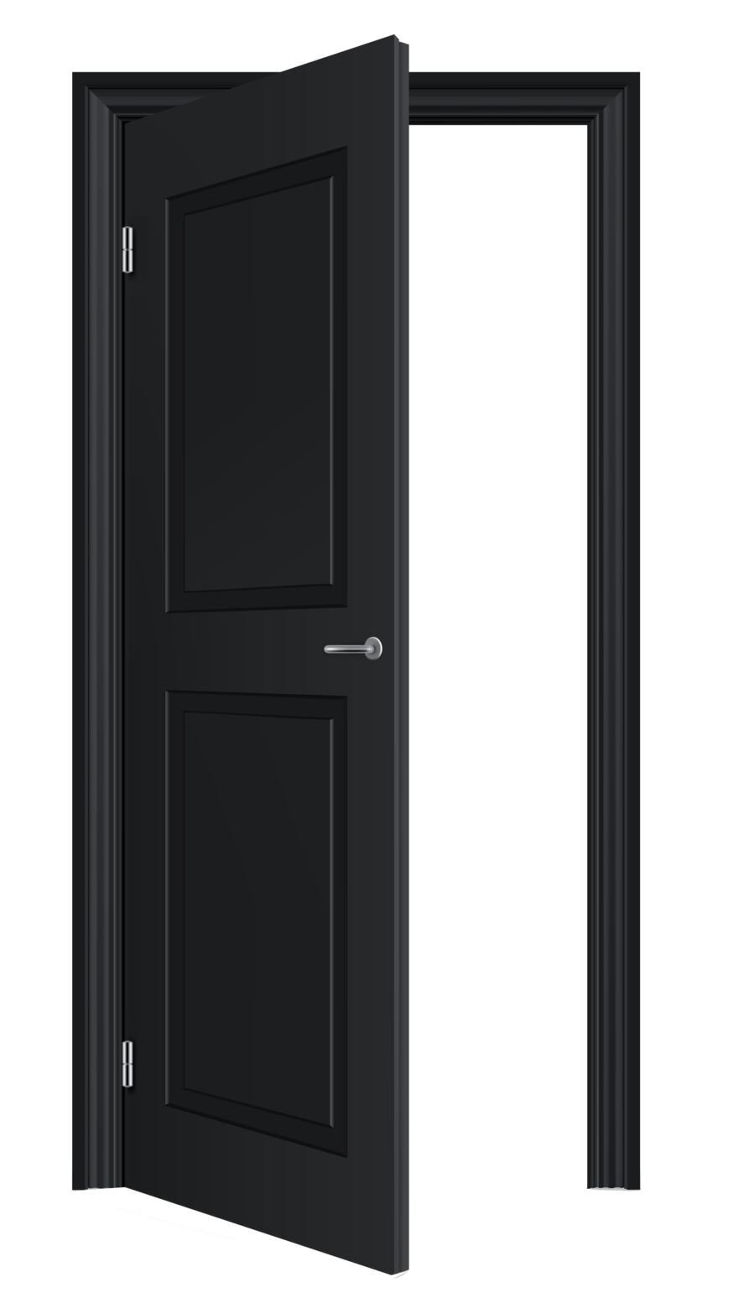
5 minutes!! !!

Slide 13
Please refer to course outline for all necessary required information.

