Slide 1
Lecture 1
Entrepreneurs – Who are they and what makes them tick?
(Let us go behind the mind of an entrepreneur and see how they think)

Slide 2
what is an ‘Entrepreneur’
An individual who takes initiative to bundle resources in innovative ways and is willing to bear the risk and/or uncertainty to act.
Being an entrepreneur today:
Involves creation process.
Requires devotion of time and effort.
Involves rewards of being an entrepreneur.
Requires assumption of necessary risks

Slide 3
an entrepreneurial action
Behavior in response to a judgmental decision under uncertainty about a possible opportunity for profit.

Slide 4
vs employees
Employees
■ people who work for someone else for a fixed income
Additional earnings go to the business owner, not to the employee.
Entrepreneurs
■ You take your own risk to do your own thing in your own time.
■ Its not all fun!!

Slide 5
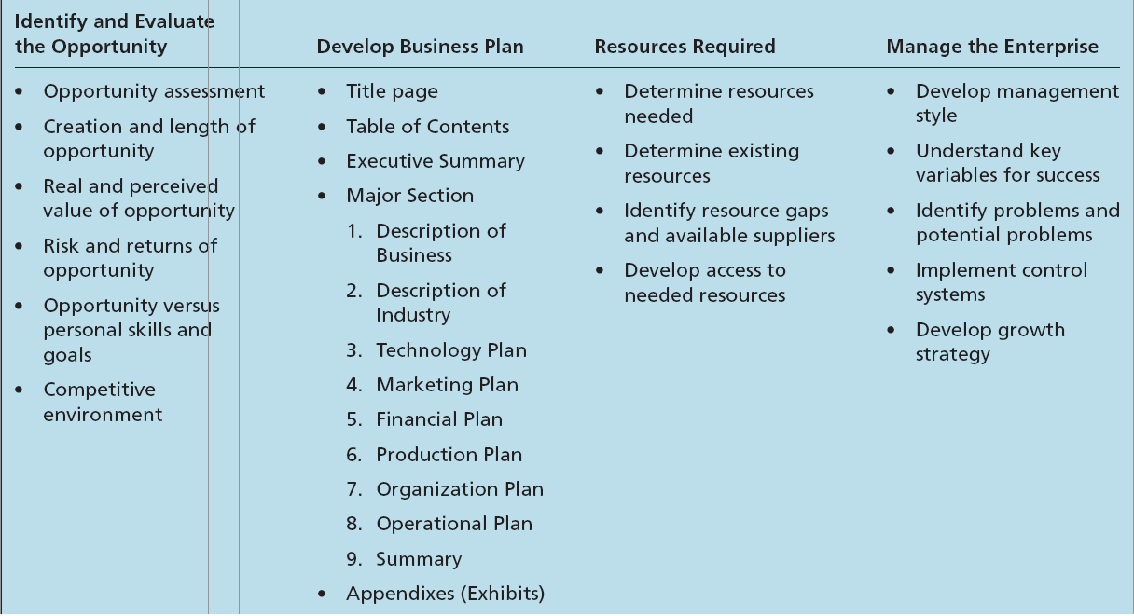
Table 1.1 - Aspects of the Entrepreneurial Process

Slide 6
There are TWO ways to go about it
WHERE TO START?
Causal process
INTERNAL
Starts with a desired outcome.
Focuses on the means to generate that outcome.
Effectuation process
Starts with what one has (who they are, what they know, and whom they know) – Self assessment
Selects among possible outcomes

Slide 7
TASK
SELF ASSESSMENT
LOOK WITHIN YOU AND JOT DOWN ALL YOUR STRENGHTS AND WEEKNESSES

Slide 8
Opportunity identification
The process by which an entrepreneur comes up with the opportunity for a new venture.
Market size and the length of the window of opportunity are the primary bases for determining risks and rewards.
(Window of opportunity - The time period available for creating the new venture)
WHERE TO START?
EXTERNAL

Slide 9
OPPORTUNITY
AN ENTREPRENEUR’S JOB IS TO:
CAPABILITY

Slide 10
COGNITIVE ADAPTABILITY
Cognitive adaptability describes the extent to which entrepreneurs are:
Dynamic, flexible, self-regulating and engaged in the process of generating multiple decision frameworks focused on sensing and processing changes in their environments and then acting on them.
It reflects in an entrepreneur’s metacognitive awareness.
When faced with a decision

Slide 11
What aids your cognitive adaptability?
Achieving cognitive adaptability
Comprehension questions – Aids understanding of the nature of the environment before addressing an entrepreneurial challenge.
Connection tasks – Stimulates thinking about the current situation in terms of similarities and differences with situations previously faced and solved.
Strategic tasks – Stimulates thoughts about which strategies are appropriate for solving the problem (and why) or pursuing the opportunity (and how).
Reflection tasks – Stimulates thinking about their understanding and feelings as they progress through the entrepreneurial process.

Slide 13
Learning from failures
Uncertainty, changing conditions, and insufficient experience can contribute to failure among entrepreneurial firms.
An entrepreneur’s motivation is not simply from personal profit but from:
Loyalty to a product.
Loyalty to a market and customers.
Personal growth.
The need to prove oneself.

Slide 14
Learning from failures (Loss orientation)
Loss-Orientation
Involves working through, and processing, some aspect of the loss experience and, as a result of this process, breaking emotional bonds to the object lost.
This process gradually provides the loss with meaning and eventually produces a changed viewpoint.
Involves confrontation, which is physically and mentally exhausting.
Characterized by feelings of relief and pain that wax and wane over time.

Slide 15
Learning from failures (Restoration orientation)
Restoration-Orientation
Based on both avoidance and a proactiveness toward secondary sources of stress arising from a major loss.
Involves suppression, which requires mental effort and presents potentially adverse consequences for health.
Provides an opportunity to address secondary causes of stress.
May reduce emotional significance of the loss.

Slide 16
ETHICS
Entrepreneurs usually develop an internal ethical code.
Personal value systems tend to be influenced by:
Peer pressure.
General social norms in the community.
Pressures from their competitors.
Business ethics - The study of behavior and morals in a business situation.

Slide 17
Entrepreneurship in economic development
Innovation is depicted as a key to economic development.
Product-evolution process - Process through which innovation is developed and commercialized.
Iterative synthesis - The intersection of knowledge and social need that starts the product development process.

