Slide 1
Growth strategies
Where do we go from here?

Slide 2
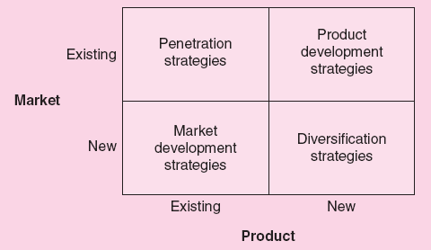
Growth strategy: Ansoff Matrix

Slide 3
Ansoff Matrix
Penetration Strategy
A strategy to grow by encouraging existing customers to buy more of the firm’s current products.
Marketing can be effective in encouraging frequent repeat purchases.
Does not involve anything new for the firm.
Relies on taking market share from competitors and/or expanding the size of the existing market.

Slide 4
Ansoff Matrix
Market Development Strategies
Strategy to grow by selling the firm’s existing products to new groups of customers.
New geographical market - Selling in new locations.
New demographic market - Selling to a different demographic group.
New product use - Selling an existing product, which may have a new use, to new groups of buyers.

Slide 5
Ansoff Matrix
Product Development Strategies
A strategy to grow by developing and selling new products to people who are already purchasing the firm’s existing products.
Provides opportunities to capitalize on existing distribution systems and on the corporate reputation the firm has with these customers.

Slide 6
Ansoff Matrix
Diversification Strategies
A strategy to grow by selling a new product to a new market.
Backward integration - A step back (up) in the value-added chain toward the raw materials.
Forward integration - A step forward (down) in the value-added chain toward the customers.
Horizontal integration - Occurs at the same level of the value-added chain but simply involves a different, but complementary, value-added chain.

Slide 7
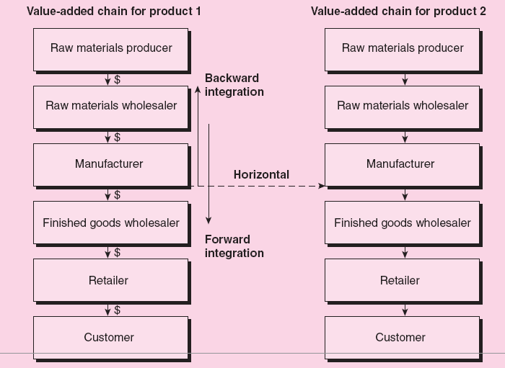
Types of integration

Slide 8
Implications of growth to the firm
Pressures on Existing Financial Resources
Firm’s resources can become stretched quite thin.
Pressures on Human Resources
Problems of employee morale, employee burn out, and an increase in employee turnover.
Pressures on the Management of Employees
May require change in management style and in dealing with employees.
Pressures on Entrepreneur’s Time
Diverting time to several activities can cause problems.

Slide 9
Overcoming the pressure
To overcome pressures, the entrepreneur could acquire new resources.
The acquisition of new resources is expensive, whether in terms of the equity sold or the interest payments from debt.
The need or the magnitude of the new resources required can be reduced through better management of existing resources.

Slide 10
Grow your business Internationally

Slide 11
To start of…
To start of, you need to make some decisions. As a business, answer the following three questions:
Which market to enter?
When to enter and on what scale?
Which Entry mode strategy?

Slide 12
1. Which market to enter?
Several factors affect the choice of entry mode including
transport costs
trade barriers
political risks
economic risks
costs
firm strategy
The optimal mode varies by situation – what makes sense for one company might not make sense for another
The choice of foreign markets will depend on their long run profit potential
Favorable markets
are politically stable
have free market systems
have relatively low inflation rates
have low private sector debt
Less desirable markets
are politically unstable
have mixed or command economies
have excessive levels of borrowing
Markets are also more attractive when the product in question is not widely available and satisfies an unmet need

Slide 13
2. When to enter and on what scale?
Early entrant vs late entrant
High vs low investment

Slide 14
3. International Growth Strategies (Mode of entry)
Exporting
Turnkey Operation
Licensing
Franchising
Joint Venture
Mergers
Acquisitions
Greenfield Investment

Slide 15
Exporting
Exporting is attractive because
it avoids the costs of establishing local manufacturing operations
Exporting is unattractive because
there may be lower-cost manufacturing locations
high transport costs and tariffs can make it uneconomical
agents in a foreign country may not act in exporter’s best interest

Slide 16
Turnkey Projects
Turnkey projects are attractive because
they are a way of earning economic returns from the know-how required to assemble and run a technologically complex process
they can be less risky than conventional FDI
Turnkey projects are unattractive because
the firm has no long-term interest in the foreign country
the firm may create a competitor
if the firm's process technology is a source of competitive advantage, then selling this technology through a turnkey project is also selling competitive advantage to potential and/or actual competitors

Slide 17
Licensing
Licensing is attractive because
the firm avoids development costs and risks associated with opening a foreign market
the firm avoids barriers to investment
the firm can capitalize on market opportunities without developing those applications itself
Licensing is unattractive because
the firm doesn’t have the tight control required for realizing experience curve and location economies
the firm’s ability to coordinate strategic moves across countries is limited
proprietary (or intangible) assets could be lost
to reduce this risk, use cross-licensing agreements

Slide 18
Franchising
An arrangement whereby the manufacturer or sole distributor of a trademarked product or service gives exclusive rights of local distribution to independent retailers in return for their payment of royalties and conformance to standardized operating procedures.
The person offering the franchise is known as the franchisor.
The franchisee is the person who purchases the franchise.

Slide 19
Franchising
Advantages of Franchising—to the Franchisee
Product acceptance - Has an accepted name, product, or service.
Management expertise - Managerial assistance provided by the franchisor.
Capital requirements - Up-front support can save entrepreneur significant time and capital.
Knowledge of the market - Offers experience in business and market.
Operating and structural controls – Helps in standardization and administrative controls.

Slide 20
Franchising
Advantages of Franchising—to the Franchisor
Expansion risk
Allows venture to expand quickly using little capital.
Business can be expanded nationally and even internationally.
Requires fewer employees than a non-franchised business.
Cost advantages
Supplies can be purchased in large quantities to achieve economies of scale.
Ability to commit larger sums of money to advertising.

Slide 21
Disadvantage
Disadvantages of Franchising
Inability of the franchisor to provide services, advertising, and location.
Franchisor’s failing or being bought out by another company.
Difficulty in finding quality franchisees.
Poor management can cause individual franchise failures.
The ability to maintain tight control over franchises becomes difficult as their number increases.

Slide 22
Investing in a franchise
Factors to be assessed before making the final decision:
Unproven versus proven franchise.
Financial stability of franchisee.
Potential market for the new franchise.
Profit potential for a new franchise.
Franchisors are required to make a full presale disclosure.
The franchise agreement contains the requirements and obligations of the franchisee.

Slide 23
Joint Venture
A joint venture is a separate entity that involves a partnership between two or more active participants.
Types of Joint Ventures:
Between private-sector companies.
Objectives - Entering new/ foreign markets, raising capital, cooperative research, etc.
Industry–university agreements.
Created for the purpose of doing research.
International joint ventures.
Factors in Joint Venture Success:
The accurate assessment of the parties involved to best manage the new entity.
The degree of symmetry between the partners.
The expectations of the results of the joint venture must be reasonable.
The timing must be right.

Slide 24
Acquisitions
The purchase of an entire company, or part of a company; the company no longer exists independently.
Advantages of an Acquisition
Established business.
Location.
Established marketing structure.
Cost.
Existing employees.
More opportunity to be creative.
Disadvantages of an Acquisition
Overconfidence in ability.
Key employee loss.
Overvaluation.
Synergy
“The whole is greater than the sum of its parts.”
Synergy should occur in both the business concept and the financial performance.

Slide 25
Mergers
Key concern - Legality of the purchase.
Process:
Determine the merger objectives and resulting gains for both companies.
Carefully evaluate the other company’s management.
Determine the value and appropriateness of the existing resources.
Establishing a climate of mutual trust.
Determine the value of a merger candidate.

Slide 26
Greenfield Investment
The main advantage of a greenfield venture is that it gives the firm a greater ability to build the kind of subsidiary company that it wants
But, greenfield ventures are slower to establish
Greenfield ventures are also risky

Slide 27
Which strategy is good for me?
The optimal International growth strategies depends on the nature of a firm’s core competencies
When competitive advantage is based on proprietary technological know-how
avoid licensing and joint ventures unless the technological advantage is only transitory, or can be established as the dominant design
When competitive advantage is based on management know-how
the risk of losing control over the management skills is not high, and the benefits from getting greater use of brand names is significant. Exporting and licensing is a more safer option.

Slide 28
Strategic Alliance
Strategic alliances refer to cooperative agreements between potential or actual competitors
range from formal joint ventures to short-term contractual agreements
the number of strategic alliances has exploded in recent decades
Strategic alliances are attractive because they
facilitate entry into a foreign market
allow firms to share the fixed costs and risks of developing new products or processes
bring together complementary skills and assets that neither partner could easily develop on its own
help a firm establish technological standards for the industry that will benefit the firm
But, the firm needs to be careful not to give away more than it receives

Slide 29
Stories of strategic alliance
Starbucks: According to Rebecca Larson, assistant Professor of Business at Liberty University, Starbucks partnered with Barnes and Nobles bookstores in 1993 to provide in-house coffee shops, benefiting both retailers. In 1996, Starbucks partnered with Pepsico to bottle, distribute and sell the popular coffee-based drink, Frappacino. A Starbucks-United Airlines alliance has resulted in their coffee being offered on flights with the Starbucks logo on the cups and a partnership with Kraft foods has resulted in Starbucks coffee being marketed in grocery stores. In 2006, Starbucks formed an alliance with the NAACP, the sole purpose of which was to advance the company's and the NAACP's goals of social and economic justice.
Hp and Disney – look it up!

