Slide 1
Creativity and the business idea

Slide 2
Where the heck does ideas come from?
Trends

Slide 3
Can you name a few trend you have observed in recent years?
Green - Tesla
Clean energy- e.g. Solar panels
Organic orientation- e.g. food / vegan
Economic- e.g. outsourcing, debt management
Social- e.g. Facebook
Health- e.g. medical app
Web- e.g. web 2.0

Slide 4
What other sources are there for generating new ideas?
Consumers- {study attitude and behavior}
Existing products and services- {visit stores regular, talk to consumers}
Distribution Channels {suppliers can give you insight, esp, retailers}
Federal government {patents and licenses}
Research and development {invest towards R&D}

Slide 5
Methods of generating new ideas
FGD – 8 to 14 people; non-experts; moderator. A great way to generate and screen ideas.
Brainstorming – don’t stop anyone; quantity.
Brainwriting –Problem Inventory Analysis
Problem Inventory Analysis – Deal with problems in a given product category and then asked to match brands with their problems.

Slide 6
Creative Problem Solving
Brainstorming
Reverse Brainstorming
The Checklist method – a list of questions repeated for different aspects.
Free association – it starts with a word related to the problem and then a chain of words are created.
Forced relationships: two elements are given and all combinations are talked about. (e.g. Soap and Shampoo)
Collective notebook method
The Gordon Method
Attribute listing: Lists all the attributes of a product
Big Dream Approach
Parameter Analysis – start with your limitations.

Slide 7
Illustration of Parameter Analysis

Slide 8
Types of Innovation
Breakthrough: Changes the game; shifts the industry; few in numbers.
Technological: Occurs more frequently, advancing the aforementioned breakthrough
Ordinary Innovation: happens frequently. Usually in process and not in technology.

Slide 9
Defining a new Innovation
Newness can be : in a consumer concept, a change or package or container, or a slight change or modification in the appearance of the product.
Companies also add products to their product line that are already marketed by other companies; products are new to the manufacturer but not the consumer.

Slide 10
Classification of a new product
Different entities defines “A NEW PRODUCT” differently

Slide 11
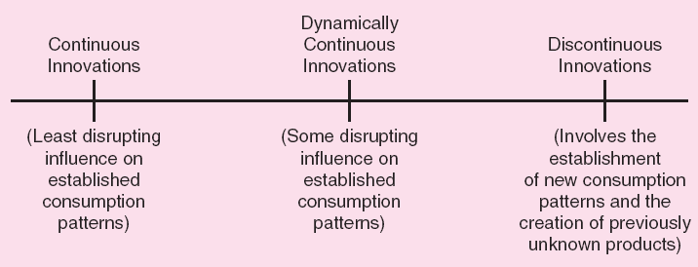
Consumer viewpoint

Slide 12
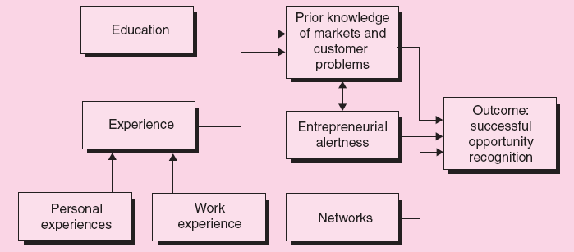

Slide 13
But remember, there always needs to be a check and balance

Slide 14
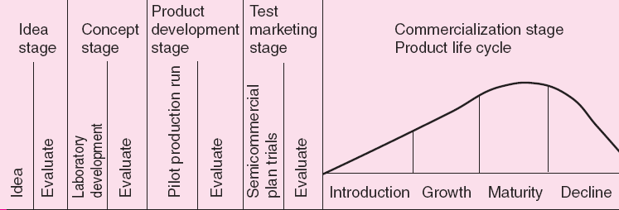
Stages of Product Development

