Slide 1
THE BUSINESS PLAN
Creating and starting your very own venture

Slide 2
Why bother with a business plan?
Provides guidance and structure in a rapidly changing business environment – every time you are confused about a decision, refer to your business plan.
They guide you both in the short and long run.

Slide 3
What is it?
A written document describing all relevant internal and external elements, and strategies for starting a new venture.
It is an integration of functional plans; addresses short-term and long-term decision making for the first three years of operation.
THIS IS YOUR MANUAL. THIS IS YOUR BIBLE!

Slide 4
Who should prepare it?
The business plan should be prepared by the entrepreneurs with consultation from other sources such as:
A lawyer
A financial advisor
Your business partners

Slide 5
The scope
Depending on who the business plan is for, the focus of the content in your business plan changes.
Regardless, when you are writing your business plan, consider:
Entrepreneur’s perspective (this is you!)
Investor’s perspective
Marketing perspective
The depth and detail of the Business Plan will depend on:
Size and scope of the proposed new venture
Size of the market
Competition
Potential growth
REMEMBER, THE BUSINESS PLAN IS ALSO A MODE OF SELF ASSESSMENT

Slide 6
How do different parties evaluate your plan?
The business plan must reflect:
The strengths of management and personnel.
The product/service.
Available resources.
Lenders are interested in the venture’s ability to pay back the debt.
Focus on the four Cs of credit - Character, cash flow, collateral, and equity contribution.
Banks want an objective analysis of the business opportunity and the risks.
Your partners wants to see what they are getting for the risk they are investing in

Slide 7
Type of investors
Personal finance
Friends and family
Angel investors
Banks and financial institution (NBFI) e.g, IDLC, Lanka Bangla, United Leasing, IPDC, IIDFC, National Finance etc.
Venture Capitalists (VC)

Slide 8
VCs’
Investors, particularly venture capitalists, have different needs:
Place more emphasis on the entrepreneur’s character.
Spend much time conducting background checks.
Demand high rates of return.
Focus on market and financial projections.
They are more involved in the business.

Slide 9
Writing is half the work…
An entrepreneur does not just write but also ‘sells’ the plan.

Slide 10
The pitch
You might have the most ground-breaking or brilliant business idea, but you are not worth *fudgecake* if you cannot communicate that.
The design of your pitch will vary depending on who you are pitching to.
Focus on why this is a good opportunity
Provide an overview of the marketing program; sales and profits
Address risks and how to overcome them.

Slide 11
The Pitch returns..
The key to a good pitch is telling a story. SO TELL A STORY!
The story of your business as it develops, grows and becomes successful.
Remember, to focus on both the positives and the negatives. Your strengths and weaknesses. Show them why you need their help. Tell them how can they be involve in the business and most importantly, SHOW THEM THE MONEY!

Slide 12
THE ELEVATOR PITCH

Slide 14
Feasibility study
Before creating a business plan, the entrepreneur must undertake a feasibility study.
Information for a feasibility study should focus on marketing, finance, and production.
Feasible, well-defined goals and objectives need to be established.
Based on this, strategy decisions can be established.

Slide 15
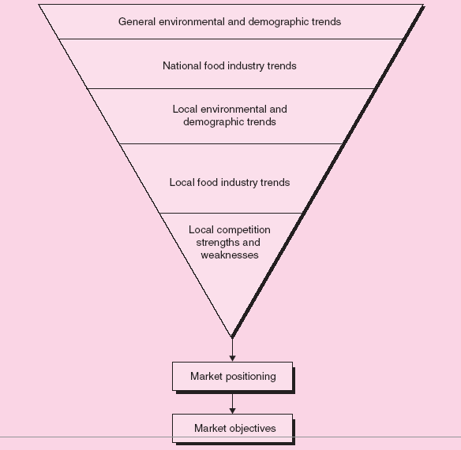
A feasibility study for a new restaurant /café business

Slide 16
Before you start with the business plan: Information needs
Operational Information Needs
Location.
Manufacturing operations.
Raw materials.
Equipment.
Labor skills.
Space.
Overhead.
Most of the information should be incorporated directly into the business plan.

Slide 17
Before you start with the business plan: Information needs
The entrepreneur has to prepare a budget of all possible expenditures and revenue sources, including sales and any external available funds.
The budget includes capital expenditures, direct operating expenses, and cash expenditures for non-expense items.
Industry benchmarks can be used in preparing the final pro forma statements in the financial plan.

Slide 18
Using the Internet
The Internet can provide information for industry analysis, competitor analysis, and measurement of market potential.
It is a valuable resource in later-stage planning and decision making; provides opportunities for marketing strategy.
An entrepreneur can access:
Popular search engines.
Competitors’ Web sites.
Social networks, blogs, and discussion groups.

Slide 19
The information you provide should:
A business plan should be comprehensive enough to give any potential investor a complete picture and understanding of the new venture.
It should help the entrepreneur clarify his or her thinking about the business.

Slide 20
THE BUSINESS PLAN

Slide 21
Introductory page
Introductory Page
Name and address of the company.
Name of the entrepreneur(s), telephone number, fax number, e-mail address, and Web site address.
Description of the company and nature of the business.
Statement of financing needed.
Statement of confidentiality of report.

Slide 22
Executive Summary
Executive Summary
About two to three pages in length summarizing the complete business plan.

Slide 23
Environmental and Industry Analysis
Environmental and Industry Analysis
The environmental analysis assesses external uncontrollable variables that may impact the business plan.
Examples: Economy, culture, technology, legal concerns, etc.
The industry analysis involves reviewing industry trends and competitive strategies.
Examples: Industry demand, competition, etc.

Slide 24
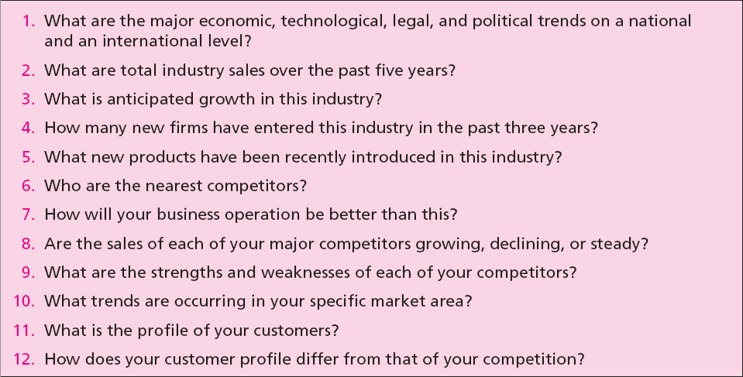
Table 7.5 - Critical Issues for Environmental and Industry Analysis

Slide 25
Describing the Venture

Slide 26
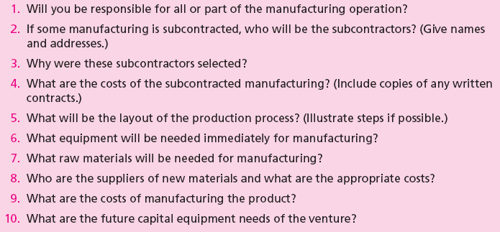
Production Plan

Slide 27
Operations Plan
Operations Plan
All businesses (manufacturing or nonmanufacturing) should include an operations plan as part of the business plan.
It goes beyond the manufacturing process.
Describes the flow of goods and services from production to the customer.
The major distinction between services and manufactured goods is services involve intangible performances.

Slide 28
Marketing Plan
Marketing Plan
It describes market conditions and strategy related to how the product/service will be distributed, priced, and promoted.
Marketing research evidence to support any of the marketing decision strategies as well as for forecasting sales should be described in this section.
Potential investors regard the marketing plan as critical to the success of the new venture.

Slide 29
Organizational Plan
Organizational Plan
It describes the form of ownership and lines of authority and responsibility of members of new venture.
In case of a partnership, the terms of the partnership should be included.
In case of a corporation, the following should be included:
Shares of stock authorized and share options.
Names, addresses, and resumes of directors and officers.
Organization chart.

Slide 30
Financial Plan
Financial Plan
It contains projections of key financial data that determine economic feasibility and necessary financial investment commitment.
It should contain:
Summarized forecasted sales and appropriate expenses for at least the first three years.
Cash flow figures for three years.
Projected balance sheet.

Slide 31
Risk Assessment
Assessment of Risk
Identifies potential hazards and alternative strategies to meet goals and objectives.
The entrepreneur should indicate:
Potential risks to the new venture.
Impact of the risks.
Strategy to prevent, minimize, or respond to the risk.
Major risks could result from:
Competitor’s reaction.
Weaknesses in marketing/ production/ management team.
New advances in technology.

Slide 32
Control/Measure
Measuring Plan Progress
Business plan projections are made on a 12-month schedule but the entrepreneur should frequently check on:
Profit and loss statement.
Cash flow projections.
Inventory control.
Production control.
Quality control.
Sales control.
Disbursements.
Web site control/web analytics.

Slide 33
Appendix
Appendix
It contains any backup material that is not necessary in the text of the document.
It may include:
Letters from customers, distributors, or subcontractors.
Secondary data or primary research data used to support plan decisions.
Leases, contracts, or other types of agreements.
Price lists from suppliers and competitors.

Slide 34
Your plan should be versatile
Updating the Plan
Entrepreneurs must be sensitive to changes in the company, industry, and market.
Determine what revisions are needed if changes are likely to affect the business plan.
This helps entrepreneurs to:
Maintain reasonable targets and goals.
Keep the new venture on a course to high probability of success.

Slide 35
Why some businesses fail
Goals are unreasonable.
Objectives are not measurable.
Entrepreneur has not made a total commitment to the business or to the family.
Lack of experience in the planned business.
No sense of potential threats or weaknesses to the business.
No customer need was established for the proposed product or service.

