Slide 1
What is a Business Environment?
The combination of internal and external factors that influence a company's operating situation.
The business environment can include factors such as: clients and suppliers; its competition and owners; improvements in technology; laws and government activities; and market, social and economic trends.

Slide 2
Types of environment
Internal environment
External environment
(i) Man
(ii) Machine
(iii) Material
(iv) Management
Micro environment
Macro environment
(a) Human resources to include jobs, hygiene, security
(b) Company Board
(c) Management structure
(a) Government
(b) Political factors
(c) Social factors
(d) Cultural factors
(e) Demographic factors
(f) Economic factors

Slide 3
Environment Analysis
Several popular frameworks exist to aid in identifying environmental factors.
They are frequently used together.
Porter's Five Forces tool is a simple but powerful tool for understanding where power lies in a business situation
The PEST or PESTEL analysis, which looks at the political, economic, social and technological factors affecting a business; sometimes environmental and legal are included.
SWOT analysis is used to look at the strengths, weaknesses, opportunities and threats affecting a business, both internally and externally

Slide 4
Porter’s Five Forces
The Porter's Five Forces tool is a simple but powerful tool for understanding where power lies in a business situation.
This is useful, because it helps you understand both the strength of your current competitive position, and the strength of a position you're considering moving into.
With a clear understanding of where power lies, you can take fair advantage of a situation of strength, improve a situation of weakness, and avoid taking wrong steps. This makes it an important part of your planning toolkit.
Conventionally, the tool is used to identify whether new products, services or businesses have the potential to be profitable. However it can be very illuminating when used to understand the balance of power in other situations.

Slide 5
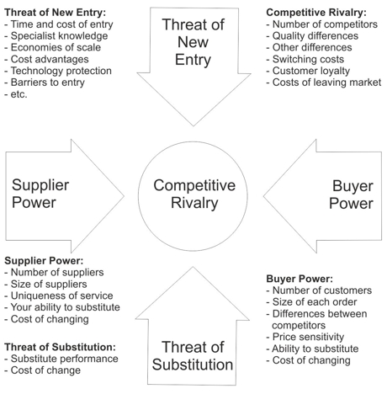
Porter’s Five Forces

Slide 6
Porter’s Five Forces
Supplier Power: Here you assess
how easy it is for suppliers to drive up prices. This is driven by the number of suppliers of each key input, the uniqueness of their product or service, their strength and control over you, the cost of switching from one to another, and so on.
The fewer the supplier choices you have, and the more you need suppliers' help, the more powerful your suppliers are.
Buyer Power: Here you ask yourself
how easy it is for buyers to drive prices down. Again, this is driven by the number of buyers, the importance of each individual buyer to your business, the cost to them of switching from your products and services to those of someone else, and so on.
If you deal with few, powerful buyers, then they are often able to dictate terms to you.

Slide 7
Porter’s Five Forces
Competitive Rivalry: What is important here is
the number and capability of your competitors. If you have many competitors, and they offer equally attractive products and services, then you'll most likely have little power in the situation, because suppliers and buyers will go elsewhere if they don't get a good deal from you.
On the other hand, if no-one else can do what you do, then you can often have tremendous strength.
Threat of Substitution: This is affected by
the ability of your customers to find a different way of doing what you do – for example, if you supply a unique software product that automates an important process, people may substitute by doing the process manually or by outsourcing it.
If substitution is easy and substitution is viable, then this weakens your power.

Slide 8
Porter’s Five Forces
Threat of New Entry: Power is also affected by
the ability of people to enter your market.
If it costs little in time or money to enter your market and compete effectively, if there are few economies of scale in place, or if you have little protection for your key technologies, then new competitors can quickly enter your market and weaken your position.
If you have strong and durable barriers to entry, then you can preserve a favorable position and take fair advantage of it.

Slide 9
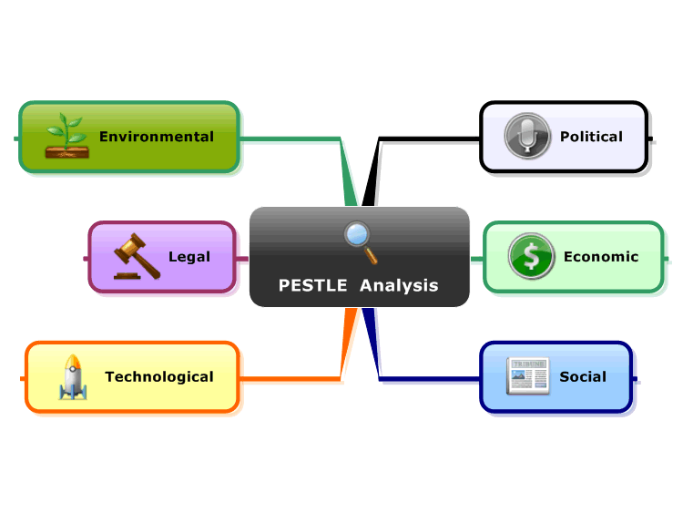
PESTLE

Slide 10
PESTLE
PESTLE analysis is in effect an audit of an organization's environmental influences with the purpose of using this information to guide strategic decision-making.
The assumption is that if the organization is able to audit its current environment and assess potential changes, it will be better placed than its competitors to respond to changes.
To help make decisions and to plan for future events, organizations need to understand the wider ‘meso-economic’ and ‘macro-economic’ environments in which they operate. (The meso-economic environment is the one in which we operate and have limited influence or impact, the macro-environment includes all factors that influence an organization but are out of its direct control).
An organization on its own cannot affect these factors, nor can these factors directly affect the profitability of an organization. But by understanding these environments, it is possible to take the advantage to maximize the opportunities and minimize the threats to the organization. Conducting a strategic analysis entails scanning these economic environments to detect and understand the broad, long term trends.
A PESTLE analysis is a useful tool for understanding the ‘big picture’ of the environment in which an organization is operating.
Specifically a PESTLE analysis is a useful tool for understanding risks associated with market (the need for a product or service) growth or decline, and as such the position, potential and direction for an individual business or organization.

Slide 11
PESTLE
Political: These factors determine the extent to which a government may influence the economy or a certain industry environment (economic environment) to a great extent.. [For example] a government may impose a new tax or duty due to which entire revenue generating structures of organizations might change. Political factors include
Trading policies
Government changes
Shareholder and their demands
Funding,
Governmental leadership
Lobbying
Foreign pressures
Conflicts in the political arena

Slide 12
PESTLE
Economic: These factors are determinants of an economy’s performance that directly impacts a company and have resonating long term effects. [For example] a rise in the inflation rate of any economy would affect the way companies’ price their products and services. Adding to that, it would affect the purchasing power of a consumer and change demand/supply models for that economy. Economic factors include
Disposable income
Unemployment level
Foreign exchange rates
Interest rates
Trade tariffs
Inflation rate
Foreign economic trends
General taxation issues
Taxation changes specific to product/services
Local economic situation and trends

Slide 13
PESTLE
Social: These factors scrutinize the social environment of the market, and gauge determinants like cultural trends, demographics, population analytics etc. An example for this can be buying trends for Western countries like the US where there is high demand during the Holiday season. Social factors includes:
Ethnic/religious factors
Advertising scenarios
Ethical issues
Consumer buying patterns
Major world events
Buying access
Shifts in population
Demographics
Health
Consumer opinions and attitudes
Views of the media
Law changes affecting
social factors
Change in Lifestyle
Brand preferences
Working attitude of people
Education
Trends
History

Slide 14
PESTLE
Technological: These factors pertain to innovations in technology that may affect the operations of the industry and the market favorably or unfavorably. This includes
Technological development
Research and development
Trends in global technological advancements
Associated technologies
Legislations in technological fields
Patents
Licensing
Access into the technological field
Consumer preferences
Consumer buying trends
Intellectual property and its laws
How mature a certain technology is
Information technology
Communication

Slide 15
PESTLE
Legal: These factors have both external and internal sides. There are certain laws that affect the business environment in a certain country while there are certain policies that companies maintain for themselves. Legal analysis takes into account both of these angles and then charts out the strategies in light of these legislations. These factors includes
Employment law
Consumer protection
Industry-specific regulations
Competitive regulations
Current legislation home market
Future legislation
Regulatory bodies and their processes
Environmental regulations

Slide 16
PESTLE
Environmental: These factors include all those that influence or are determined by the surrounding environment. This aspect of the PESTLE is crucial for certain industries particularly for example tourism, farming, agriculture etc. Factors of a business environmental analysis include but are not limited to climate, weather, geographical location, global changes in climate, environmental offsets etc. These factors are
Ecological
Environmental issues
International
National
Stakeholder/ investor values
Staff attitudes
Management style
Environmental regulations
Customer values
Market value

Slide 17
SWOT & Strategic Implications
STRENGTH
WEAKNESS
OPPORTUNITIES
SO
WO
THREATS
ST
WT
SO: UTILIZE IT MORE
WO: WORK HARDER
ST: DEFEND YOUR STRENGTH
WT: GET RID OF THEM

Slide 18
How to Use SWOT Analysis
Strengths:
What advantages does your organization have?
What do you do better than anyone else?
What unique or lowest-cost resources can you draw upon that others can't?
What do people in your market see as your strengths?
What factors mean that you "get the sale"?
What is your organization's Unique Selling Proposition (USP)?
Consider your strengths from both an internal perspective, and from the point of view of your customers and people in your market.
Weaknesses:
What could you improve?
What should you avoid?
What are people in your market likely to see as weaknesses?
What factors lose you sales?
Again, consider this from an internal and external basis: Do other people seem to perceive weaknesses that you don't see? Are your competitors doing any better than you?

Slide 19
How to Use SWOT Analysis
Opportunities:
What good opportunities can you spot?
What interesting trends are you aware of?
Useful opportunities can come from such things as:
Changes in technology and markets on both a broad and narrow scale.
Changes in government policy related to your field.
Changes in social patterns, population profiles, lifestyle changes, and so on.
Local events.
Threats
What obstacles do you face?
What are your competitors doing?
Are quality standards or specifications for your job, products or services changing?
Is changing technology threatening your position?
Do you have bad debt or cash-flow problems?
Could any of your weaknesses seriously threaten your business?

Slide 20
Stake Holders Analysis
Stakeholder Analysis is the technique used to identify the key people who have to be won over. You then use Stakeholder Planning to build the support that helps you succeed.
The benefits of using a stakeholder-based approach are that:
You can use the opinions of the most powerful stakeholders to shape your projects at an early stage. Not only does this make it more likely that they will support you, their input can also improve the quality of your project
Gaining support from powerful stakeholders can help you to win more resources – this makes it more likely that your projects will be successful
By communicating with stakeholders early and frequently, you can ensure that they fully understand what you are doing and understand the benefits of your project – this means they can support you actively when necessary
You can anticipate what people's reaction to your project may be, and build into your plan the actions that will win people's support.

Slide 21
Stake Holders Analysis
Step 1 – Identify Your Stakeholders
Your boss | Alliance partners | The press
Shareholders | Trades associations | Your team Lenders
Government | Your co-workers | Interest groups
Senior executives | Suppliers | Customers Analysts
The public | Prospective customers

Slide 22
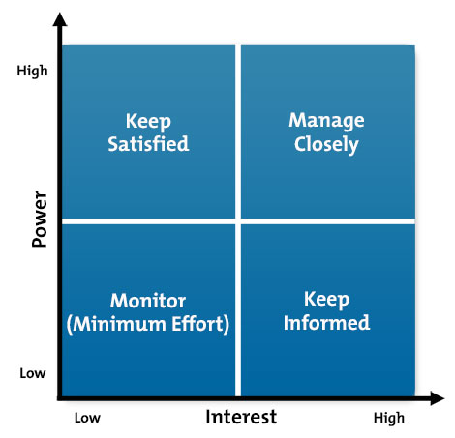
Stake Holders Analysis
Step 2 – Prioritize Your Stakeholders

