Slide 1
Marketing Plan
Welcome to Marketing

Slide 2
The Marketing Plan
A marketing plan is a business document outlining your marketing strategy and tactics. It's often focused on a specific period of time (i.e. over the next 12 months) and covers a variety of marketing-related details, such as costs, goals, and action steps.

Slide 3
WHAT IS MARKETING?
VALUE
FUCTIONAL
EXPERIENTIAL
PSYCOLOGICAL

Slide 4
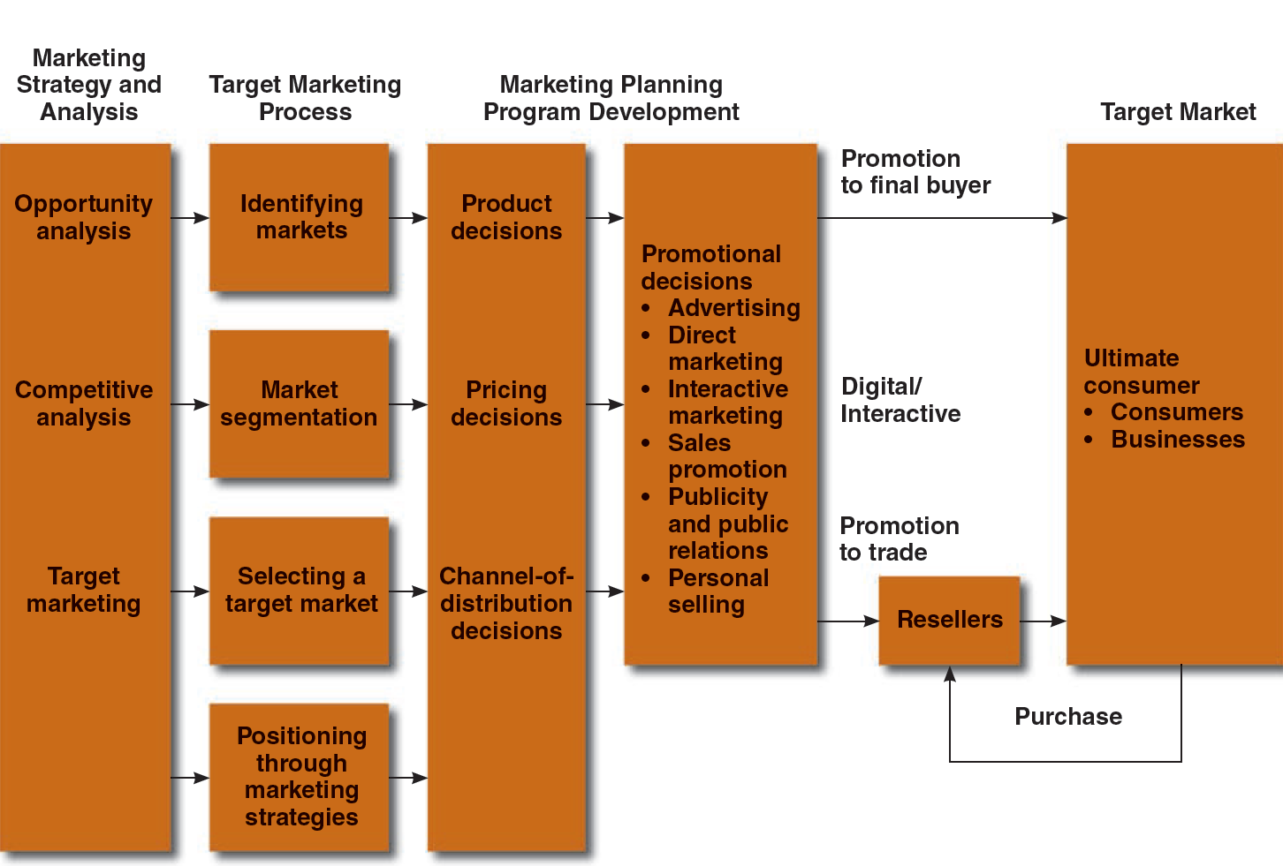
Figure 2.1 - Marketing and Promotions Process Model
2.
THE MARKETING PLAN
1.
3.
4.

Slide 5
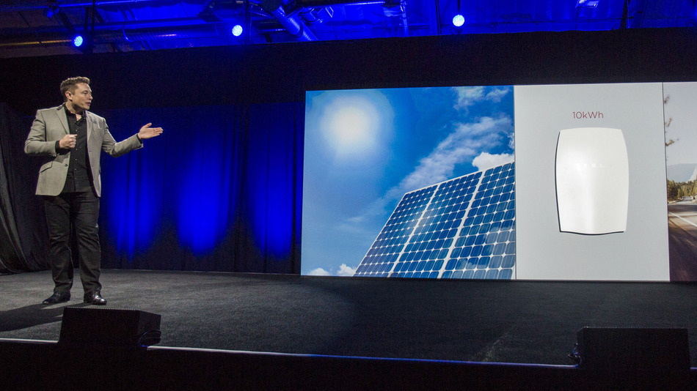
1.
Opportunity can come from a change in technology and the Macroenvironment

Slide 6
OR Opportunities can also come from competitors

Slide 7
2. THE TARGET MARKETING PROCESS

Slide 8
Market Segmentation
Dividing a market into distinct groups with common needs, who respond similarly to a marketing situation
Criteria
Geographic segmentation: Markets are divided into different geographic units
Demographic segmentation: Dividing the market on the basis age, sex, family size, education, income, and social class
Psychographic segmentation: Dividing the market on the basis of personality, lifecycles, and/or lifestyles
Behavioral Segmentation:Dividing consumers into groups according to their usage, loyalties, or buying responses to a product
Benefit Sought: Grouping of consumers on the basis of attributes sought in a product

Slide 9
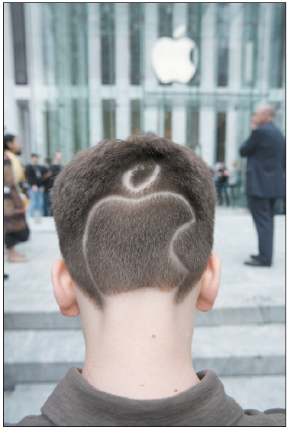
Behavioral

Slide 10
Selecting Target Market
Determine how many segments to enter
Determine which segments offer the most potential

Slide 11
Market Coverage strategies
Undifferentiated marketing
Ignoring segment differences and offering just one product or service to the entire market
Differentiated marketing
Involves marketing in a number of segments, developing separate marketing strategies for each
Concentrated marketing
Selecting a segment and attempting to capture a large share of this market

Slide 12
Positioning Strategies
Attributes & Benefits
Price /Quality
Use/Application
Product Class
Product Users
Competitors
Cultural Symbols

Slide 13
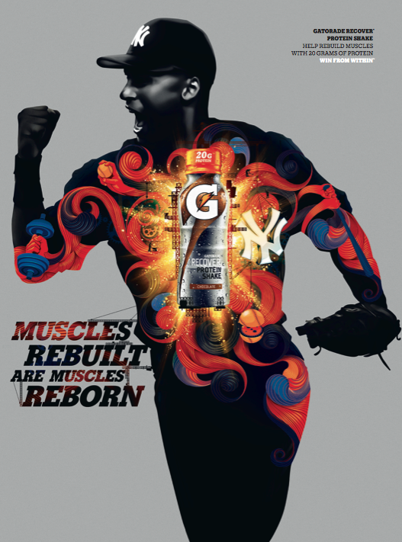
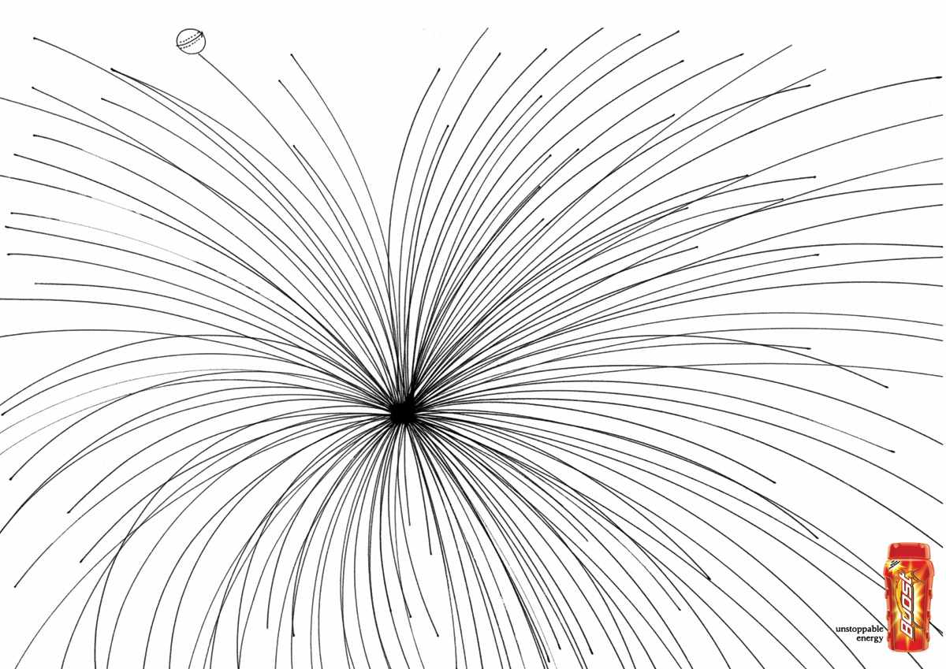
Positioning by Product Attributes & Benefits
Talks about specific characteristics and benefits offered
Salient attributes

Slide 14
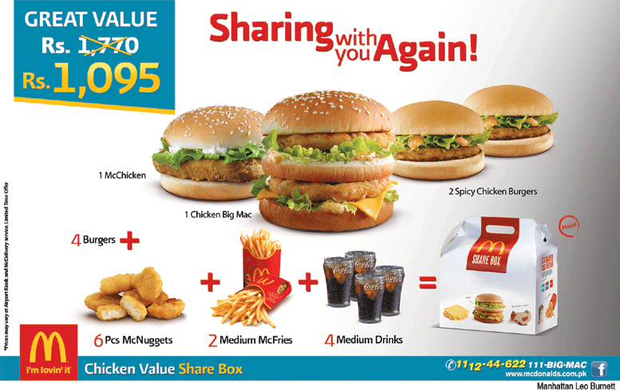
Positioning by Price/Quality
Reflects the image of a high quality brand, while cost, if not irrelevant, secondary
Product quality must reflect the high price

Slide 15
Positioning by product Class
Competition comes from outside the product class/category. This positioning tries to battle it

Slide 16
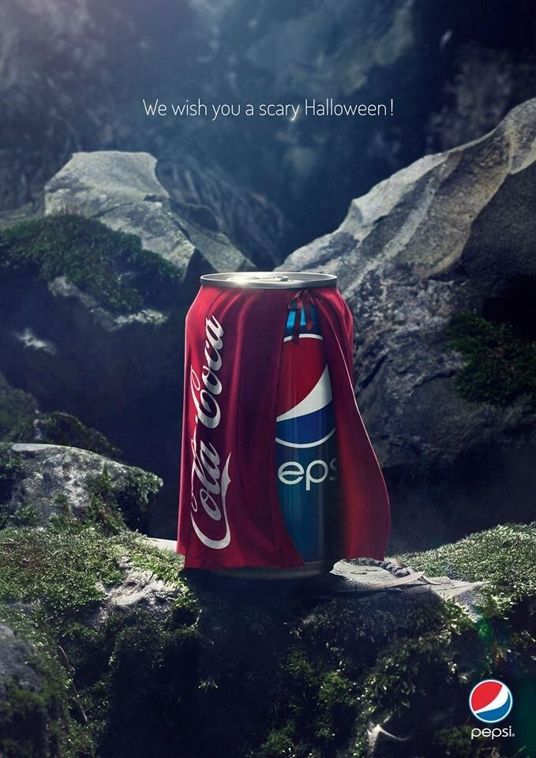
Positioning by Competitors
Position their products against the competitor’s positioning

Slide 17
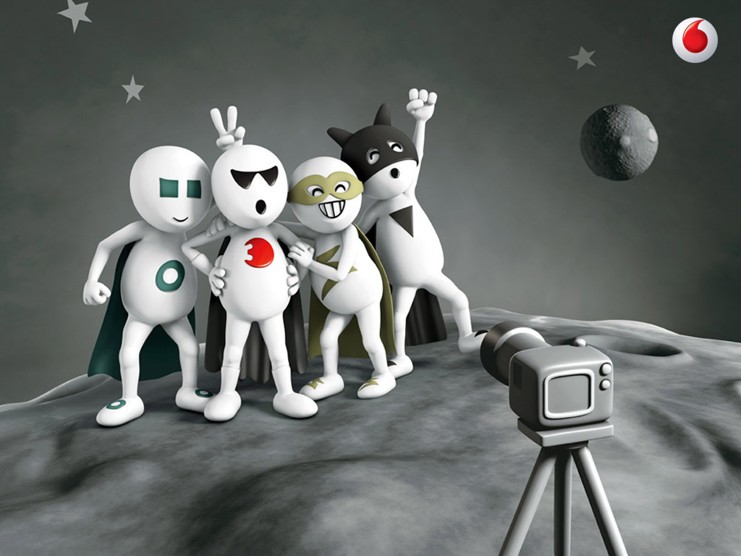
Positioning by Symbols

Slide 18
Repositioning
Altering a product’s or brand’s position due to:
Declining or stagnant sales
Anticipated opportunities in other market positions
Difficult to accomplish because of entrenched perceptions and attitudes toward the product or brand
Notes:
or declining sales or because of anticipated opportunities in other market positions.

Slide 19
Repositioning
Change target market
Change brand image

Slide 20
Product Decisions
3. MARKETING PLANNING AND PROGRAM / THE 4P DECISION
Product symbolism: Refers to:
What a product or brand means to consumers
What consumers experience in purchasing and using a product
Branding
Building and maintaining a favorable identity of the company and its products
Packaging
Provides functional benefits such as economy, protection, and storage

Slide 21
Branding
Builds and maintains brand awareness and interest
Develops and enhances attitudes toward the company or product
Builds relationships between the consumer and the brand
Brand identity: Combination of name, logo, symbols, design, packaging, and image of associations held by consumers
Brand equity: Intangible asset of added value

Slide 22
Price Decisions
Price variable - Refers to what the consumer has to give in exchange for a purchase
Factors that determine price
Costs
Demand factors
Competition
Perceived value
Product quality
Advertising
Pricing strategy for new brands:
Price Skimming
Price Penetration

Slide 23
Marketing Channels
Interdependent organizations involved in making a product or service available for use
Direct channels: Directly deal with customers
Driven by direct-response ads, telemarketing, the Internet
Used when selling expensive and complex products
Indirect channels: Network of wholesalers and/or retailers

Slide 24
Promotional Strategies
Push Strategy: Making a product and pushing it onto consumers
Pull strategy: Asking the consumers what they want, raise demand and make them pull the product.

