Slide 1
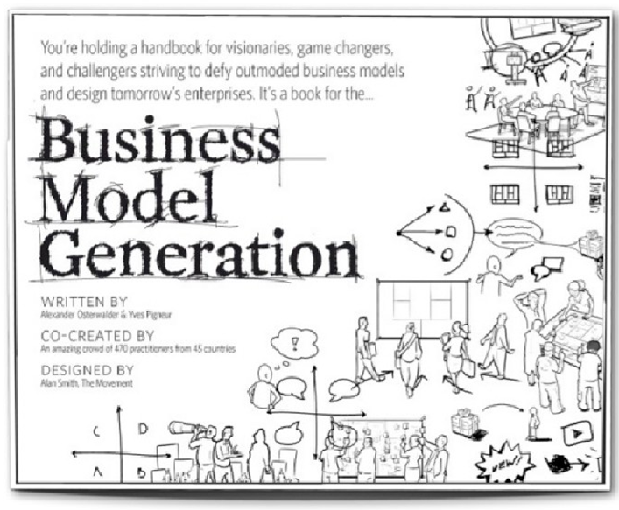
Based on
Business Model Generation
by
Alexander Osterwalder

Slide 2
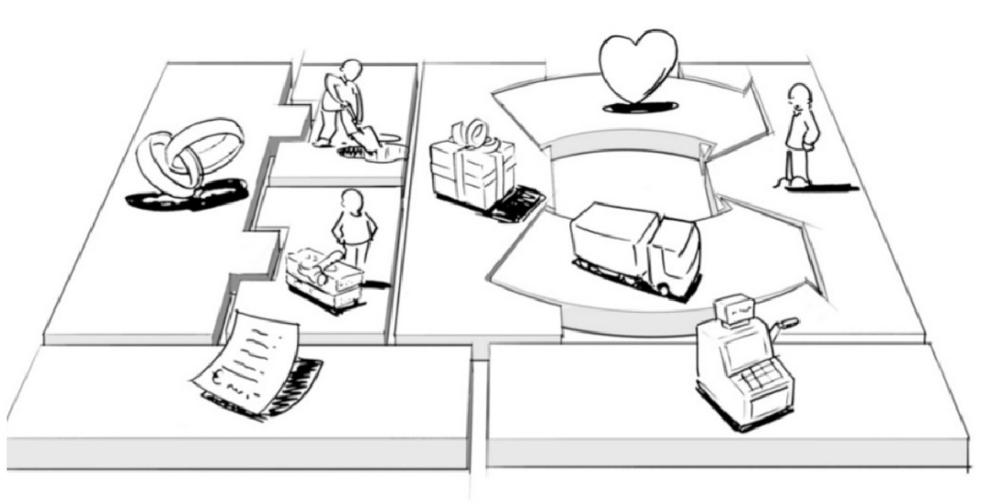
The Business Model Canvas

Slide 3
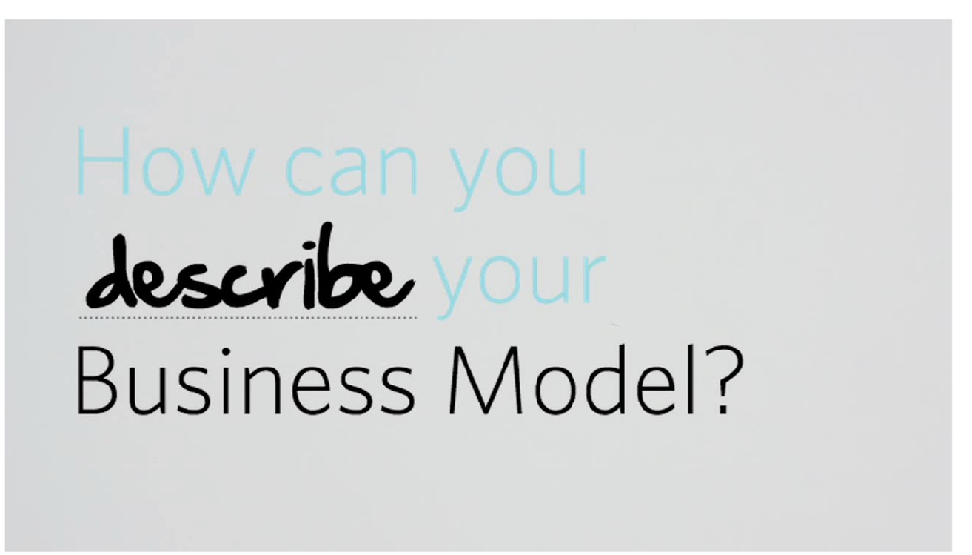
9 Building Blocks Of A Business Model

Slide 4
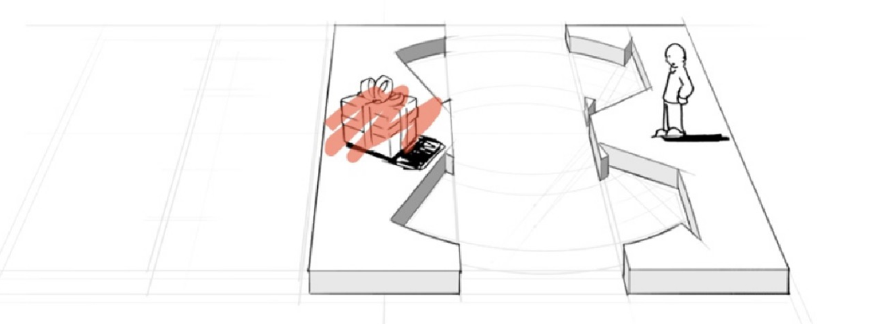
1. Value Proposition

Slide 5
Value Proposition
What problem are you trying to solve?
And how: The bundle of products and services that create value for a specific Customer Segment. This is where you list all the features/attributes of your products or services that would solve the problem for your target segment(s)

Slide 6
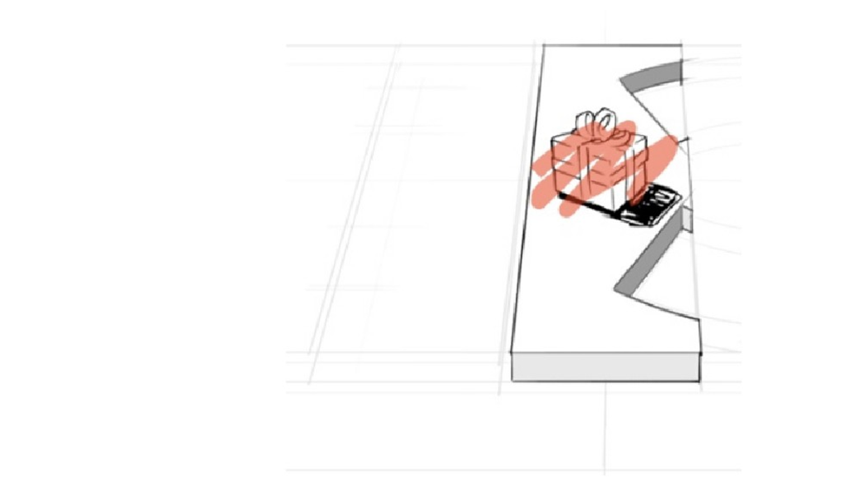
Elements Of Value Proposition
Newness
Performance Customization
Getting the job done Design
Brand/status

Slide 7
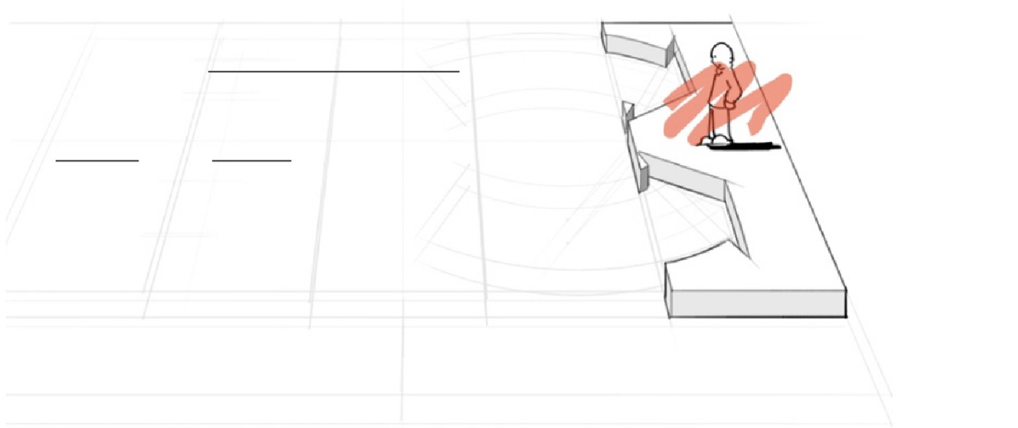
2. Customer Segments
– who are you trying to solve the problem for?
the different groups of people or organizations an enterprise aims to reach and serve
For whom are we creating value? Who are our most important customers?

Slide 8
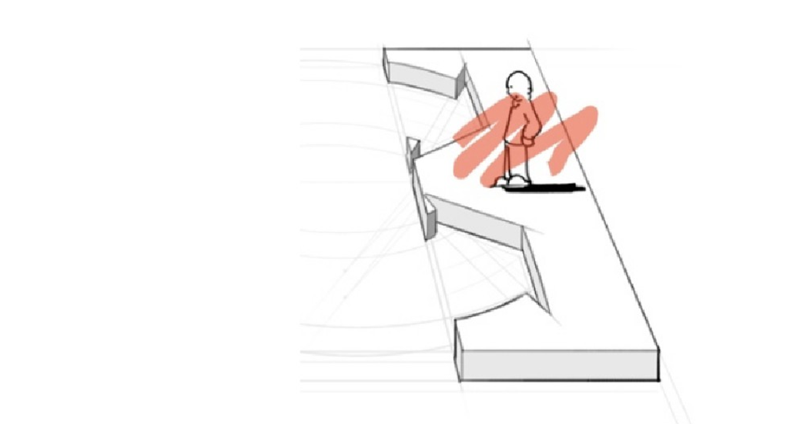
Customer Segment Types
Mass market
Niche market
Segmented market Diversified market

Slide 9
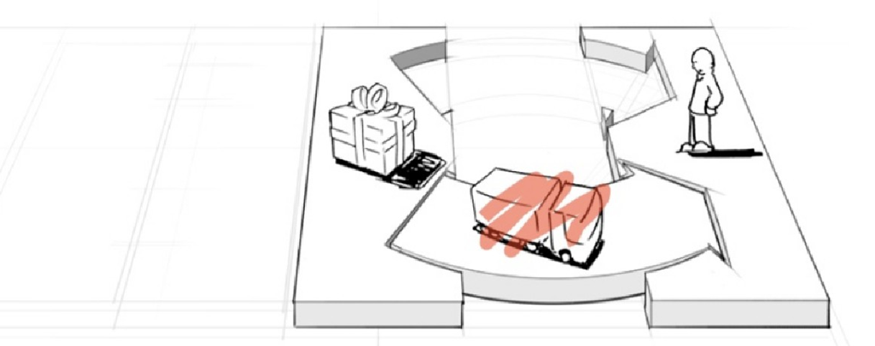
3. Channels
- How are you going to deliver that solution to your target

Slide 10
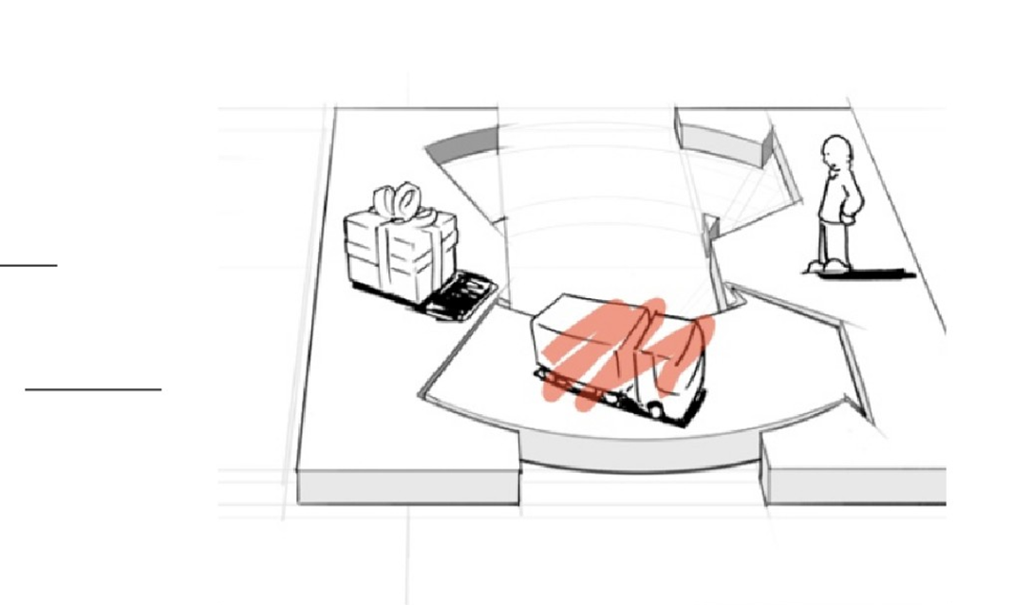
Channels
How a company
communicates with and reaches its Customer Segments to deliver a Value Proposition

Slide 11
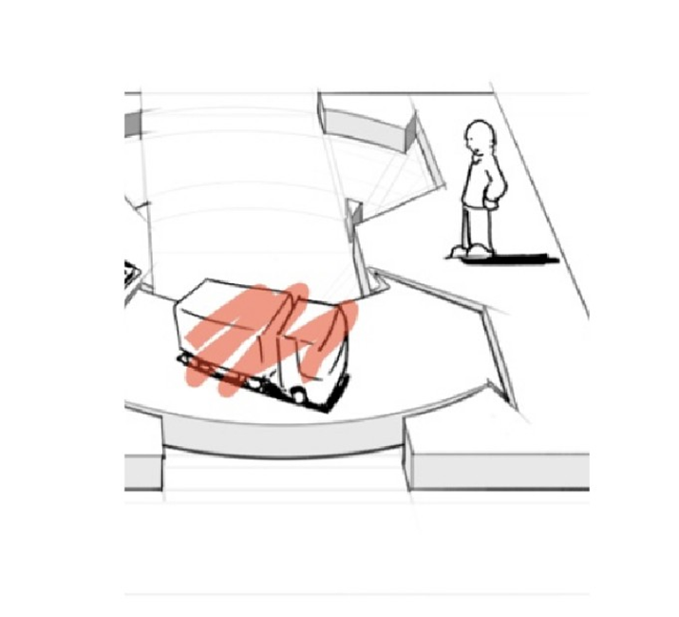
Channels
Through which Channels do our CS want to be reached?
Which channels work best?
Which ones are most cost- efficient?
How are we integrating them with customer routines?

Slide 12
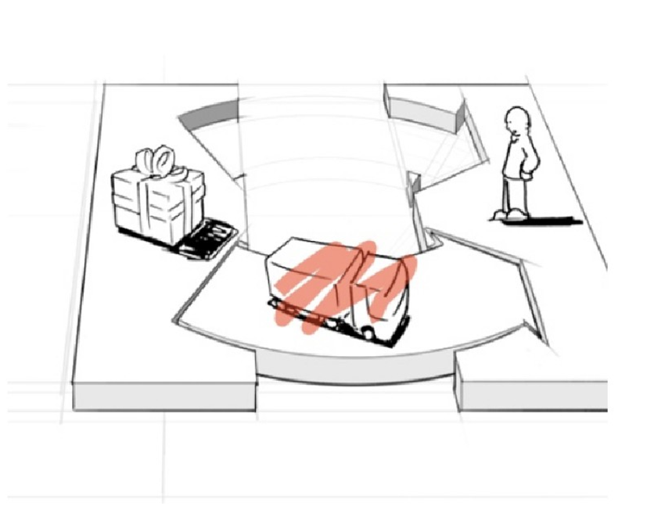
Channels Types
Sales force
Web sales Own stores Partner stores Wholesaler

Slide 13
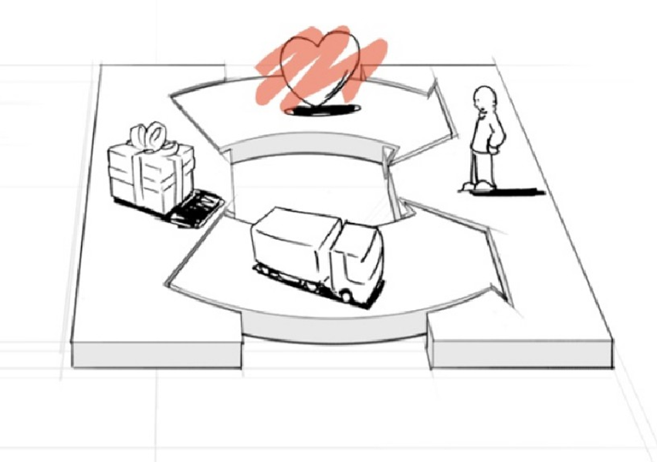
4. Customer Relations
- The customers you just targeted: how are you going to get them, keep them and grow them

Slide 14
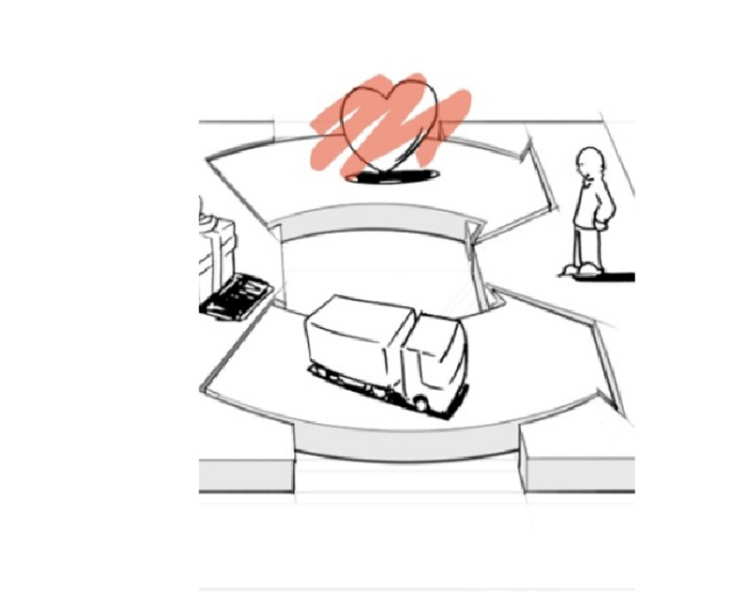
Customer Relations
Describes the types of relationships a company establishes with specific Customer Segments

Slide 15
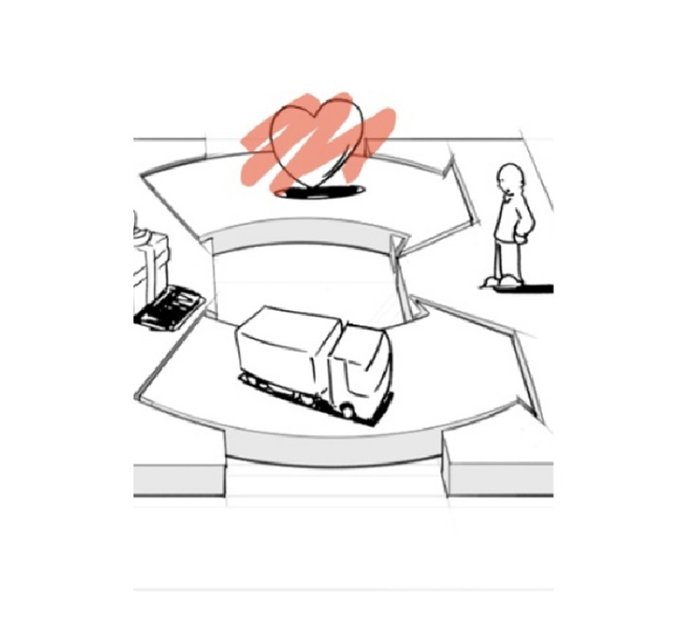
Customer Relations
What type of relationship do we establish and maintain with customer segment?
How costly are they?
How are they integrated with the rest of our business model?

Slide 16
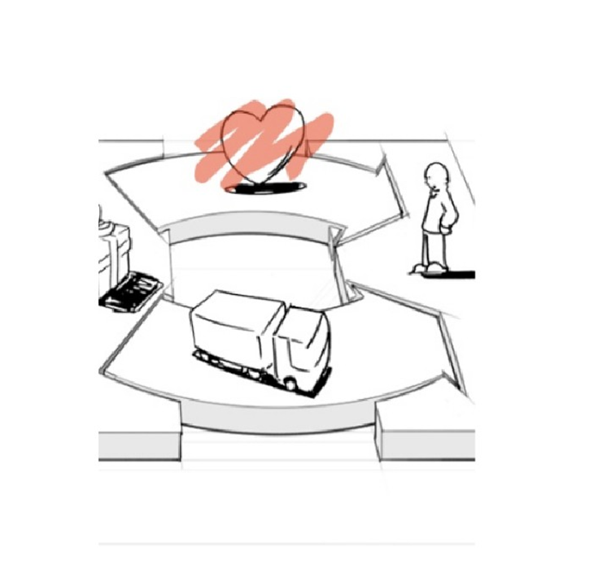
Customer Relations Types
Personal assistance
Dedicated personal assistance Self-service
Automated services Communities
Co-creation

Slide 17
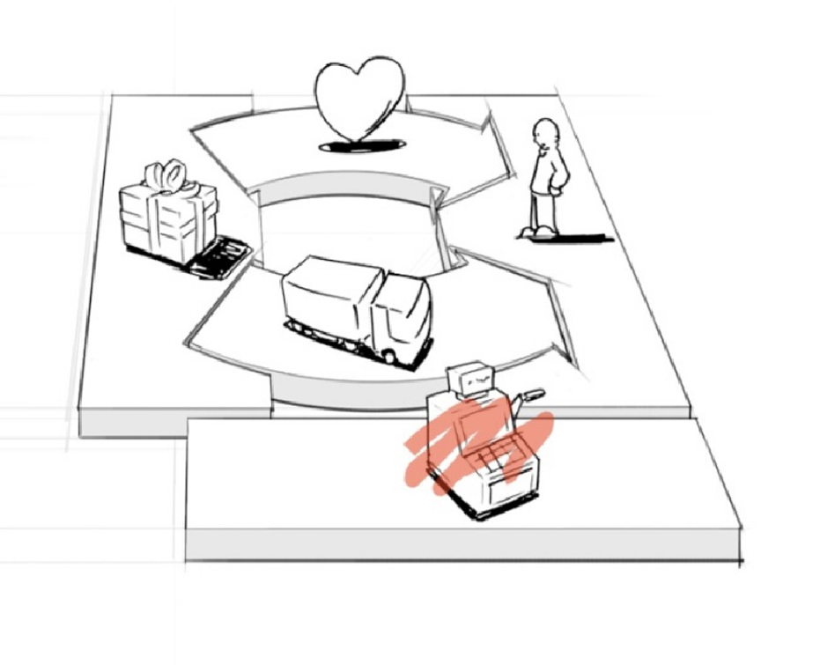
5. Revenue Streams
- How and what are they paying your in return for solving their problem

Slide 18
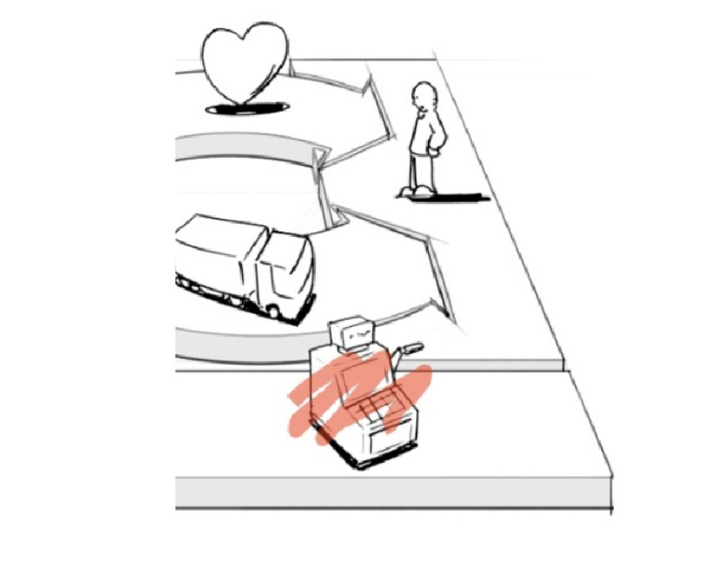
Revenue Streams
The cash a company
generates from each
Customer Segment (costs must be subtracted from revenues to create earnings)

Slide 19
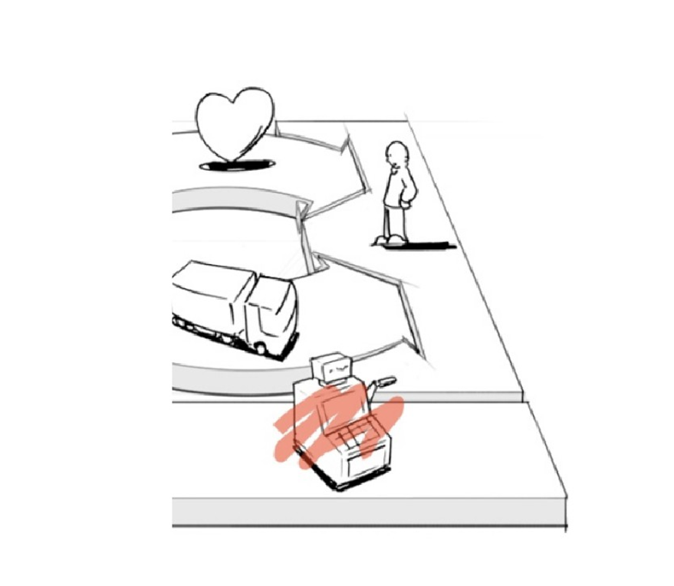
Revenue Streams
For what value are our
customers really willing to pay? For what do they currently pay?
How are they currently paying? How much does each RS contribute to overall revenues?

Slide 20
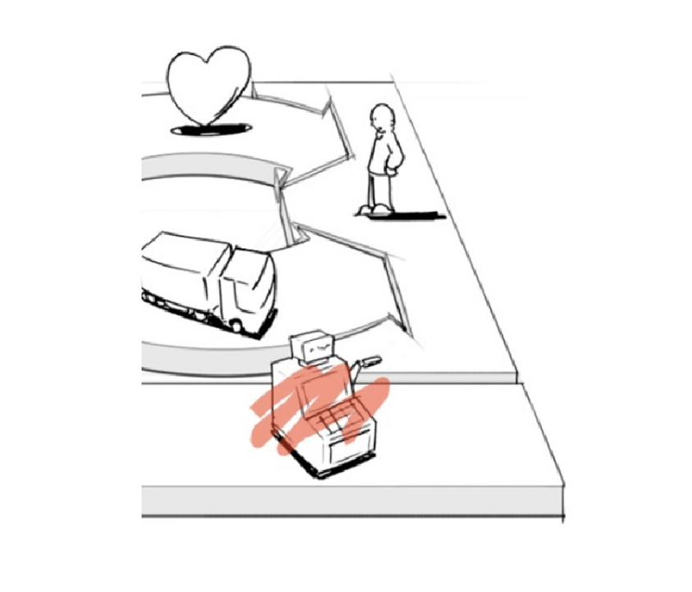
Revenue Streams Types
Asset sale
Usage fee
Subscription fees
Lending/Renting/Leasing Licensing
Brokerage fees Advertising

Slide 21
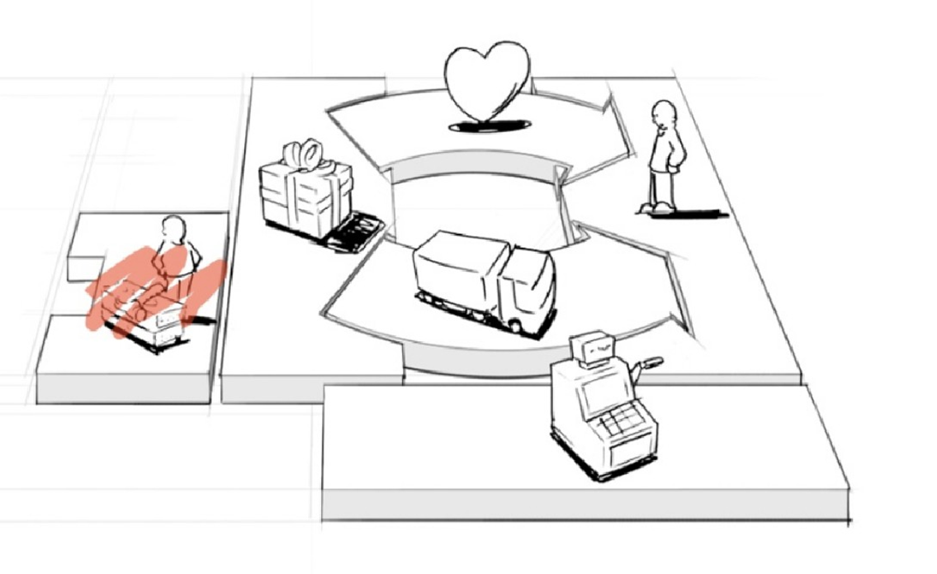
6. Key Resources
- What resources would you need to make all those happen?

Slide 22
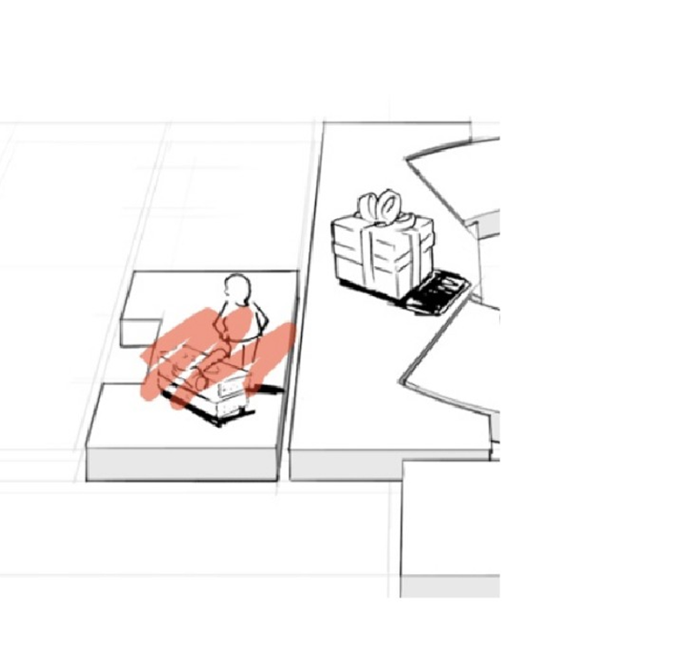
Key Resources
The most important assets required to make a business model work

Slide 23
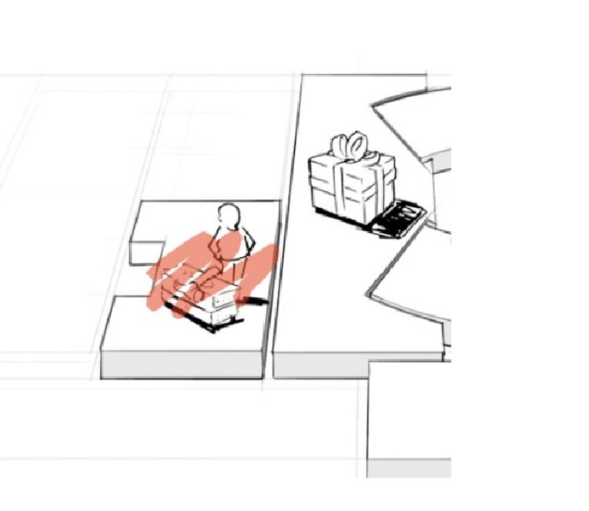
Key Resources
What Key Resources do our Value Propositions require?
Our Distribution Channels? Customer Relationships? Revenue Streams?

Slide 24
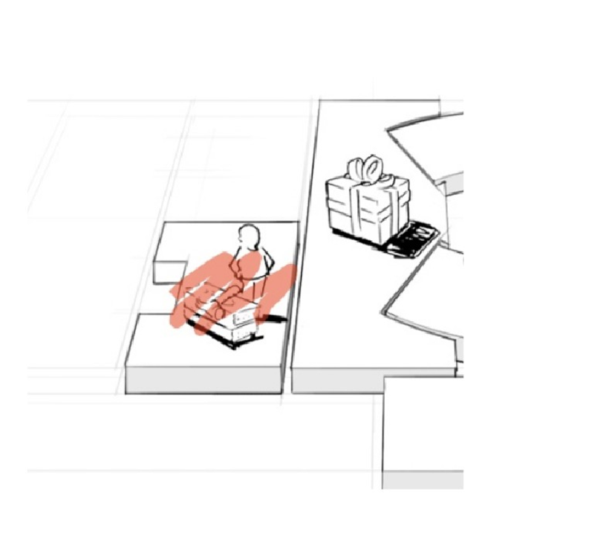
Key Resources Types
Physical
Intellectual Human
Financial

Slide 25
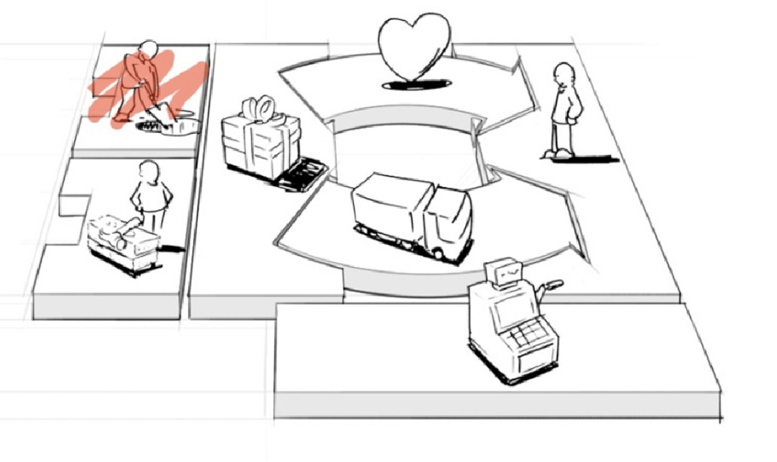
7. Key Activities
- what are the most important thing you have to do for the business to work?

Slide 26
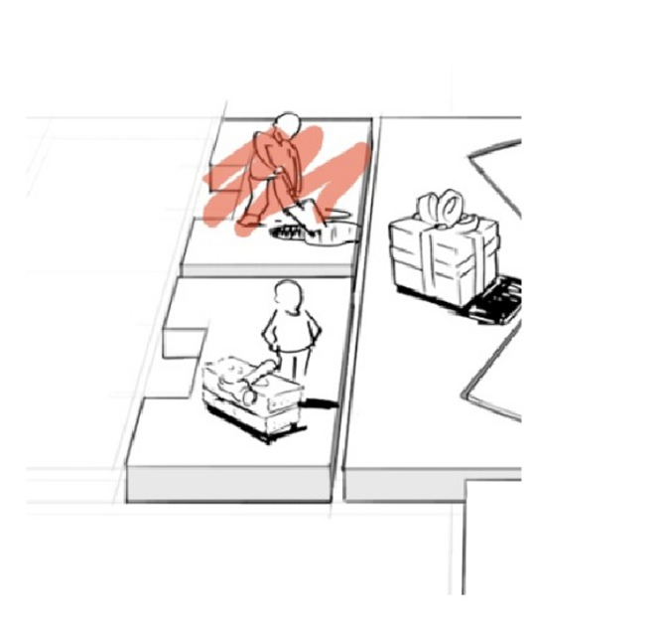
Key Activities
The most important things a company must do to make its business model work

Slide 27
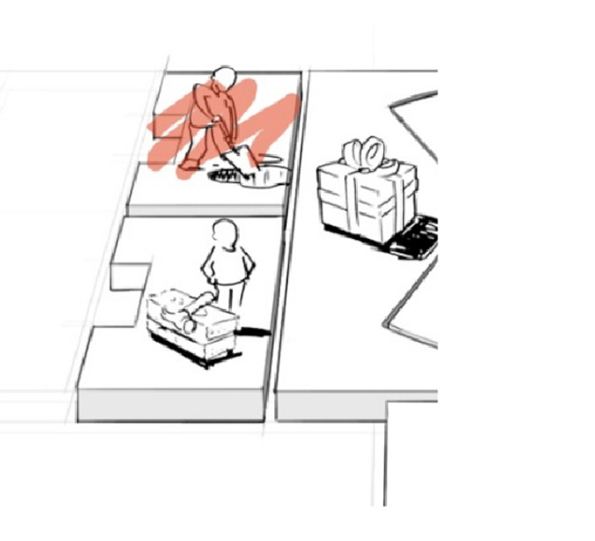
Key Activities
What Key Activities do our Value Propositions require?
Our Distribution Channels? Customer Relationships? Revenue Streams?

Slide 28
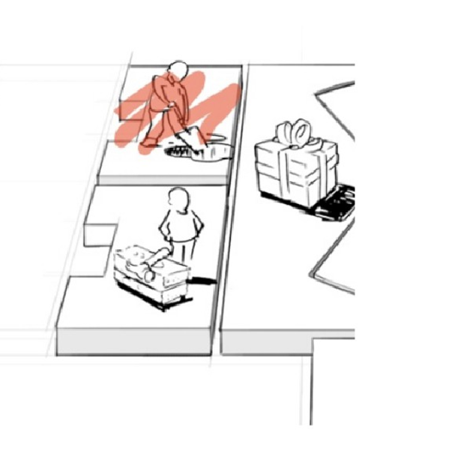
Key Activities Types
Production
Problem solving Platform/network

Slide 29
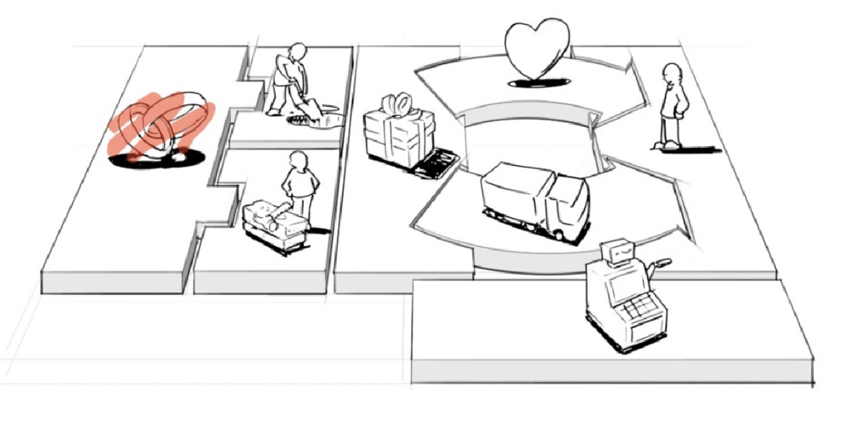
8. Key Partnerships
- who do you need by your side to make all those happen?

Slide 30
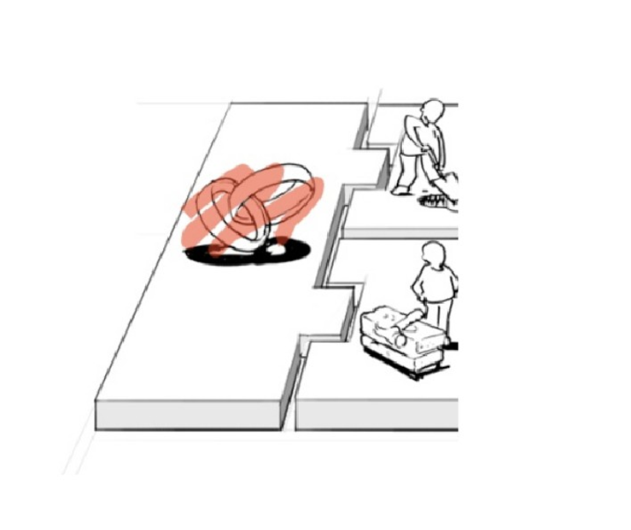
Key Partnerships
The network of suppliers and partners that make the business model work
LOOK AT YOUR VALUE CHAIN

Slide 31
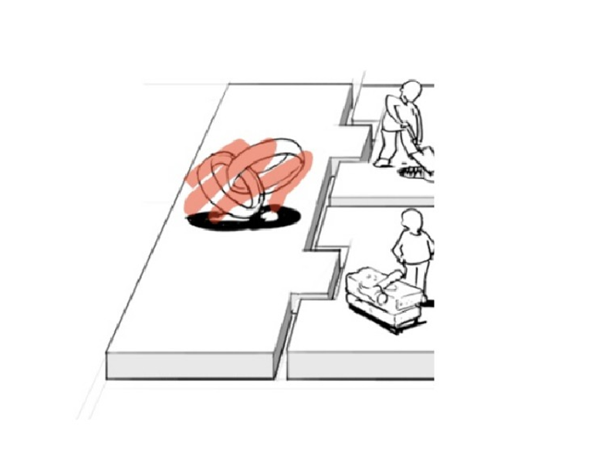
Key Partnerships
Who are our Key Partners? Who are our key suppliers? Which Key Resources are we acquiring from partners?
Which Key Activities do partners perform?

Slide 32
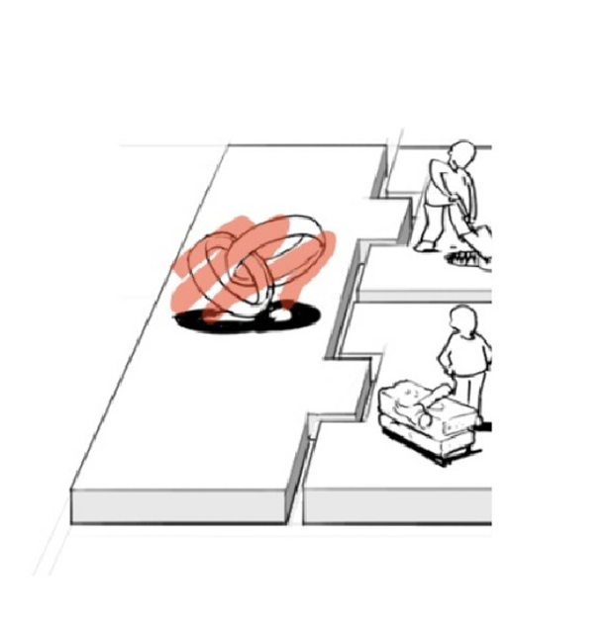
Partnership Types
Strategic alliances between non-competitors
Coopetition: strategic partnerships between competitors
Joint ventures to develop new businesses
Buyer-supplier relationships to assure reliable supplies

Slide 33
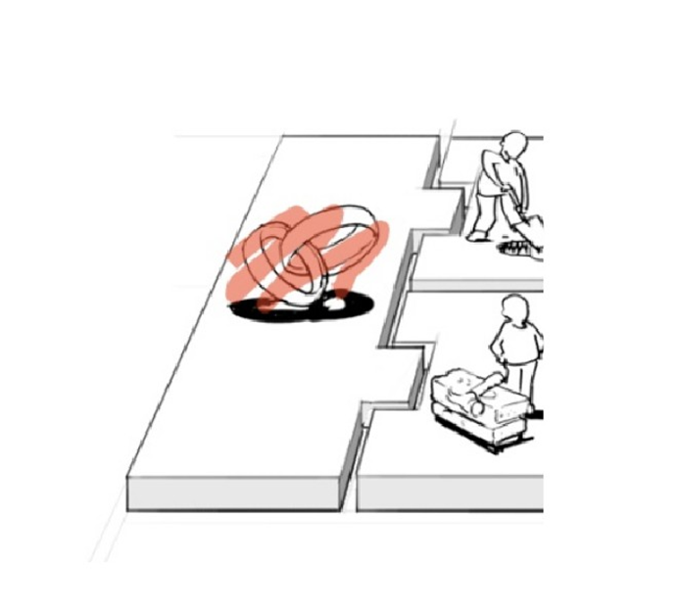
Motivations For Creating Partnerships
Optimization and economy
of scale
Reduction of risk and uncertainty
Acquisition of particular resources and activities

Slide 34
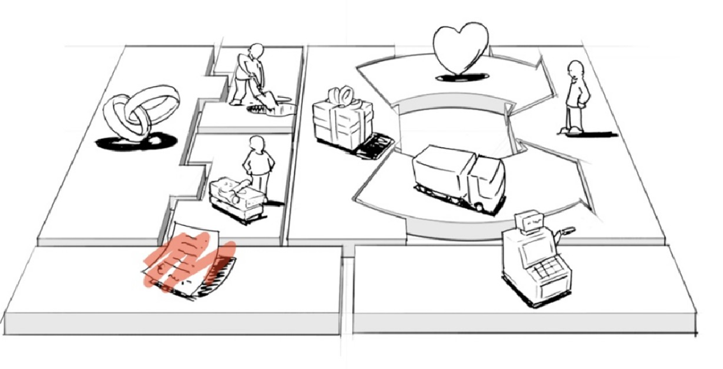
9. Cost Structure
- How much are all those going to cost you?

Slide 35
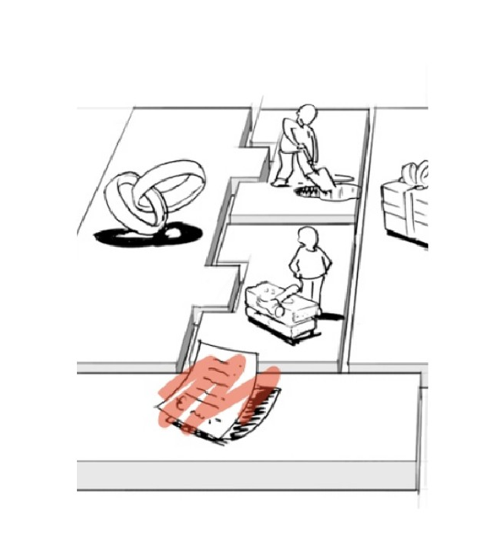
Cost Structure
All costs incurred to operate a business model

Slide 36
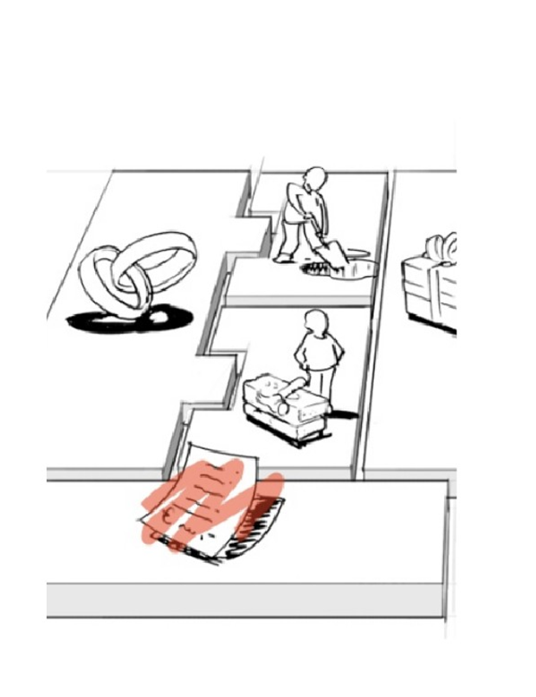
Cost Structure
What are the most important costs inherent in our business model?
Which Key Resources are most expensive?
Which Key Activities are most expensive?

Slide 37
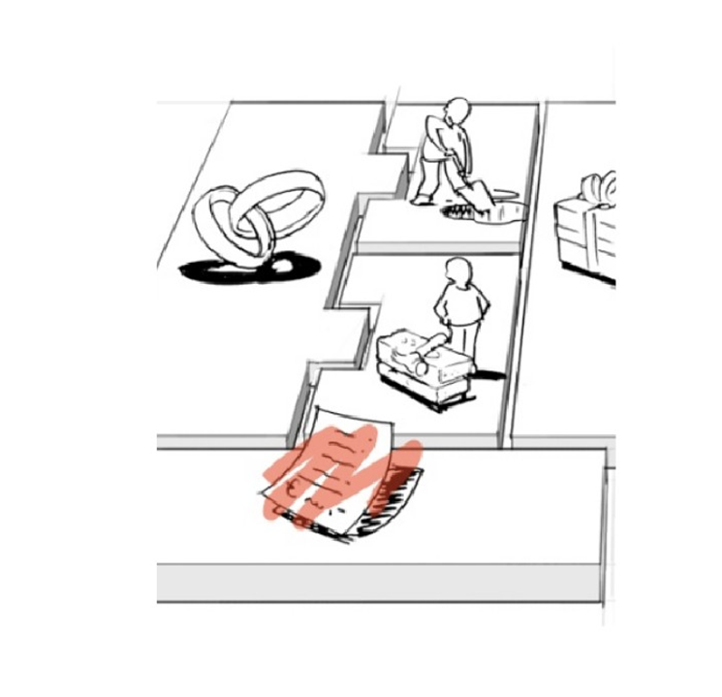
Cost Structure Types
Cost-driven
Value-driven Fixed costs Variable costs

