Slide 1
Organizational Plan
Its time to ‘organize’ stuff!

Slide 2
For your project
Organization plan
What is the form of ownership of the organization? If a partnership, who are the partners and what are the terms of agreement? If incorporated, who are the principal shareholders and how much stock do they own? How many shares of voting or nonvoting stock have been issued and what type? Who are the members of the board of directors? (Give names, addresses, and resumes.) Who has check-signing authority or control? Who are the members of the management team and what are their backgrounds? What are the roles and responsibilities of each member of the management team? What are the salaries, bonuses, or other 'forms of payment for each member of the Management team?

Slide 3
Forms of business
Three basic legal forms of business:
Proprietorship - Single owner, unlimited liability, controls all decisions, and receives all profits.
Partnership - Two or more individuals having unlimited liability who have pooled resources to own a business.
Corporation (C corporation) - Most common form of corporation; regulated by statute; treated as a separate legal entity for liability and tax purposes

Slide 4
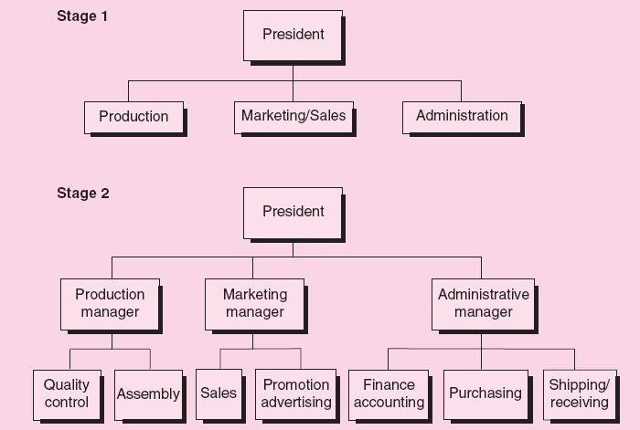
organogram

Slide 5
The Board
A group of people voted in by the shareholders to dictate the direction of the company. They sit regularly to discuss the way forward. They decide on long-term plans such as how to utilize the company’s investment and where they want to see the company in the next 1 – 5 years or so.

Slide 6
The Role of a Board of Directors
Functions of the board of directors:
Reviewing operating and capital budgets.
Developing longer-term strategic plans for growth and expansion.
Resolving conflicts among owners or shareholders.
Ensuring the proper use of assets.
Developing a network of information sources for the entrepreneurs.

Slide 7
The Chairman
An individual from the board is then selected by the board, typically for a limited period of time, to carry on the board’s vision/plan.
The chairman is then responsible for making sure that the company is working towards achieving the boards vision.
If the chairman is doing a good enough job, he/she is then elected for a second term, and if not, the board votes in another person to carry on their task.

Slide 8
The CEO
Is employed by the Chairman to attend to the day-to-day activities of the company.
The CEO is merely an office, granted a very high ranking office of the company.
The CEO reports directly to the Chairman
The CEO takes out a monthly salary

Slide 9
The Management Team
A management team must be able to accomplish three functions:
Execute the business plan.
Identify fundamental changes in the business as they occur.
Make adjustments to the plan based on changes in the environment and market that will maintain profitability.
The Management team consists of functional team who takes the objective set by the CEO and breaks it down into functional objective. They are the CEO’s foot soldiers.

Slide 10
Board of Advisors
Independent party with no stake at the company. They help the company make decision.
The provide the company with a third party perspective.
They do it for the relationship.

