Slide 1
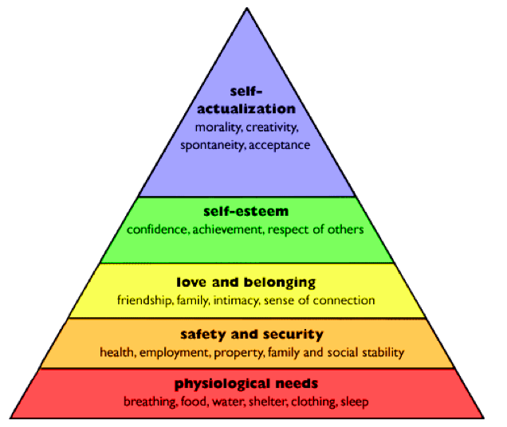
Psychological factors
Maslow’s hierarchy of needs

Slide 2
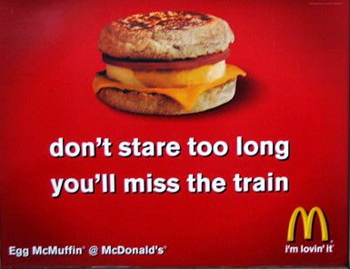
Maslow’s hierarchy
1. Physiological
Product
MacDonald
Slogan
I’m lovin’ it
Core value
Hedonism

Slide 3
Maslow’s hierarchy
2. Safety
Product
Volvo
Slogan
A car you believe in
Core value
Security

Slide 4
Maslow’s hierarchy
3. Belongingness
Product
Facebook
Slogan
Things that connect us
Core value
Prosocial

Slide 5
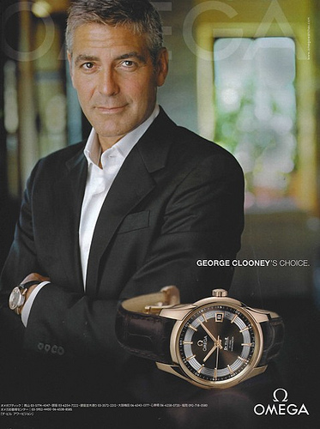
Maslow’s hierarchy
4. Esteem
Product
Omega
Slogan
George Clooney’s choice
Core value
Power, Achievement

Slide 6
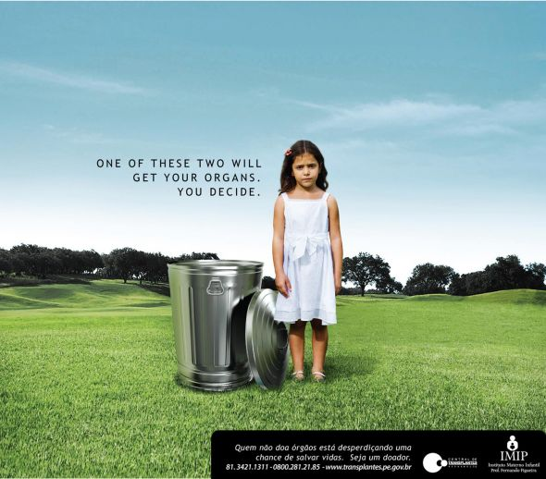
Maslow’s hierarchy
5. Self actualisation
Product
Organ Donation
Slogan
One of this two will get your organ, you decide
Core value
Benevolence, Universalism

