Slide 1
WELCOME
PRINCIPLES OF MANAGEMENT
(MGT210)

Slide 2
MAHTAB MUNTAZERI (Mbt)
Lecturer,
Department of Marketing & INB
School of Business & Economics,
North South University.
CONTACTS
Office: NAC711
Consultation Hour :
TBA
Email: mahtab.muntazeri@northsouth.edu
Website: http://mahtab-nsu.weebly.com

Slide 3
Communication
Please utilize the class time in a best possible way.
Office hours are there for your academic help. But remember, it requires your preparation as well.
You MUST be professional in writing e-mails.
There’s a Facebook group called “Mbt class update” for providing urgent notices and sharing of academic contents. However, social media communication will be limited to this group only.

Slide 4
Course Readings
Text book
Author | Title | Edition & Year | Publisher | ISBN
Stephen P. Robbins and Mary Coulter | Management | 12th, January, 2013 | Pearson | ISBN-13: 978-0-273-75277-6

Slide 5
Course Evaluation
Assessment Strategy and Grading Scheme
Assessment Criteria | Weight
Midterm Exam 1 | 20%
Midterm Exam 2 | 20%
Final Exam | 30%
Group Project | 15%
Class Attendance & Participation | 5%
Case Analysis/Workshops | 10%

Slide 6
Grading Policy
Numerical Scores | Letter Grade | Grade Points
93 and above | A | 4.0
90 - 92 | A- | 3.7
87 - 89 | B+ | 3.3
83 - 86 | B | 3.0
80 - 82 | B- | 2.7
77 - 79 | C+ | 2.3
73 - 76 | C | 2.0
70 - 72 | C- | 1.7
67 - 69 | D+ | 1.3
60 - 66 | D | 1.0
Below 60 | F | 0.0
 | I** Incomplete | 0.0
 | W** Withdrawal | 0.0

Slide 7
Policies to follow…
Attendance & Participation- Maximum of two missed classes will be excused and after that 1 marks will be deducted for each missed class. There will NOT be any late attendance.
Etiquette- Please be quiet during lectures unless, of course, class participation is required. And be punctual.

Slide 8
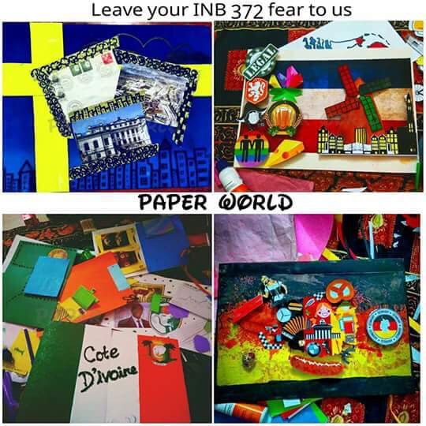
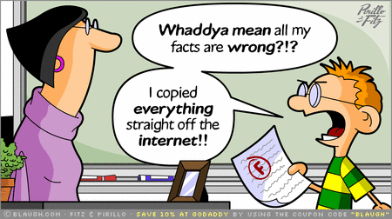
Policies to follow…
Plagiarism: If any information is taken from any sources, it must be referenced properly. Plagiarism may result in a “Fail” grade.

Slide 9
Exam Policies
All exam related information will be provided in the class in due course. However, please don’t ask for “suggestion”. You need to understand all the topics and prepare yourselves accordingly.
Make-up Exam- Only extreme situations might be “considered”. Any make-up taken will be comprehensive. There is NO make-up for quizzes, debate, case works & final project.
Students must remain in their own class & section for all the exams & course work.

Slide 10
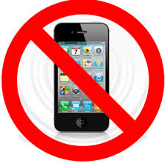
Policies to follow…

Slide 11
THANK YOU

