Slide 1
MISSION STATEMENT:
A statement of the organization’s purpose- what it wants to accomplish in the larger environment.
A mission statement asks..
What is our business?
Who is the customer?
What do consumers value?
What should our business be?

Slide 2
DEFINING A
MARKET-ORIENTED MISSION:
MARKET ORIENTED
Characteristics of a Good Mission Statement:
REALISTIC
SPECIFIC
FIT MARKET ENVIRONMENT
DISTINCTIVE COMPETENCES
MOTIVATING
1
GOAL 1:
EXPLAIN STRATEGIC PLANNING

Slide 4
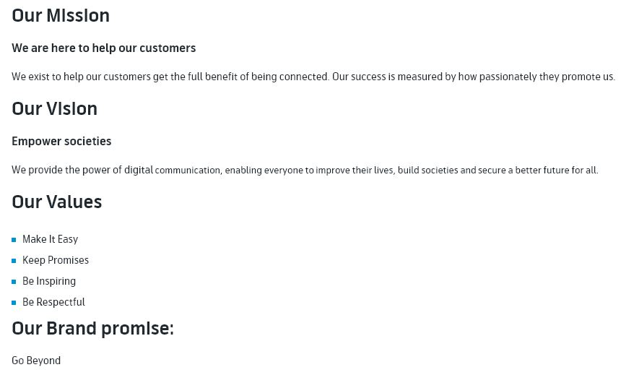

Slide 5
