Slide 1
WELCOME
INTRODUCTION TO MARKETING
(MKT202)

Slide 2
MAHTAB MUNTAZERI (Mbt)
Lecturer,
Department of Marketing & INB
School of Business & Economics,
North South University.
CONTACTS
Office: NAC727
Consultation Hour :
TBA
Email: mahtab.muntazeri@northsouth.edu
Website: http://mahtab-nsu.weebly.com

Slide 3
Communication
Please utilize the class time in a best possible way.
Office hours are there for your academic help. But remember, it requires your preparation as well.
You MUST be professional in writing e-mails.
There’s a Facebook group called “Mbt class update” for providing urgent notices and sharing of academic contents. However, social media communication will be limited to this group only.

Slide 4
Course Readings
Text book
Philip Kotler, Gary Armstrong and Peggy Cunningham: Principles of Marketing, -15thEdition, Prentice Hall.

Slide 5
Course Evaluation
Mid-Term I ……………………………………………... Mid-Term II …………………………………………….. Final Exam ……………………………………………… Quizzes ……………………………………………......... Group Project & Presentation ……………....................... Attendance & Participation …………………………..... | 15% 15% 30% 10% 25% 5%

Slide 6
Grading Policy
Numerical Scores | Letter Grade | Grade Points
93 and above | A | 4.0
90 - 92 | A- | 3.7
87 - 89 | B+ | 3.3
83 - 86 | B | 3.0
80 - 82 | B- | 2.7
77 - 79 | C+ | 2.3
73 - 76 | C | 2.0
70 - 72 | C- | 1.7
67 - 69 | D+ | 1.3
60 - 66 | D | 1.0
Below 60 | F | 0.0
 | I** Incomplete | 0.0
 | W** Withdrawal | 0.0

Slide 7
YOUR GRADE IS YOUR ACHIVEMENT. ABSOLUTELY BASED ON YOUR PERFORMANCE, NOTHING ELSE.
Grading Policy

Slide 8
Policies to follow…
Attendance & Participation- Three missed classes will be excused. 1 mark will be deducted for each missed class after that.
Quizzes- Best 4 out of 5.
Group Project- A marketing plan.
Deadlines- Must be maintained strictly.
Make-up Exam- Only extreme situations might be “considered”. Any make-up taken will be comprehensive.
Etiquette- Please be quiet during lectures unless, of course, class participation is required. And be punctual.

Slide 9
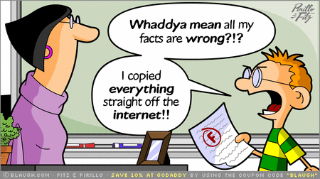
Policies to follow…
Plagiarism: If any information is taken from any sources, it must be referenced properly. Plagiarism may result in a “Fail” grade.

Slide 10
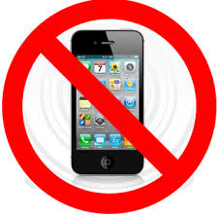
Policies to follow…

Slide 11
5 minutes!! !!

Slide 12
What is Marketing?
Notes:
Consists of all profit-seeking activities and enterprises that provide goods (tangible items) and services necessary to an economic system
1. Provides the means through which standards of living improve
2. An exchange between a buyer, who recognizes the need for a good or services, and a seller, who receives money for the good or service
3. Provides profits or rewards for businesspeople, who take risks in blending people, technology and information to create and market want-satisfying goods and services
4. Businesspeople also recognize social and ethical responsibilities to employees, customers, suppliers, competitors, government and the general public

Slide 13
Marketing Defined: “The process by which companies create value for the customers and build strong customer relationships in order to capture value from customers in return”
What is Marketing?

Slide 14
What is Marketing?
Marketing— organizational function and set of processes for creating, communicating, and delivering value to customers and for managing customer relationships in ways that benefit the organization and its stakeholders.
Exchange process— activity in which two or more parties give something of value to each other to satisfy perceived needs.
Notes:
Marketing is the link between the organization and the people who buy and use its products
Marketers use the data to understand the needs and wants of both final customers and business buyers so that they can satisfy them.
Marketing
1. It begins with discovering unmet customer needs and continues with researching the potential market.
2. Producing a good or service capable of satisfying the targeted customers; and promoting, pricing, and distributing that good or service
3. When two or more parties benefit from trading things of value, they have entered into an exchange process
4. The exchange process allows each group to concentrate on what it does best and then trading excess goods for scarce ones

Slide 15
Definitions of Marketing
AMA- “Marketing is the activity, set of institutions, and processes for creating, communicating, delivering, and exchanging offerings that have value for customers, clients, partners, and society at large.”
Dr. Philip Kotler- “the science and art of exploring, creating, and delivering value to satisfy the needs of a target market at a profit. Marketing identifies unfulfilled needs and desires. It defines, measures and quantifies the size of the identified market and the profit potential. It pinpoints which segments the company is capable of serving best and it designs and promotes the appropriate products and services.”
http://heidicohen.com/marketing-definition/

Slide 16
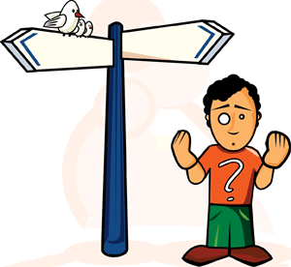
ANY QUESTION ??

