Slide 1
The Family and Its Social Class Standing
CHAPTER
TEN

Slide 2
What is a Group?
Two or more people who interact to accomplish either individual or mutual goals
A membership group is one to which a person either belongs or would qualify for membership
A symbolic group is one in which an individual is not likely to receive membership despite acting like a member

Slide 3
Group
Reference Group
A person or group that serves as a point of comparison (or reference) for an individual in the formation of either general or specific values, attitudes, or behavior.
Indirect Reference Group
Individuals or groups with whom a person identifies but does not have direct face-to-face contact, such as movie stars, sports heroes, political leaders, or TV personalities.

Slide 4
Major Consumer Reference Groups
Reference Groups
Individual
Family
Friends
Social Class
Selected Subcultures
One's Own Culture
Other Cultures

Slide 5
Factors Encouraging Conformity: A Reference Group Must ...
Inform or make the individual aware of a specific product or brand
Provide the individual with the opportunity to compare his or her own thinking with the attitudes and behavior of the group
Influence the individual to adopt attitudes and behavior that are consistent with the norms of the group
Legitimize the decision to use the same products as the group

Slide 6
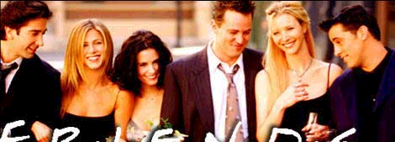
Selected Consumer-Related Reference Groups
Friendship groups
Shopping groups
Work groups
Virtual groups or communities
Consumer-action groups

Slide 7
Brand Communities
Group of runners who meet at the Niketown store in Boston on Wednesdays
Saturn car owners who meet for reunions and barbecues
Harley Davidson Owner Groups
Saab owners

Slide 8
Reference Group Appeals
Celebrities
The expert
The “common man”
The executive and employee spokesperson
Trade or spokes-characters
Other reference group appeals
Ann Taylor uses a
Celebrity Appeal:
Christy Turlington

Slide 9
Households
Family Households:
Married couple,
Nuclear family,
Extended family
Households
Non-Family Households:
Unmarried couples,
Friends/ Roommates

Slide 10
The Changing Family Structure & Composition
Types of families
Nuclear
Extended
Single-parent
Changes in household spending patterns
Chapter Ten Slide

Slide 11
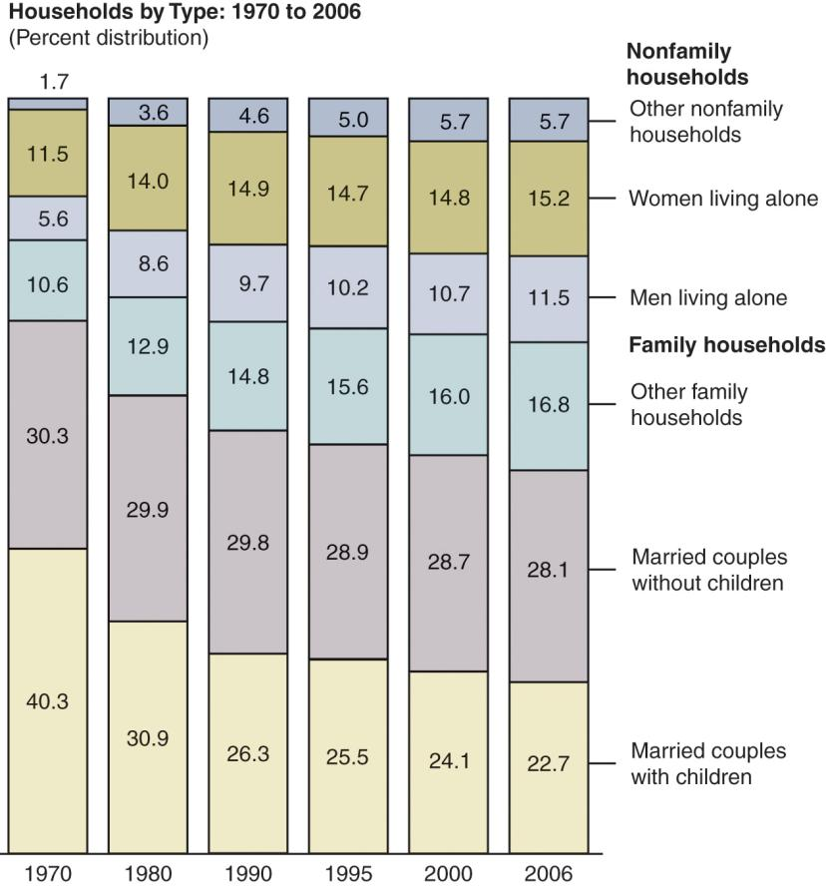
Evidence of the Dynamic Nature of U.S. Households
Chapter Ten Slide

Slide 12
As You See It, What Is the Main “Family Message” of This Ad?
Chapter Ten Slide

Slide 13
It Reminds Parents of the Importance of Creating “Quality Time.”
Chapter Ten Slide

Slide 14
Socialization and Related Roles of Family Members
Consumer socialization
Socialization Agent
Growing up in a Materialistic World
Adult Consumer socialization agent
Intergenerational socialization

Slide 15
Consumer Socialization
The process by which children acquire the skills, knowledge, and attitudes necessary to function as consumers.
Chapter Ten Slide

Slide 16
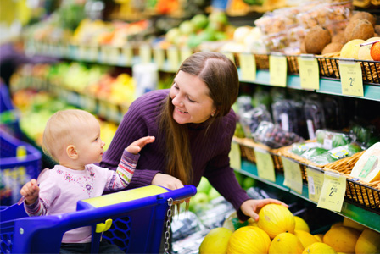
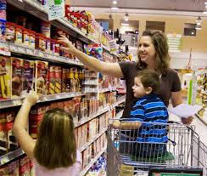
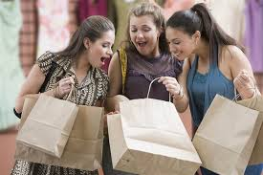
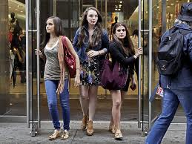

Slide 17
Discussion Questions
How do marketers influence consumer socialization?
Does this seem unethical? At what point would it be unethical?
Chapter Ten Slide

Slide 18
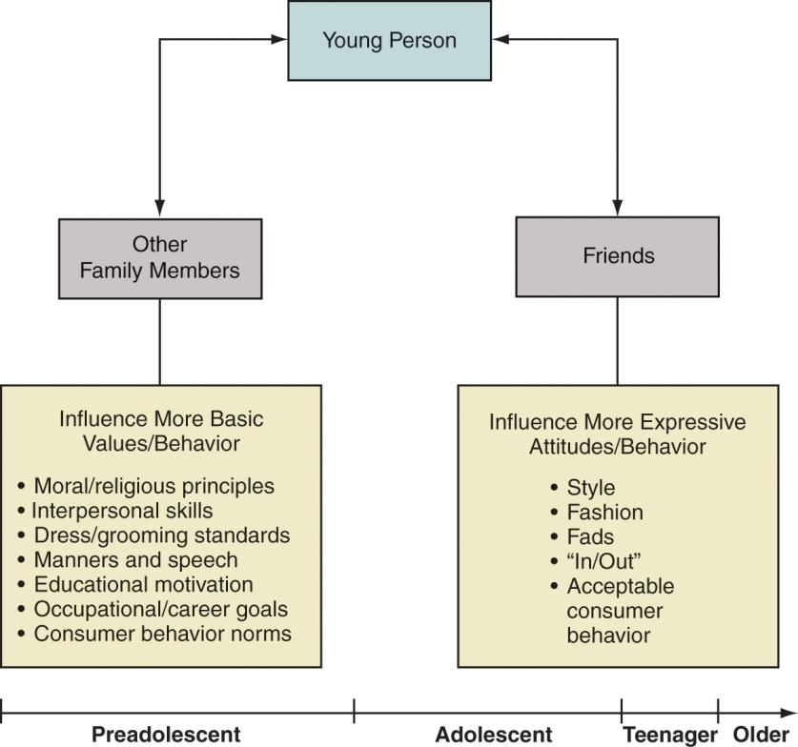
A Simple Model of the Socialization Process - Figure 10.4
Chapter Ten Slide

Slide 19
Other Functions of the Family
Economic well-being
Emotional support
Suitable family lifestyles
Chapter Ten Slide

Slide 20
Family Decision Making
Dynamics of Husband-Wife Decision Making
Husband-Dominated
Wife-Dominated
Expanding Role of Children In Family Decision Making
Choosing restaurants and items in supermarkets
Teen Internet mavens
Pester power
Chapter Ten Slide

Slide 21
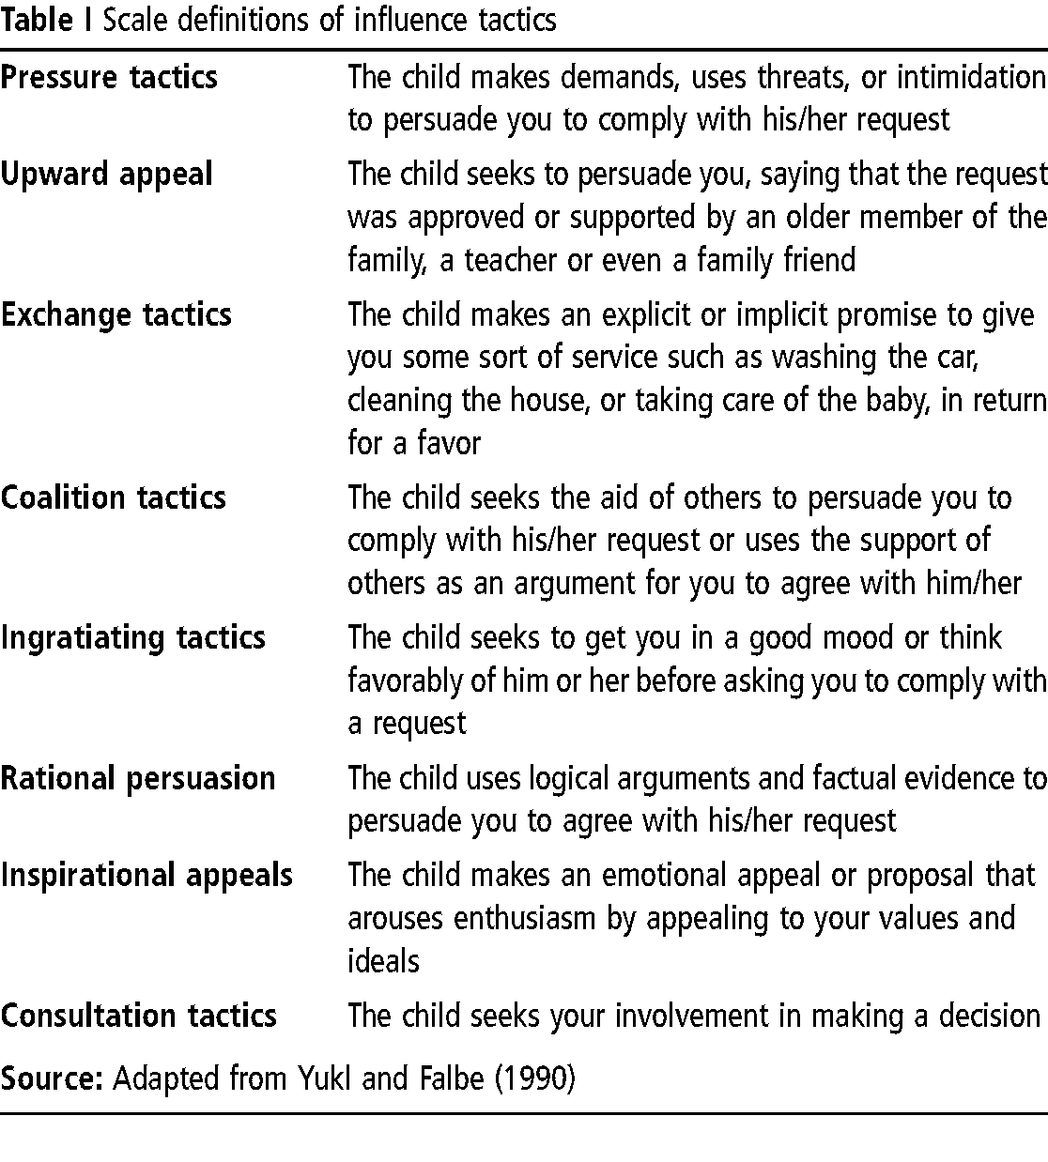
tactics used by children to influence their parents

Slide 22
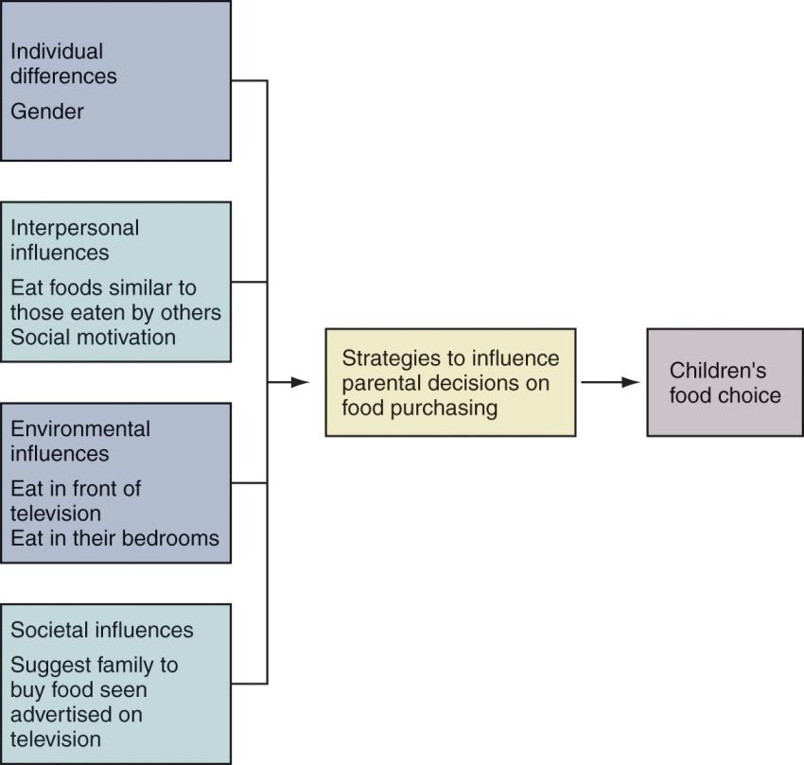
Framework of 10-year-old Influencer Figure 10.5
22
Chapter Ten Slide
Notes:
Here is a framework that was built from a study of how children use strategies to influence their parents to purchase food. As you can see, these kids want to eat food that other kids eat, they want to eat in front of the TV, and they want to eat food that they see advertised on television.

Slide 23
The Family Life Cycle
Traditional Family Life Cycle
Stage I: Bachelorhood
Stage II: Honeymooners
Stage III: Parenthood
Stage IV: Postparenthood
Stage V: Dissolution
Modifications - the Nontraditional FLC
Chapter Ten Slide

Slide 24
To Which Stage of the Family Life Cycle Does This Ad Apply, and Why?
Chapter Ten Slide

Slide 25
Bachelorhood – The Target Consumer Is Not Yet Married
Chapter Ten Slide

Slide 26
Which Subgroup of “Empty Nesters” Does This Ad Most Likely Target?
Chapter Ten Slide

Slide 27
The ones who are would like to pursue new interests and fulfill unsatisfied needs
Chapter Ten Slide

Slide 28
Nontraditional FLC Family Stages
Alternative FLC Stage | Definition/Commentary
Childless couples | Increasingly acceptable with more career-oriented married women and delayed marriages
Couples who marry later in life | Likely to have fewer or no children
Couples with first child in late 30’s or later | Likely to have fewer children. Want the best and live quality lifestyle
Single parents I | High divorce rate - about 50% lead to this
Single parents II | Child out of wedlock
Single parents III | Single person who adopts
Extended family | Adult children return home. Divorced adult returns home. Elderly move in with children. Newlyweds live with in-laws.
Chapter Ten Slide

Slide 29
Social Class
The division of members of a society into a hierarchy of distinct status classes, so that members of each class have either higher or lower status than members of other classes.
Chapter Ten Slide

Slide 30
Social Class and Social Status
Status is frequently thought of as the relative rankings of members of each social class
wealth
power
prestige
Social Comparison Theory
states that individuals
compare their
own possessions against those
of others to determine their
relative social standing.

Slide 31
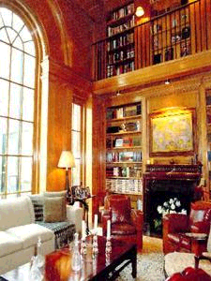
Status Consumption
The process by which consumers actively increase their social standing through conspicuous consumption or possessions
Conspicuous consumption
The buying of expensive goods in order to impress people and show them how rich you are

Slide 32
Characteristics of Social Class
Hierarchical
A natural form of segmentation
Provides a frame of reference for consumer behaviour
Reflects a person’s relative social status

Slide 33
Social Class Measure and Distribution Table 10.8
SOCIAL CLASSES and PERCENTAGE
Upper 4.3%
Upper-middle 13.8%
Middle 32.8%
Working 32.3%
Lower 16.8%
Chapter Ten Slide

Slide 34
Social Class Measurement
Subjective Measures
individuals are asked to estimate their own social-class positions
Objective Measures
individuals answer specific socioeconomic questions and then are categorized according to answers
Chapter Ten Slide

Slide 35
Objective Measures
Single-variable indexes
Occupation
Education
Income
Composite-variable indexes
Index of Status Characteristics
Socioeconomic Status Score
Chapter Ten Slide

Slide 36
Discussion Questions
What are the advantages to a marketer using the objective method to measure social class?
When would the subjective or reputational method be preferred?
Chapter Ten Slide

Slide 37
Social Class Mobility
Upward mobility
Downward mobility
37
Chapter Ten Slide

Slide 38
Geodemographic Clusters
A composite segmentation strategy that uses both geographic variables (zip codes, neighborhoods) and demographic variables (e.g., income, occupation) to identify target markets.
Chapter Ten Slide

Slide 39
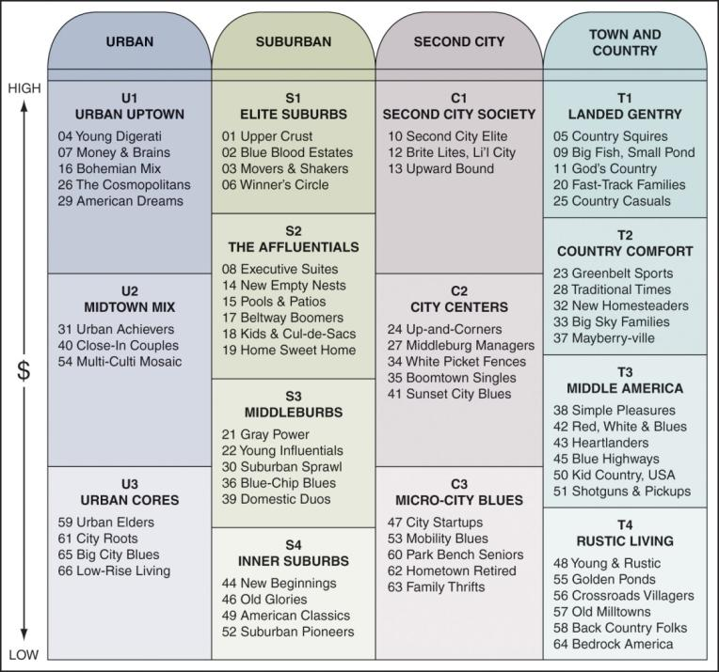
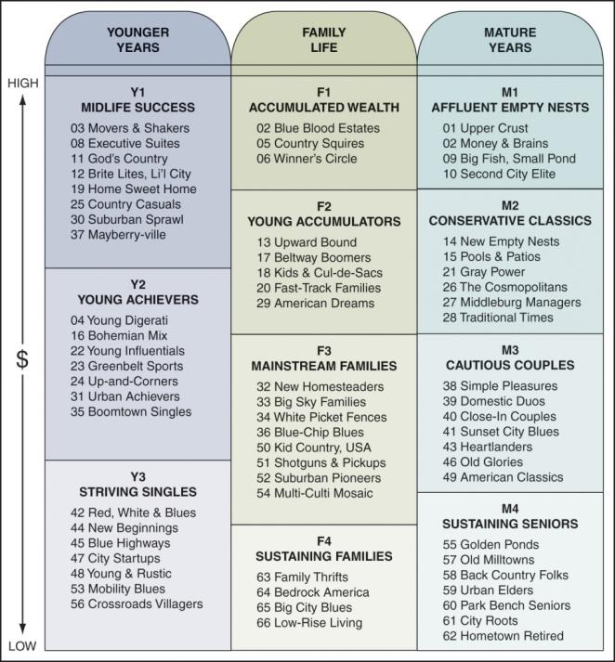
Prizm Clusters Figure 10.10a, b
Chapter Ten Slide

Slide 40
The Affluent Consumer
Growing number of households can be classified as “mass affluent” with incomes of at least $75,000
Some researchers are defining affluent to include lifestyle and psychographic factors in addition to income
Chapter Ten Slide

Slide 41
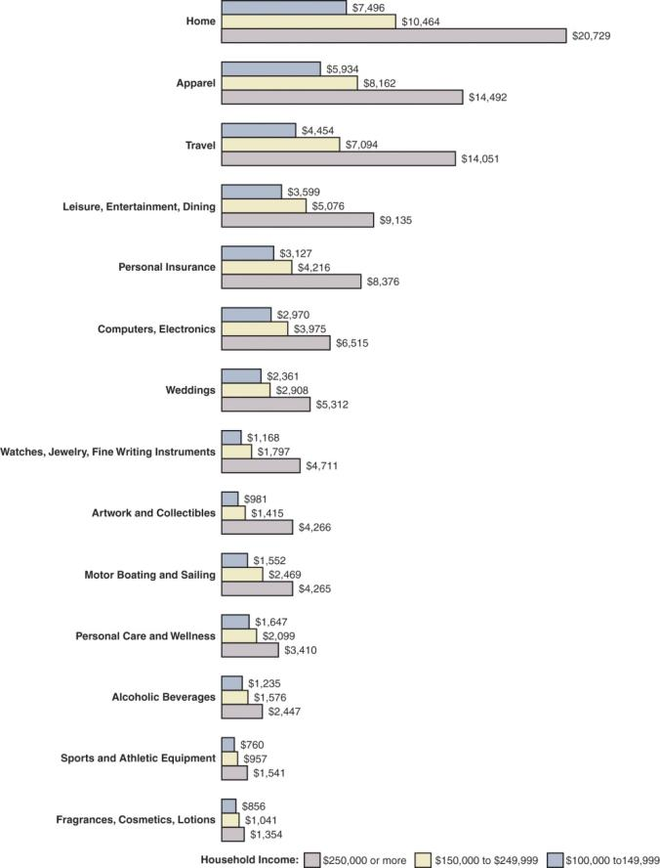
The Affluent Consumer
Three Segments of Affluent Customers’ Average Household Expenditures - Figure 10.12
Chapter Ten Slide

Slide 42
What Is the Name of the Segment Targeted by This Ad, and Why Is the Appeal Shown Here Used?
Chapter Ten Slide

Slide 43
This Ad was Used Because it is Effective for the Affluent Consumer.
Chapter Ten Slide

Slide 44
What Is the Middle Class?
The “middle” 50 percent of household incomes - households earning between $25,000 and $85,000
The emerging Chinese middle class
Moving up to more “near luxuries”
Chapter Ten Slide

Slide 45
The Working Class?
Households earning $40,000 or less control more than 30 percent of the total income in the U.S.
These consumers tend to be more brand loyal than wealthier consumers.
Chapter Ten Slide

Slide 46
Discussion Questions
What types of products are targeted to the working class?
What issues must marketers consider when targeting their ads to the working class?
Chapter Ten Slide

Slide 47
The Techno Class
Having competency with technology
Those without are referred to as “technologically underclassed”
Parents are seeking computer exposure for their children
Geeks now viewed as friendly and fun
Chapter Ten Slide

Slide 48
Consumer Behavior and Social Class
Clothing, Fashion, and Shopping
Saving, Spending, and Credit
Social Class and Communication
Chapter Ten Slide

