Slide 1
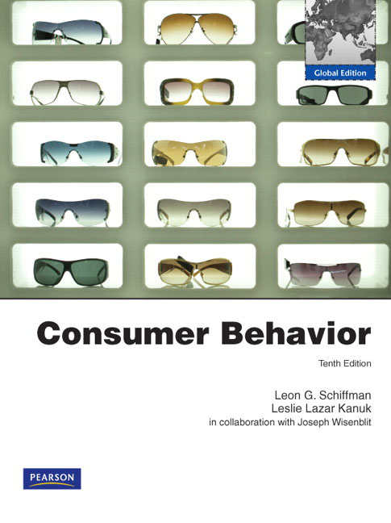
Market Segmentation and Strategic Targeting
CHAPTER
THREE

Slide 2
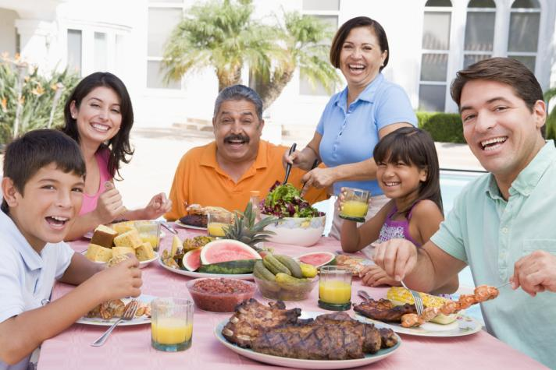
Why Segmentation is Necessary
Consumer needs differ
Differentiation helps products compete
Segmentation helps identify suitable media
Not all consumers are alike – different customers have different needs. By segmenting the market and choosing target markets, companies can differentiate their products to provide the benefits that the segments desire. Once a marketer has identified his segment, he can choose media that is targeted to that segment for advertising.
Chapter Three Slide

Slide 3
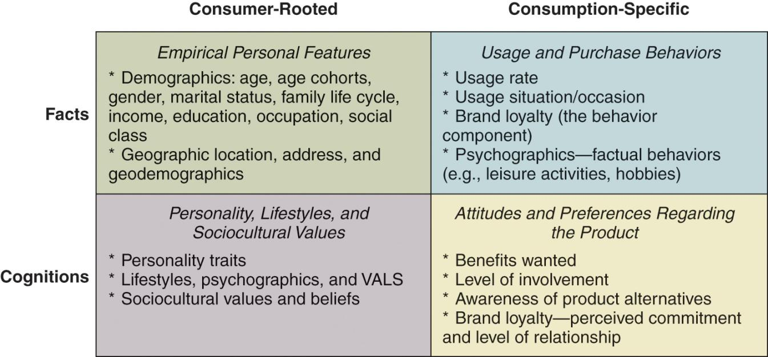
Bases for Segmentation
Consumer-rooted segmentation is based on the consumers characteristics. Consumption-specific segmentation is based on the consumers’ interaction or potential interaction with the product. The two can be classified to facts (what is known and measurable) and cognitions (which are abstracts and can be determined only through more complex questioning).
Chapter Three Slide

Slide 4
Consumer-Rooted Segmentation Bases
Demographics
Geodemographic
Personality Traits
Lifestyles
Sociocultural
Chapter Three Slide

Slide 5
Demographic Segmentation
Demographics are the core of almost all segmentation because they are easy and logical. In addition, they are a cost-effective way to reach segments and demographic shifts are easier to identify than other types of shifts.
Age
Gender
Marital Status
Income, Education, and Occupation
Family Life-cycle
Chapter Three Slide

Slide 6
Geodemographic Segmentation
It is based on geography and demographics (analysis of people demographically by where they live)
People who live close to one another are similar in income levels, tastes, preferences, lifestyles and consumption (Birds of a feather flock together). They might eat similar foods, like the same movies, and take the same types of vacations.
Geodemographic segmentation is a popular use of geography in targeting
Chapter Three Slide

Slide 7
Personality Traits
Personality traits help us identify what segments are valuable to marketers (examples of traits: extraversion, introversion, trust, perceived risk, ambition, aggression…etc.).
People often do not identify these traits because they are guarded or not consciously recognized (so that projective techniques are used)
For instance, consumers who are open minded and perceive less risk than others in trying new things are likely to be consumers innovators. They are more likely to buy new product when it first introduced and before many other consumers. Therefore marketers of new products must identify these individuals and target them during the new product’s introduction. Besides, innovators have “exhibition” personality trait (they want to be the center of a group). This trait might be important for marketers because innovators spread word-of-mouth messages regarding new products and services.
Chapter Three Slide

Slide 8
Lifestyles
Lifestyle Includes activities, interests, and opinions (AIOs)
VALS = Consumers values + lifestyles (Psychographics).
They explain buyer’s purchase decisions and choices.
Chapter Three Slide

Slide 9
Example: Two Views of Post-Retirement Lifestyle (Two segments)
AS AN OPPORTUNITY TO MAKE A NEW START
This group regards retirement as an exciting time. Work will have been largely unrewarding, so the transition is seen as a freedom from the constraints of their former role. Retirement will invigorate such people and inspire them toward undertaking activities that work largely prevented them from pursuing.
AS A CONTINUATION OF THEIR PRE-RETIREMENT LIFESTYLE
To such people, retirement is not perceived as signaling a drastic change. Work life has not been as unsatisfying as for others, hence its ending is not greeted with euphoria. There is, however, some satisfaction that retirement permits more opportunity to devote time to existing activities outside of their working role. The future is likely to see an increase in such activities but no real desire to engage in new ones.
Chapter Three Slide

Slide 10
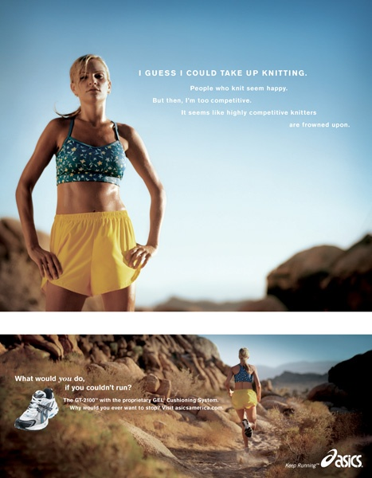
What Kind of Consumer Does This Ad Target?
This Ad Targets Runners Who Are Physically Active People and Also Relish the Outdoors.
Chapter Three Slide

Slide 11
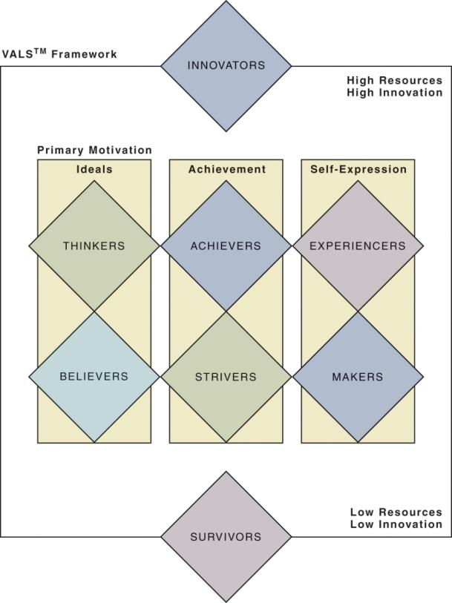
VALS – Figure 3.4
1- Innovators (consumers with high resources and high innovation).
2- Ideals motivated segments (consumers who are guided with knowledge and principles).
3- Achievement motivated segments (consumers who are looking for products and services that demonstrate success to their peers).
4- Self-expression motivated segments (consumers who desire social or physical activity, variety, and risk).
5- Survivors (consumers with low resources and low innovation).
Chapter Three Slide

Slide 12
VALS Psychographic Segmentation
Innovators – (high resources, high innovation): they are, successful, seek sophisticated – upscale products, especially with innovative technology.
Thinkers – (motivated by ideals, high resources). They are educated, practical – favor durability, functionality, and value in products.
Achievers – (motivated by achievement, high resources): they are goal-oriented, centered on career and family, prefer premium products that demonstrate success to their peers.
Experiencers – (motivated by self-expression, high resources): they are young, enthusiastic, impulsive, fashionable, social, like entertainment.

Slide 13
VALS Psychographic Segmentation
Believers – (motivated by ideals, low resources): they are conservative, conventional, slow to alter their consumption habits, and choose familiar products.
Strivers – (motivated by achievement, low resources): they are trendy-representing latest trends, fun-loving, emulate wealthy people.
Makers – (motivated by self-expression, low resources): they are self-sufficient, not materialistic, spend leisure time with and friends, prefer value to luxury.
Survivors – (low resources, low innovation): they are concerned about safety and security, focus on needs, price sensitive, brand loyal and buy discounted products.

Slide 14
Socio-Cultural Values and Beliefs
Sociological = group
Anthropological = cultural
Include segments based on
Cultural values
Sub-cultural membership
Cross-cultural affiliations
An American might identify with common American cultural values, such as fitness and health but also with sub-cultural values if they are Hispanic or Asian Americans. In this global world, marketers must often think cross-culturally, including many countries and more global marketing segmentation. Consumer may be cross-cultural if they were born in one country and are now living in another.
Chapter Three Slide

Slide 15
Consumption-Specific Segmentation Bases
Usage rate
Usage situation
Benefit segmentation
Perceived brand loyalty
Brand relationship
Chapter Three Slide

Slide 16
Usage-Behavior
Usage rate: Usage rate is often based on whether a group of consumers are heavy, medium, light, or nonusers of a product.
Many marketers target the heavy consumers since they are often the most loyal and account for the largest portion of sales.
A company with a strong growth objective might target the other usage segments to fuel their growth in the marketplace
a marketer might target those who are unaware of their product in order to start the process that could lead to purchase.
Chapter Three Slide

Slide 17
Usage-Behavior
Usage-situation segmentation
Segmenting on the basis of special occasions or situations
Example : When I’m away on business, I try to stay at a suites hotel
Usage rate or amount is important to some marketers, but it might also be worth considering WHEN a given product is used. This is the basis for a usage-situation segmentation opportunity. People might consume certain products for special events, certain days of the week, or certain times during the year. Think of the rise of sales in chocolate and flowers for Valentine’s Day.
Chapter Three Slide

Slide 18
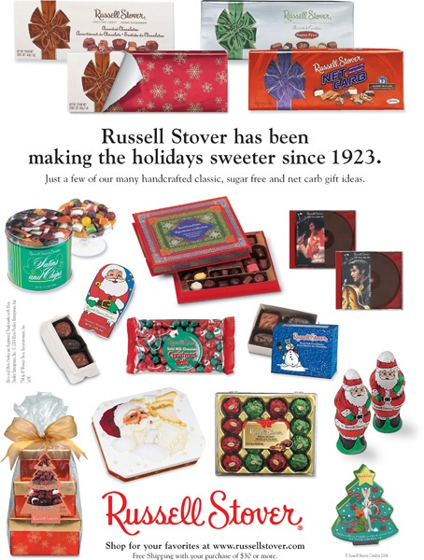
Which Consumption-Related Segmentation Is Featured in This Ad?
This is an Example of a Situational Special Usage Segmentation.
Chapter Three Slide

Slide 19
Benefits Segmentation
Benefits sought represent consumer needs
Important for positioning
Consumer Benefits of media (for information)
In many ways, segmentation is tied to the benefits that a group desires from your product or service. Knowing these benefits is important for positioning your product in the minds of the consumer. Consumers are constantly weighing the benefits of different types of media and noticing that digital media might be preferred in immediacy and accessibility but that traditional media often provides more depth and details.
Chapter Three Slide 19

Slide 20
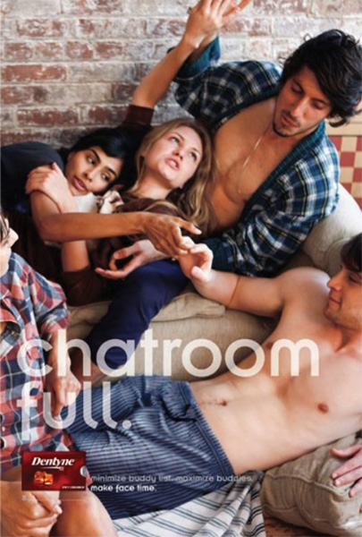
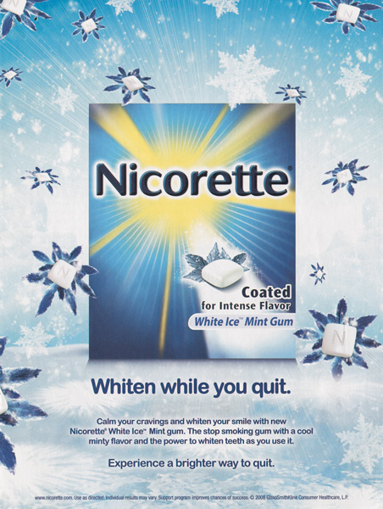
Which Distinct Benefit Does Each of the Two Brands Shown in This Figure Deliver?

Slide 21
The Dentyne Ad’s Benefit is Fresh Breath and the Nicorette Ad is Whitening and Smoking Cessation
Chapter Three Slide

Slide 22
Implementing Segmentation Strategies
Undifferentiated Marketing
Mass segment
Differentiated:
Several segments with individual marketing mix for every segment
Concentrated/Niche Marketing
One segment
Countersegmentation: involves combining existing segments for a company to become more efficient and profitable.
Chapter Three Slide

Slide 23
Implementing Segmentation Strategies
Micro- and behavioral targeting
Personalized advertising messages
Narrowcasting
Email
Mobile
Use of many data sources
Micro-targeted began in 2004 and is growing field within marketing. It is growing due to the marketer’s ability to use complex databases and personalized media including email and mobile phones. Micro-targeting focuses on delivering a personalized advertising message to the user whether they are at work, at home, or on-the-go.
Chapter Three Slide

Slide 24
Criteria for Effective Targeting
Identifiable
Sizeable
Stable
Accessible
Congruent the company’s objectives and resources
Chapter Three Slide

Slide 25
Criteria for Effective Targeting
Target market should be:
Identifiable: marketer must be able to see or find the characteristic they have chosen for segmentation. Demographics are easy to be identified, but lifestyles and benefits sought are more difficult.
Sizeable: large enough to be profitable to the marketer.
Stable: consumers are not “fickle” and likely to change very quickly in lifestyles or consumption patterns because a segment should be predictable.
Accessible: marketer must be able to reach that market in an economical way. (media advances made in easier).
Congruent: with the company’s objectives and resources.
Chapter Three Slide

